Slide 1
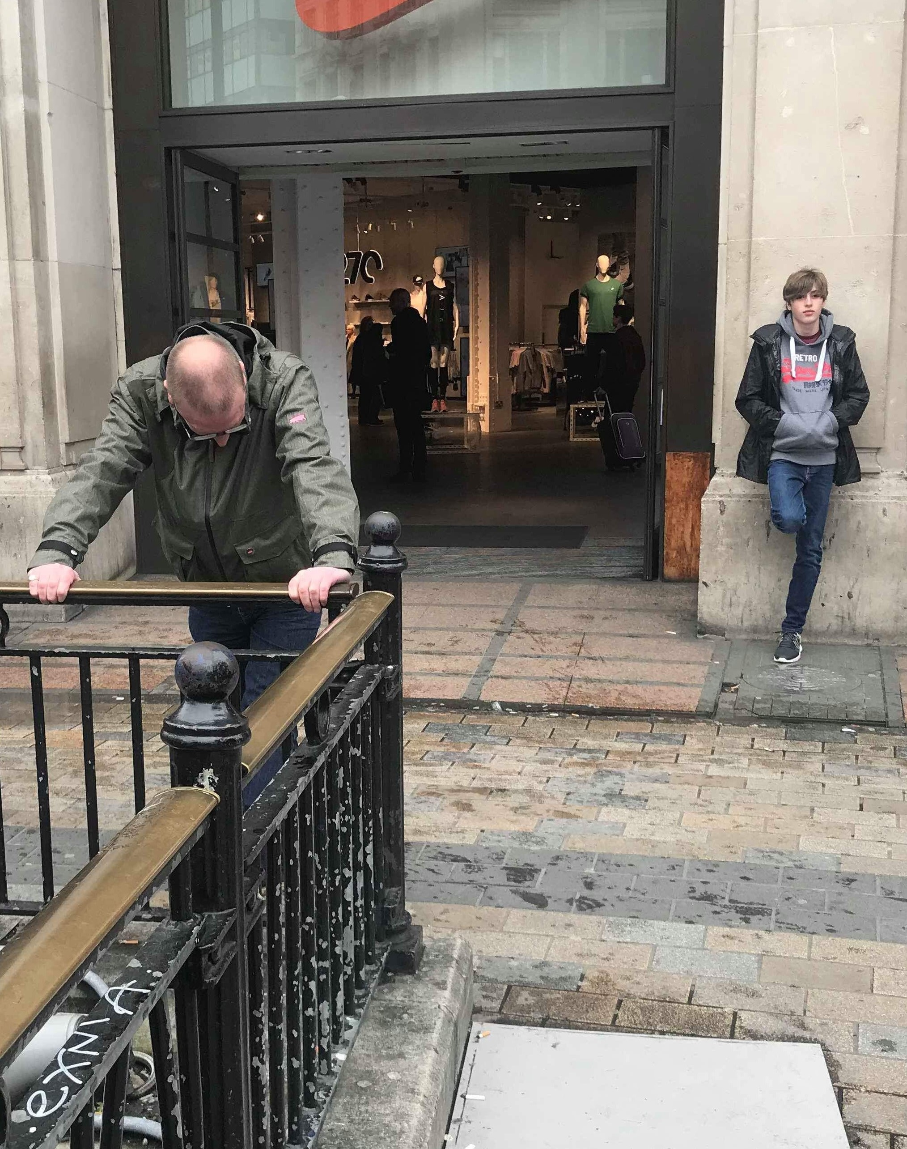
FE Presentation 2020
By
Michael Palmer

Slide 2
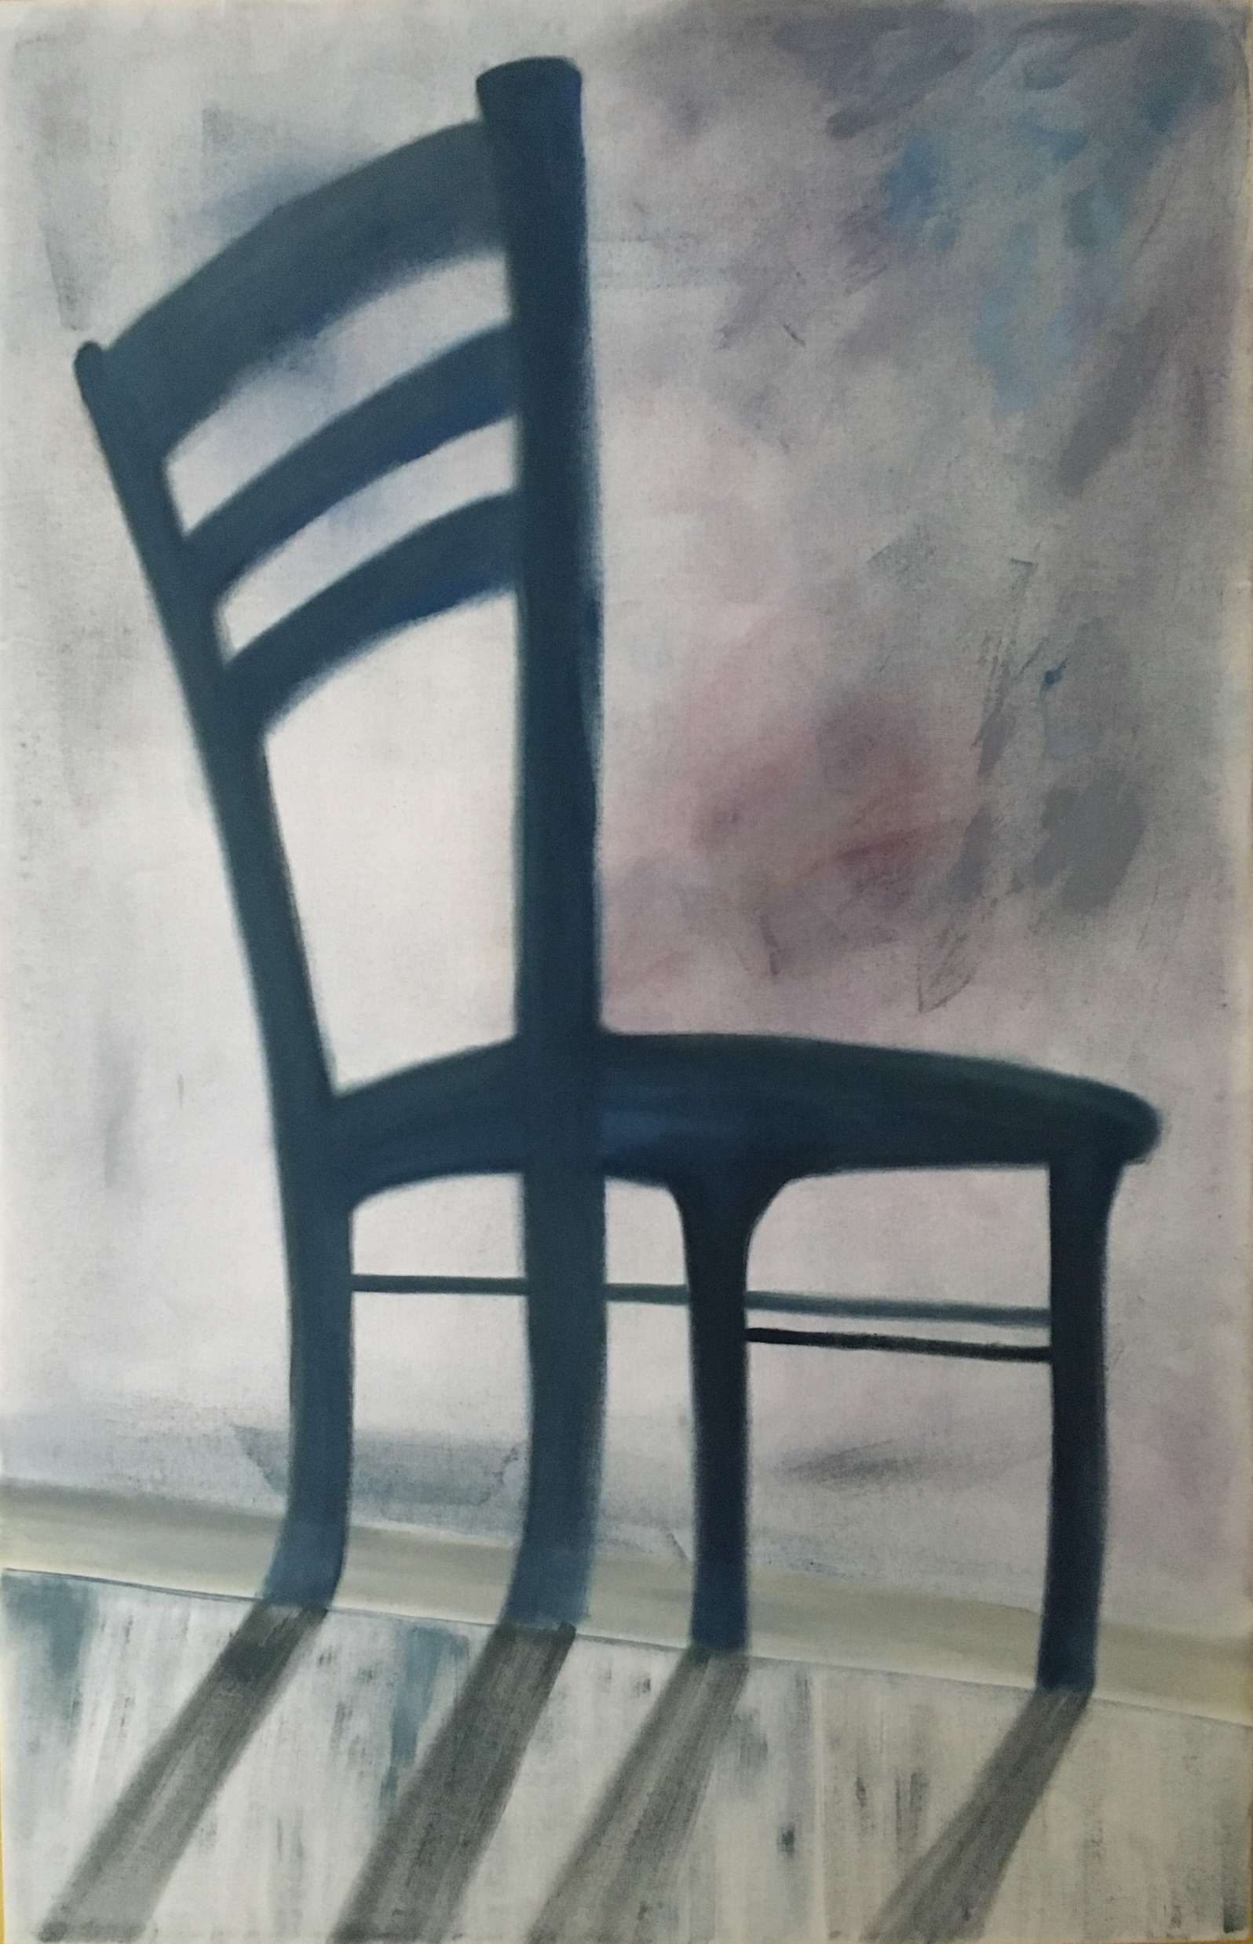
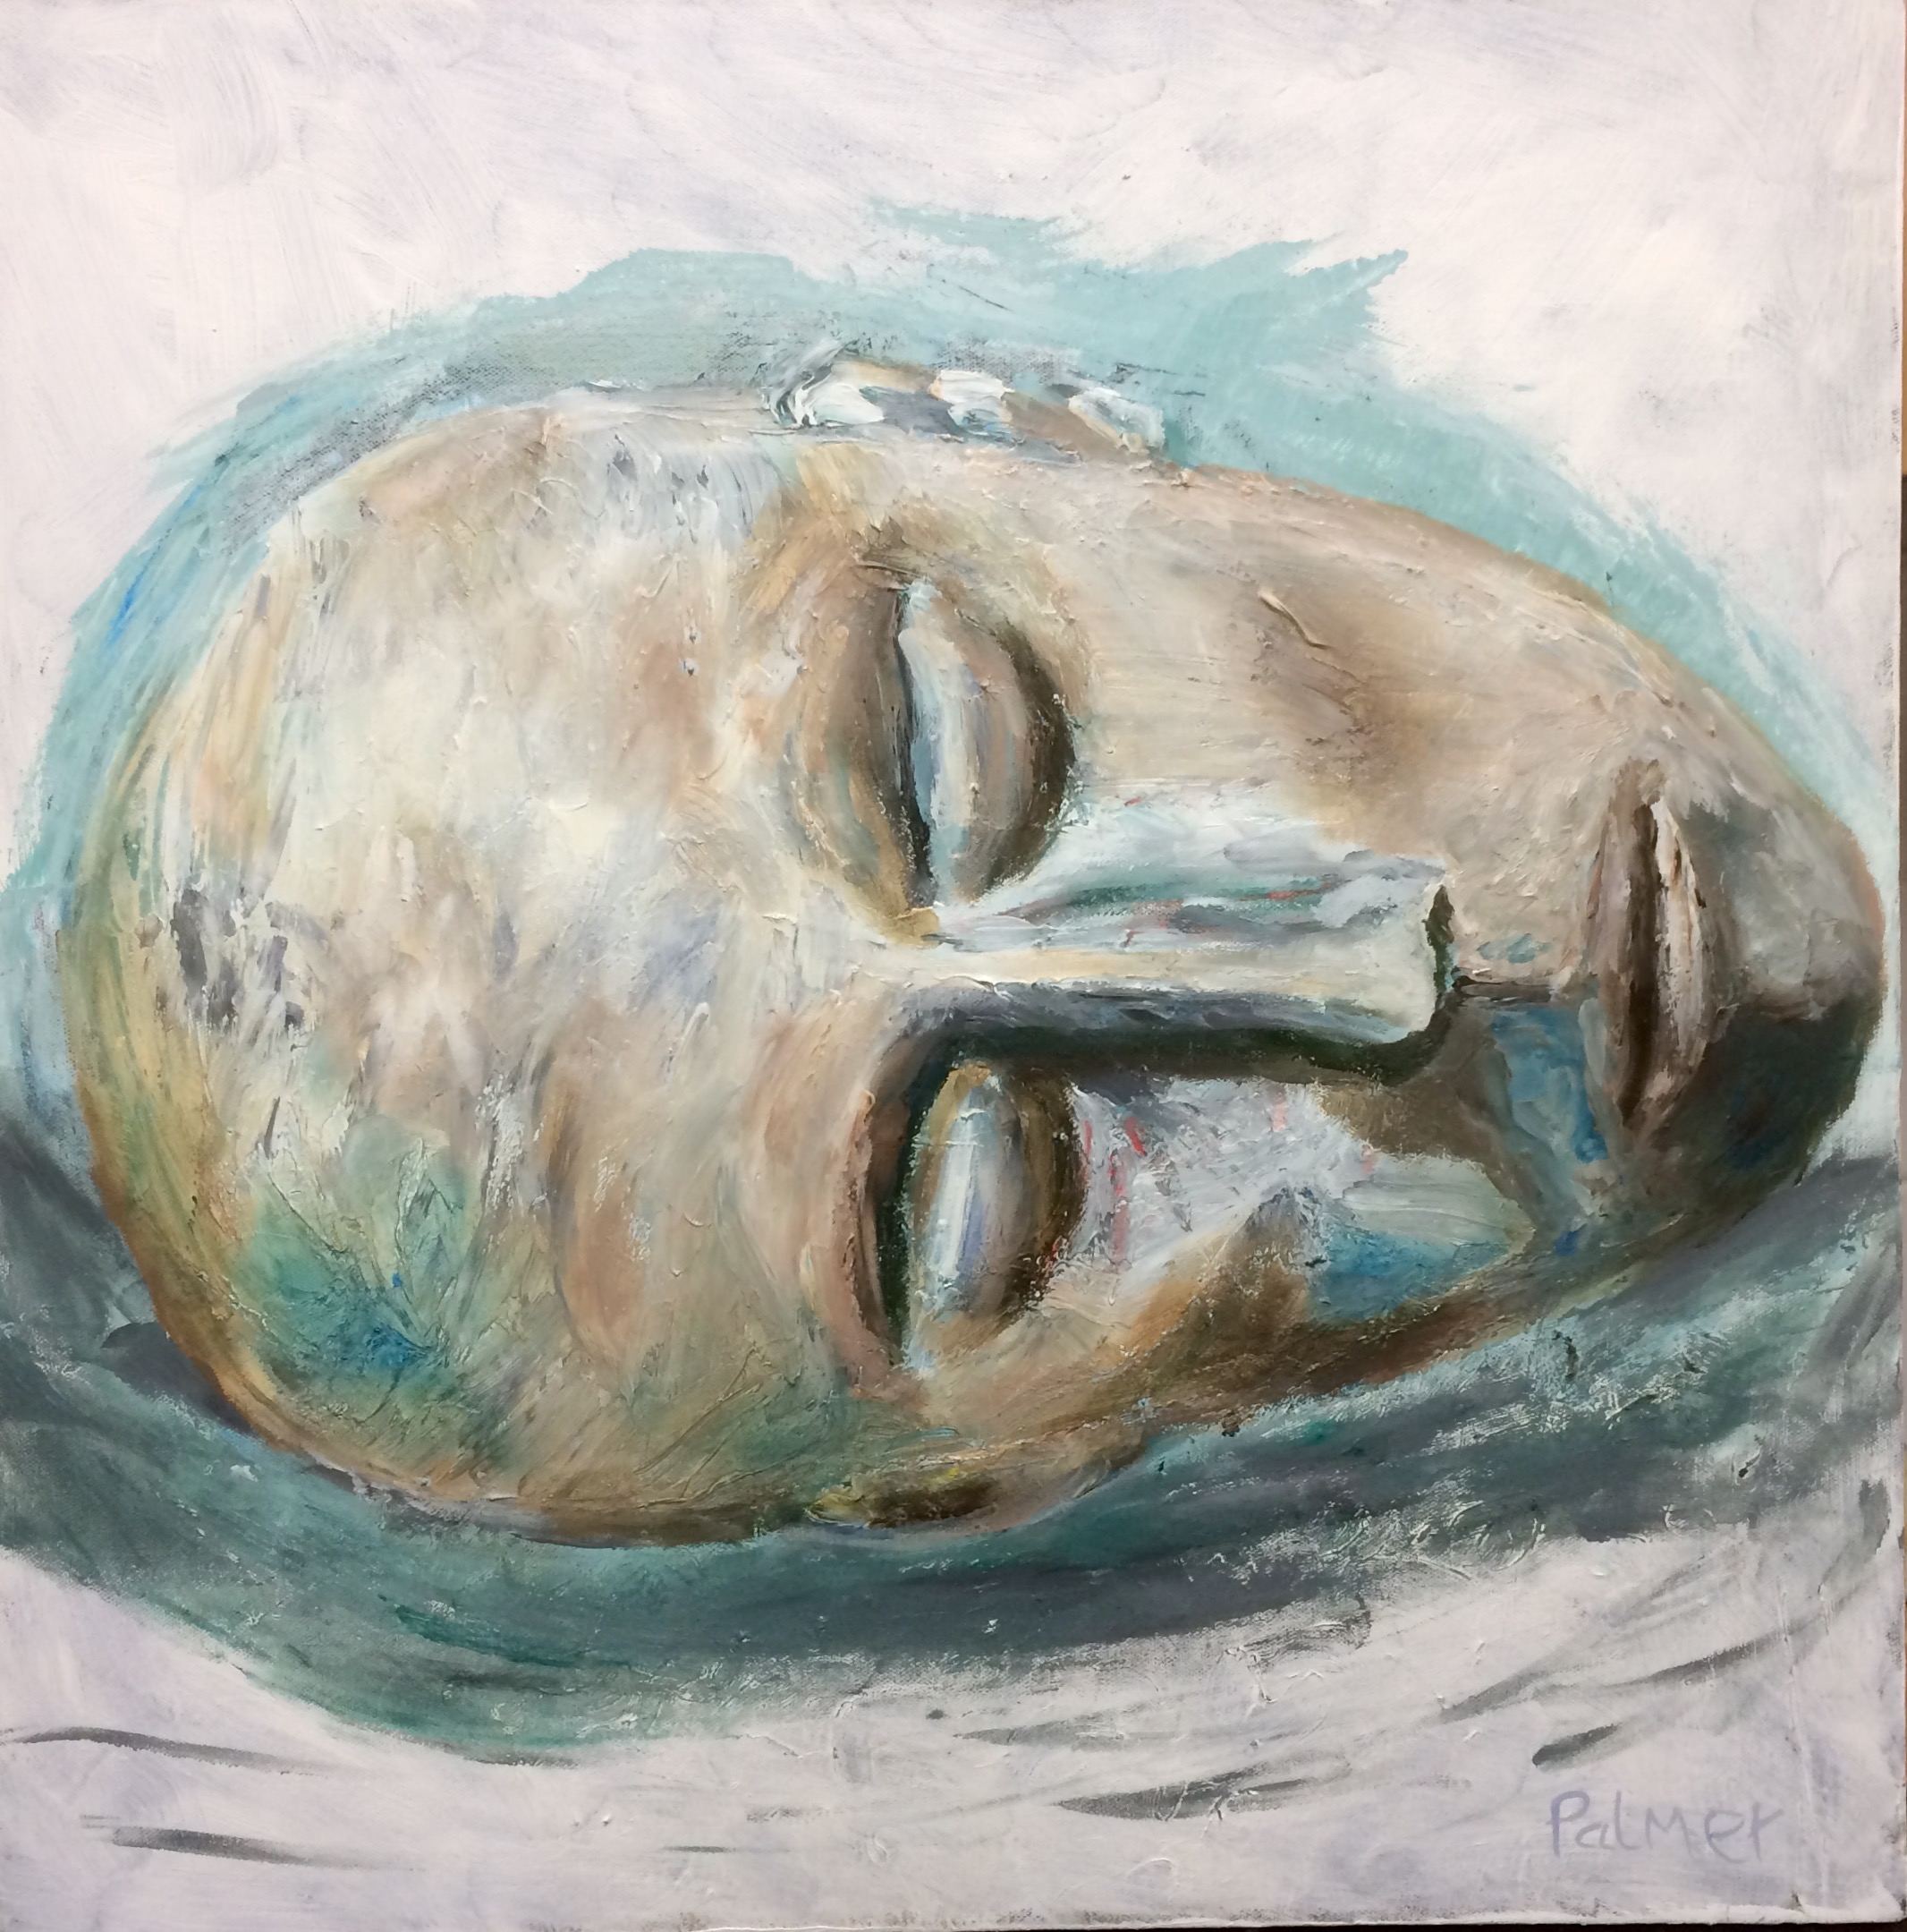

Slide 3
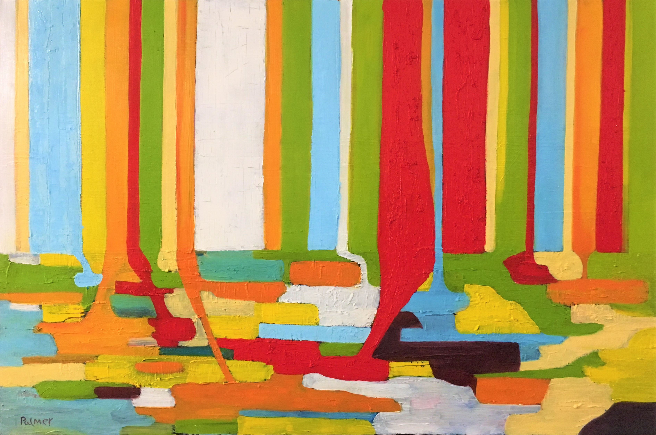
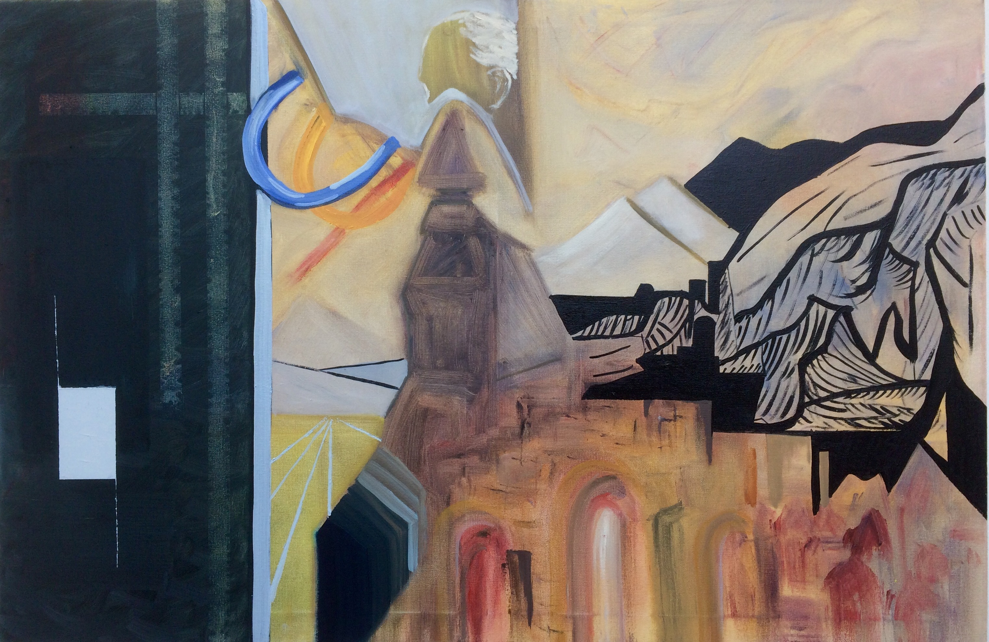

Slide 4
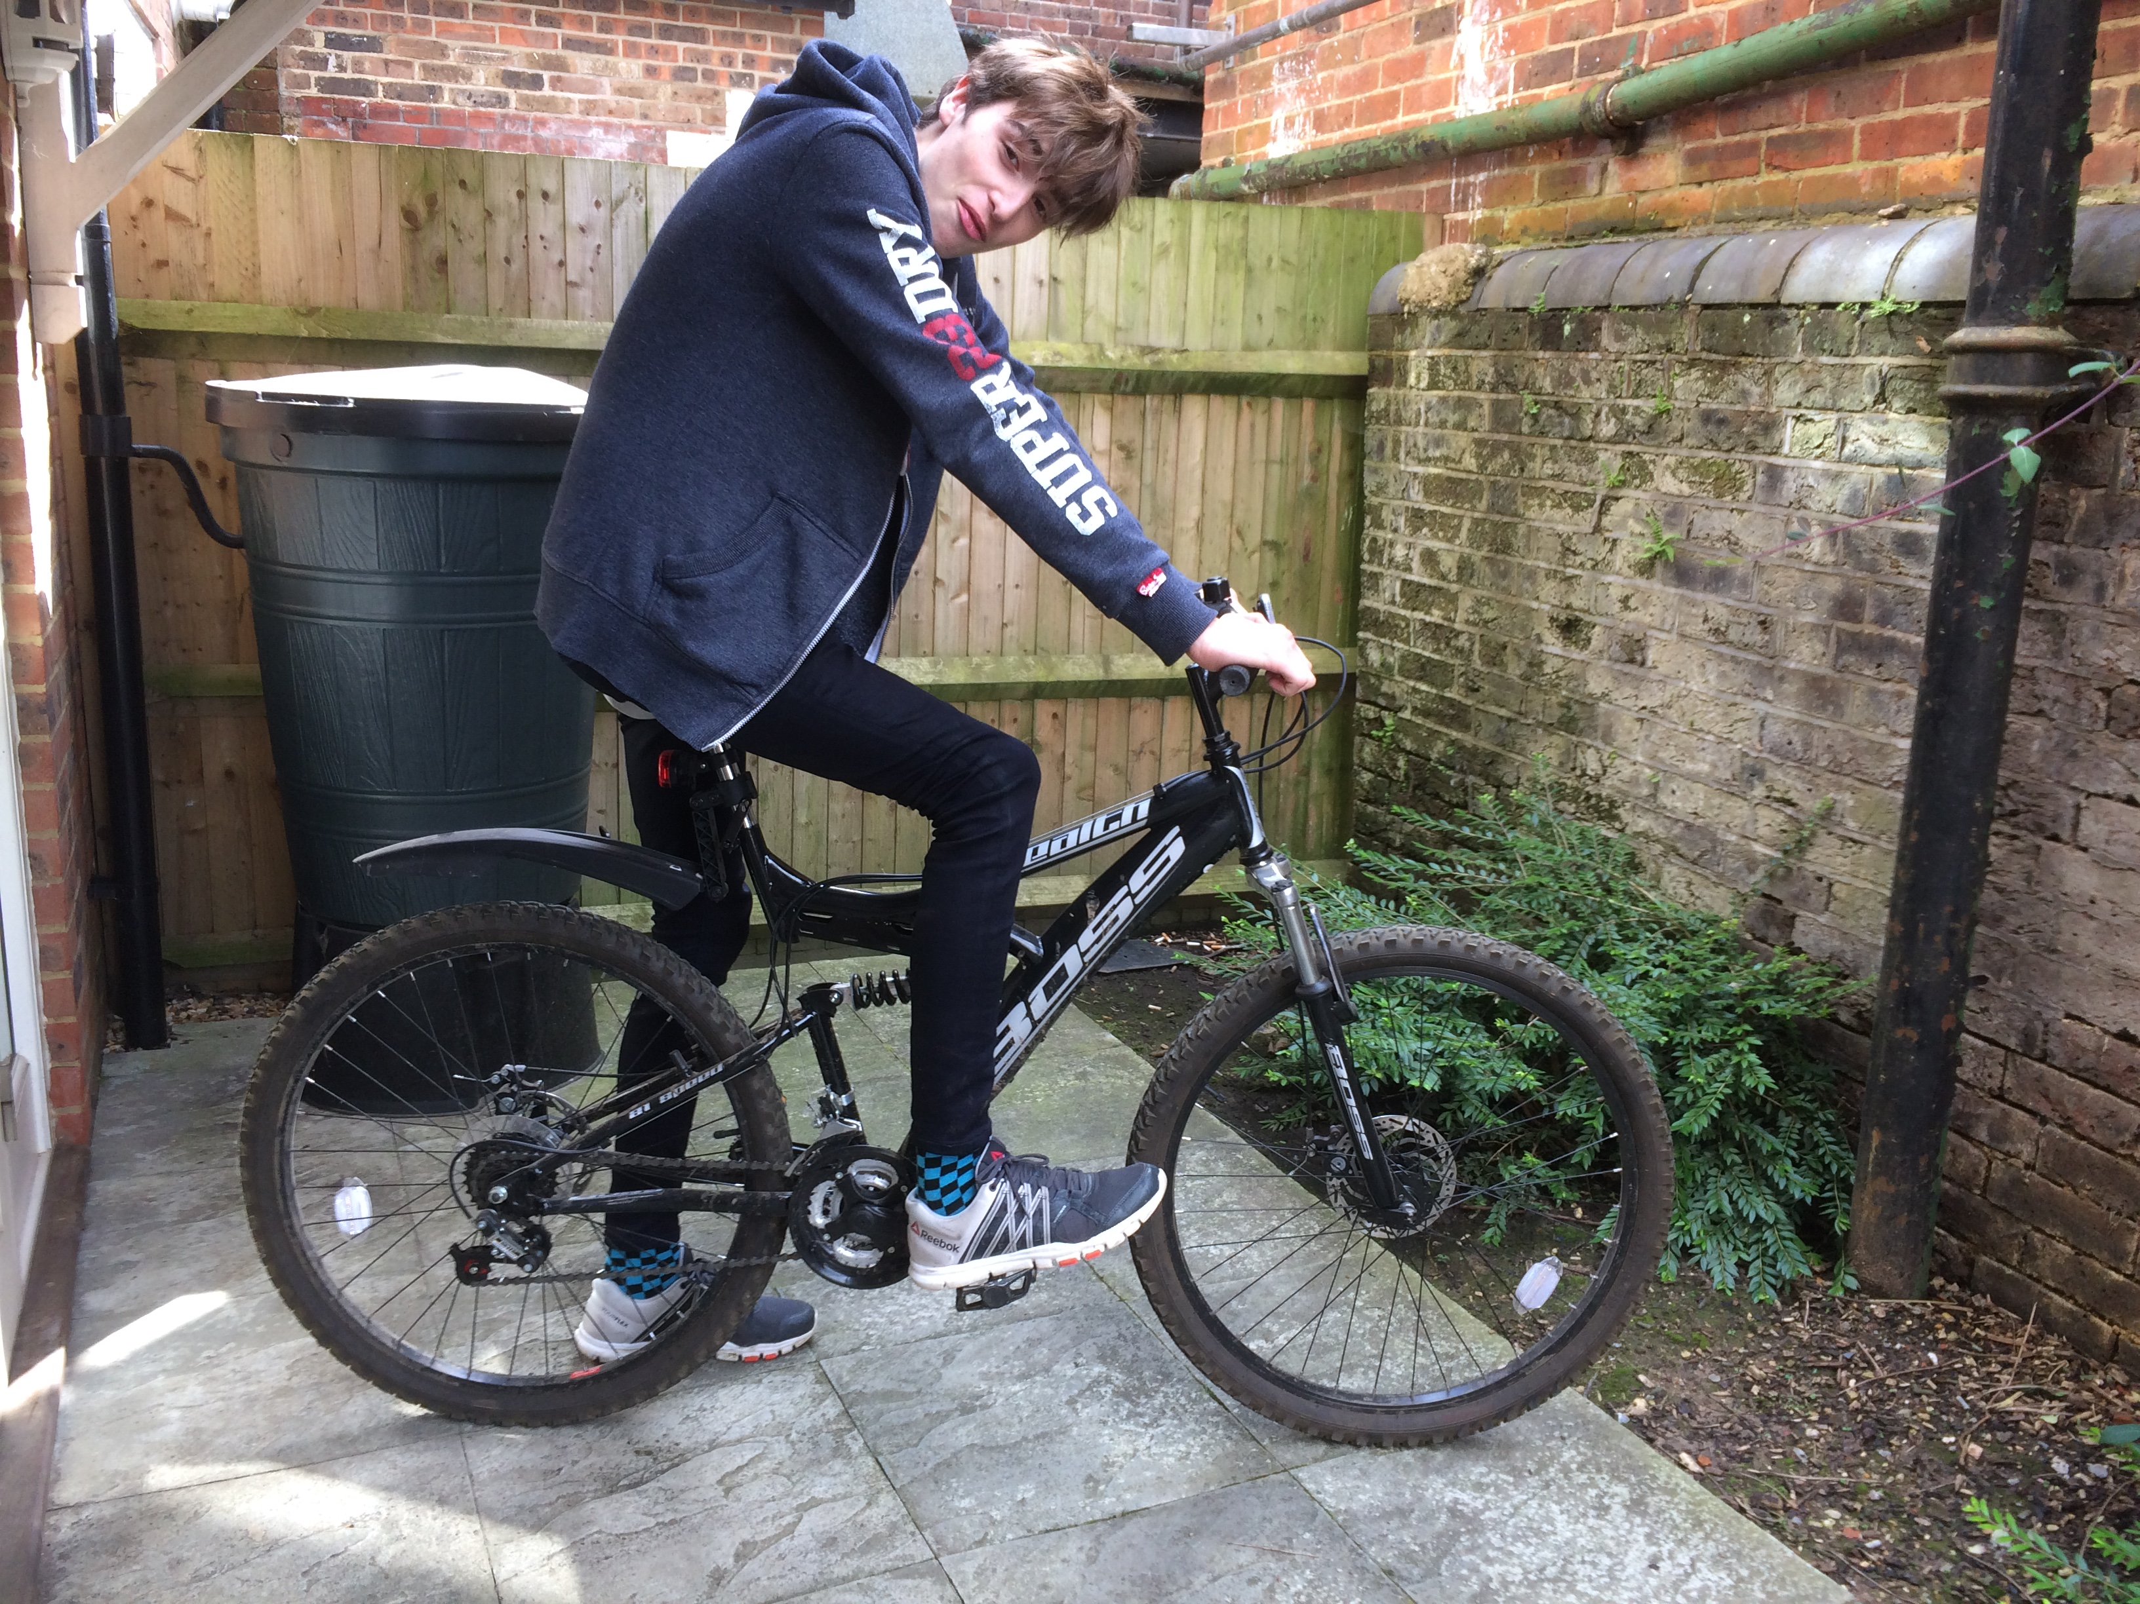
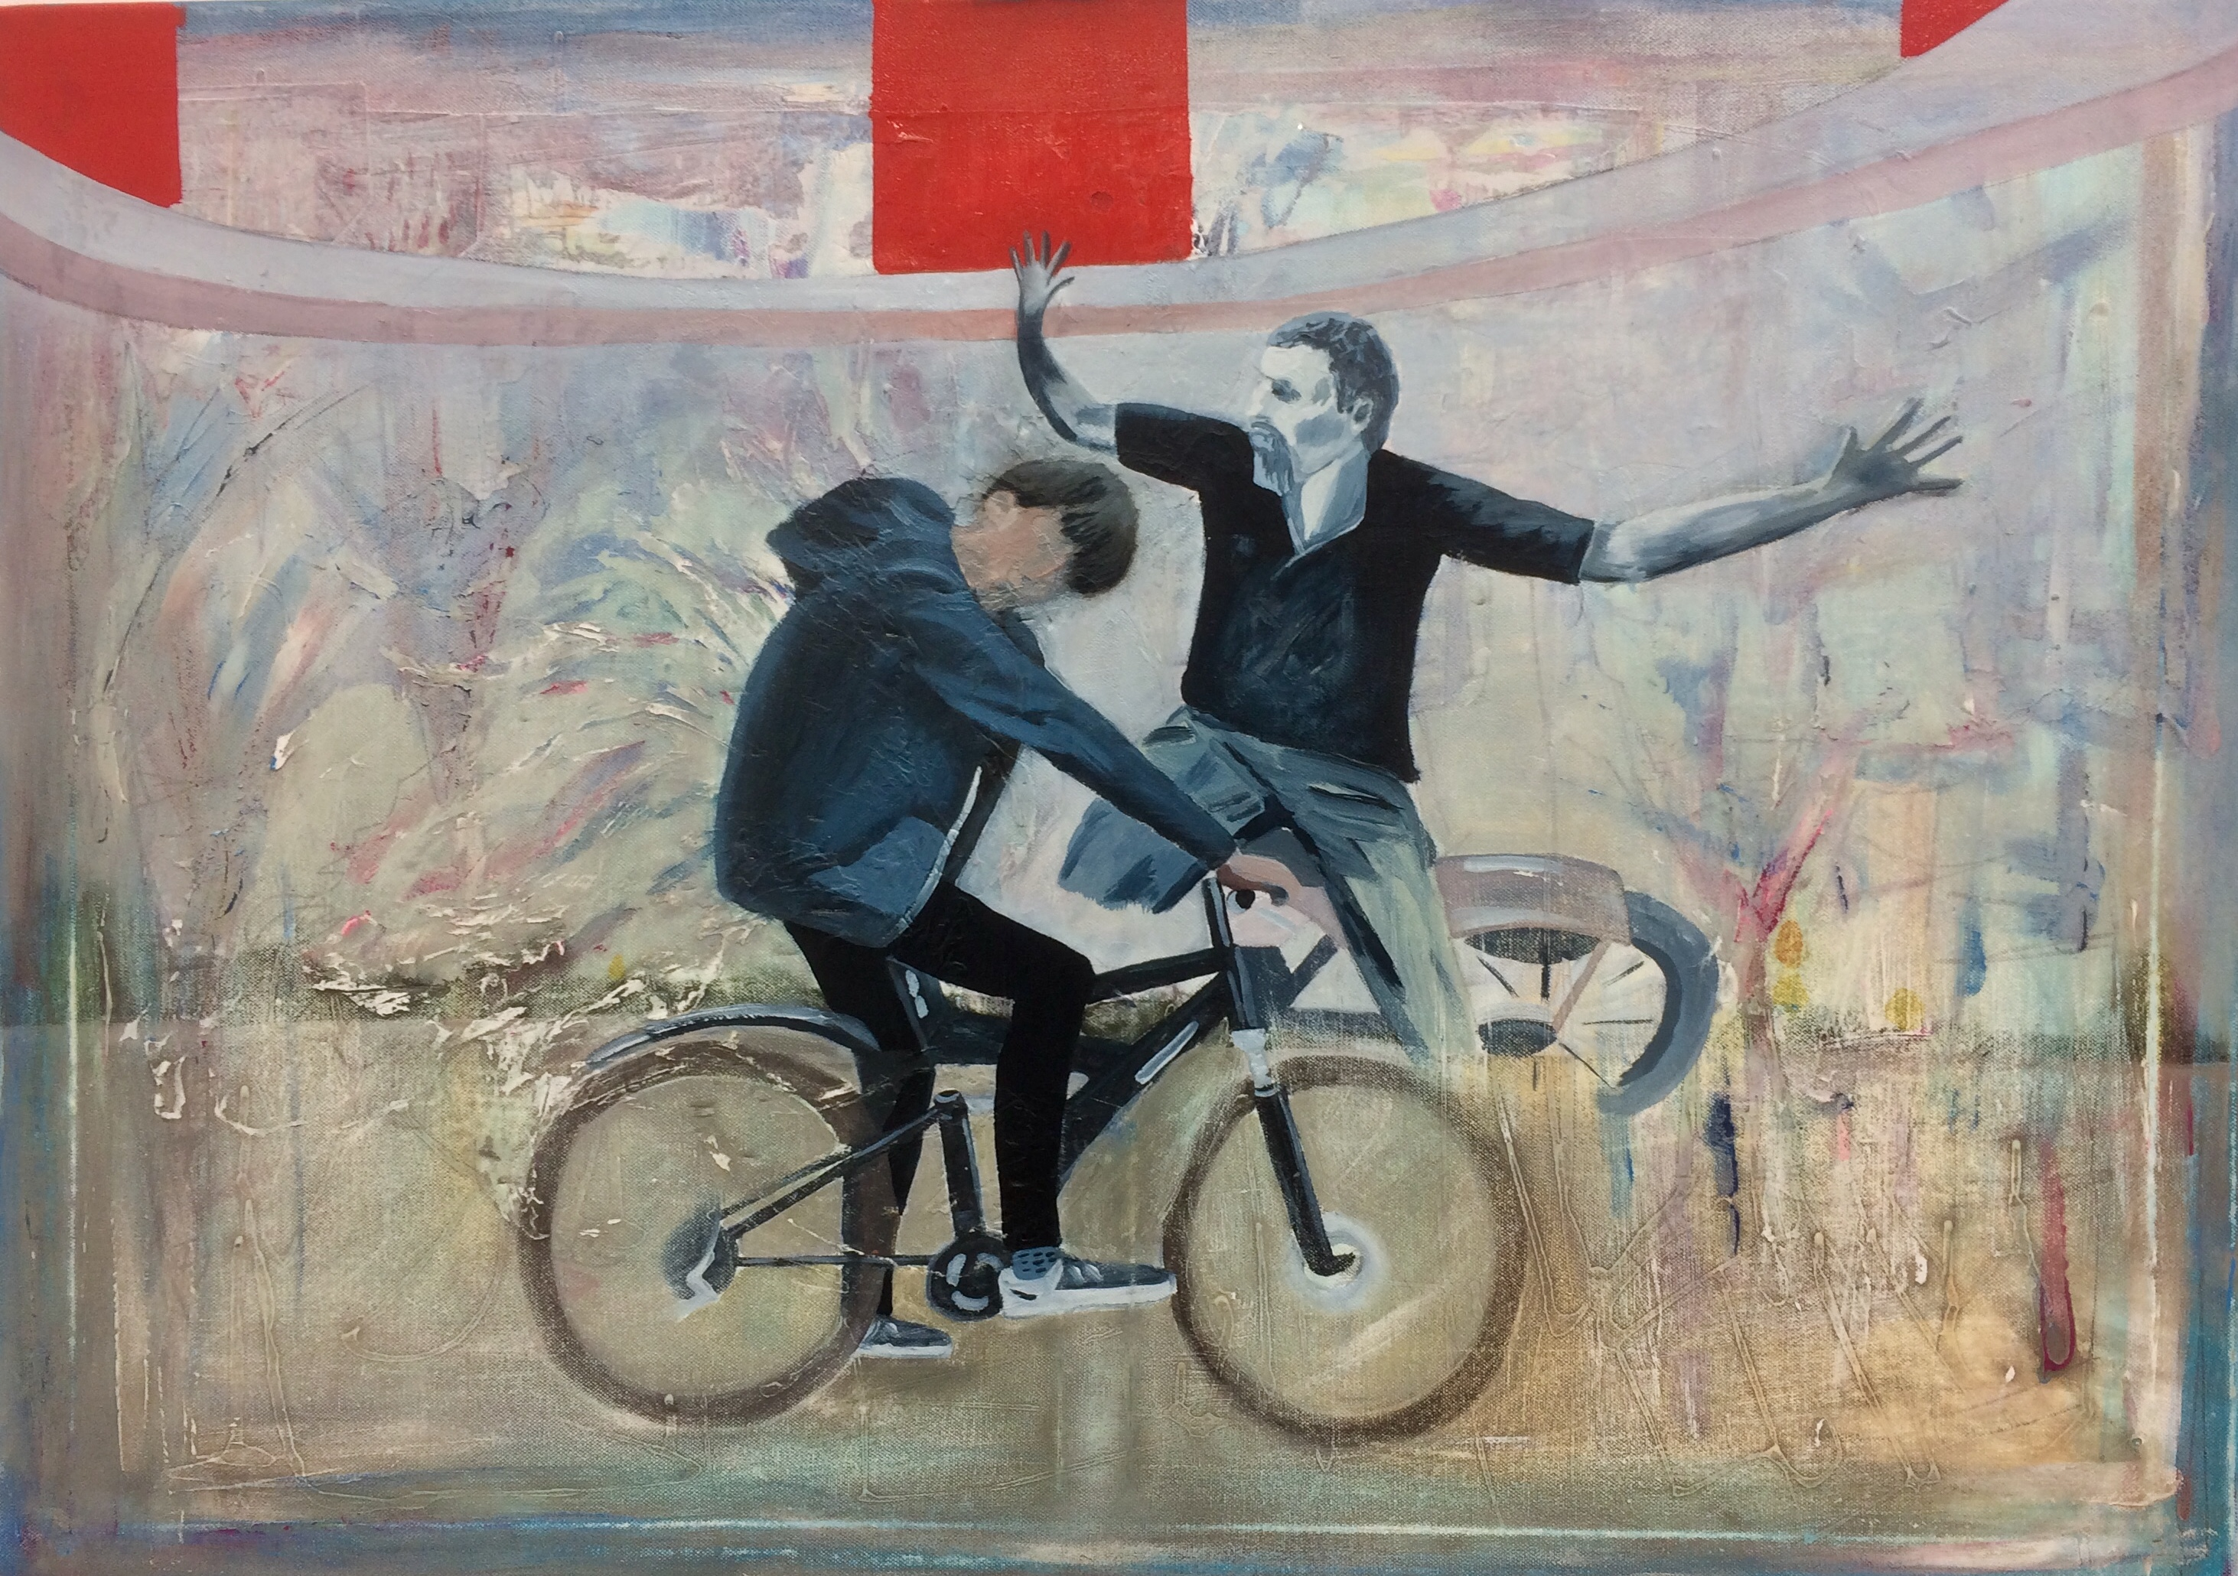
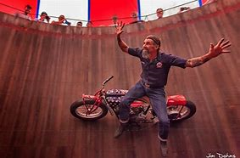
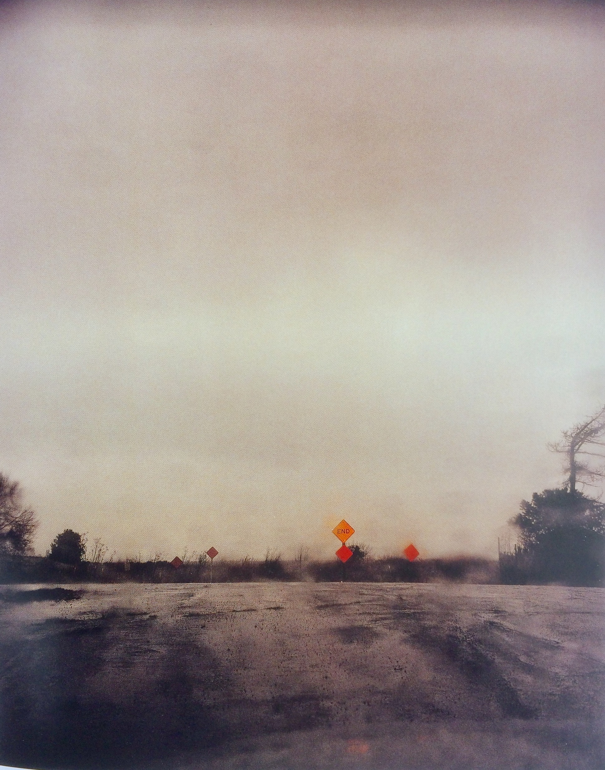

Slide 5
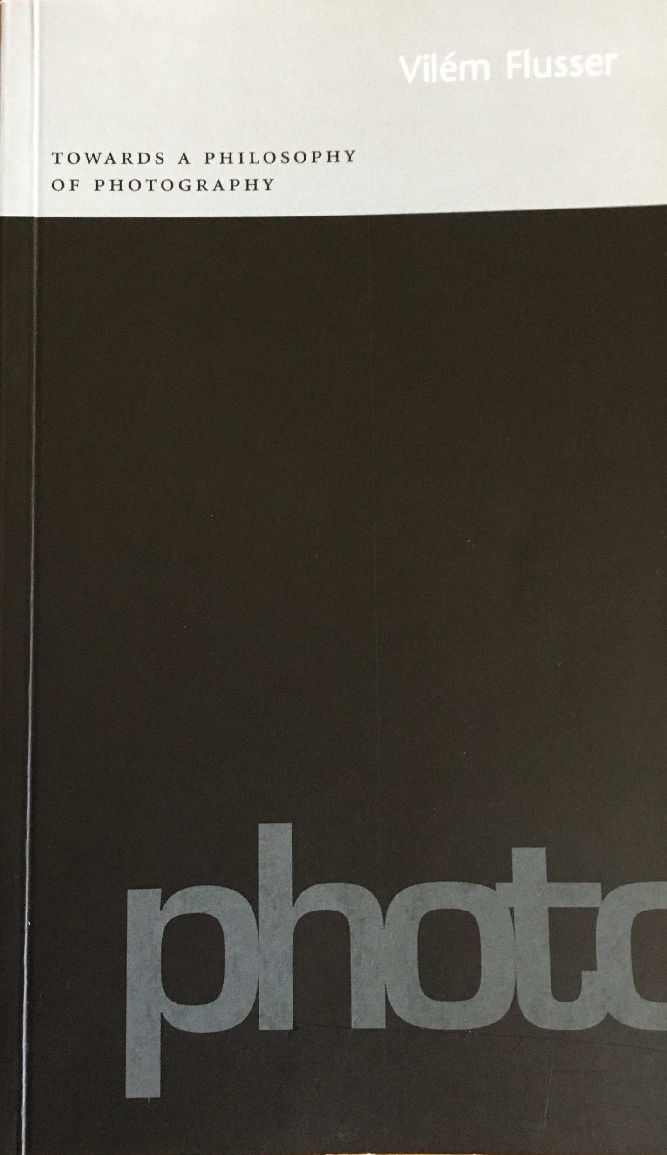
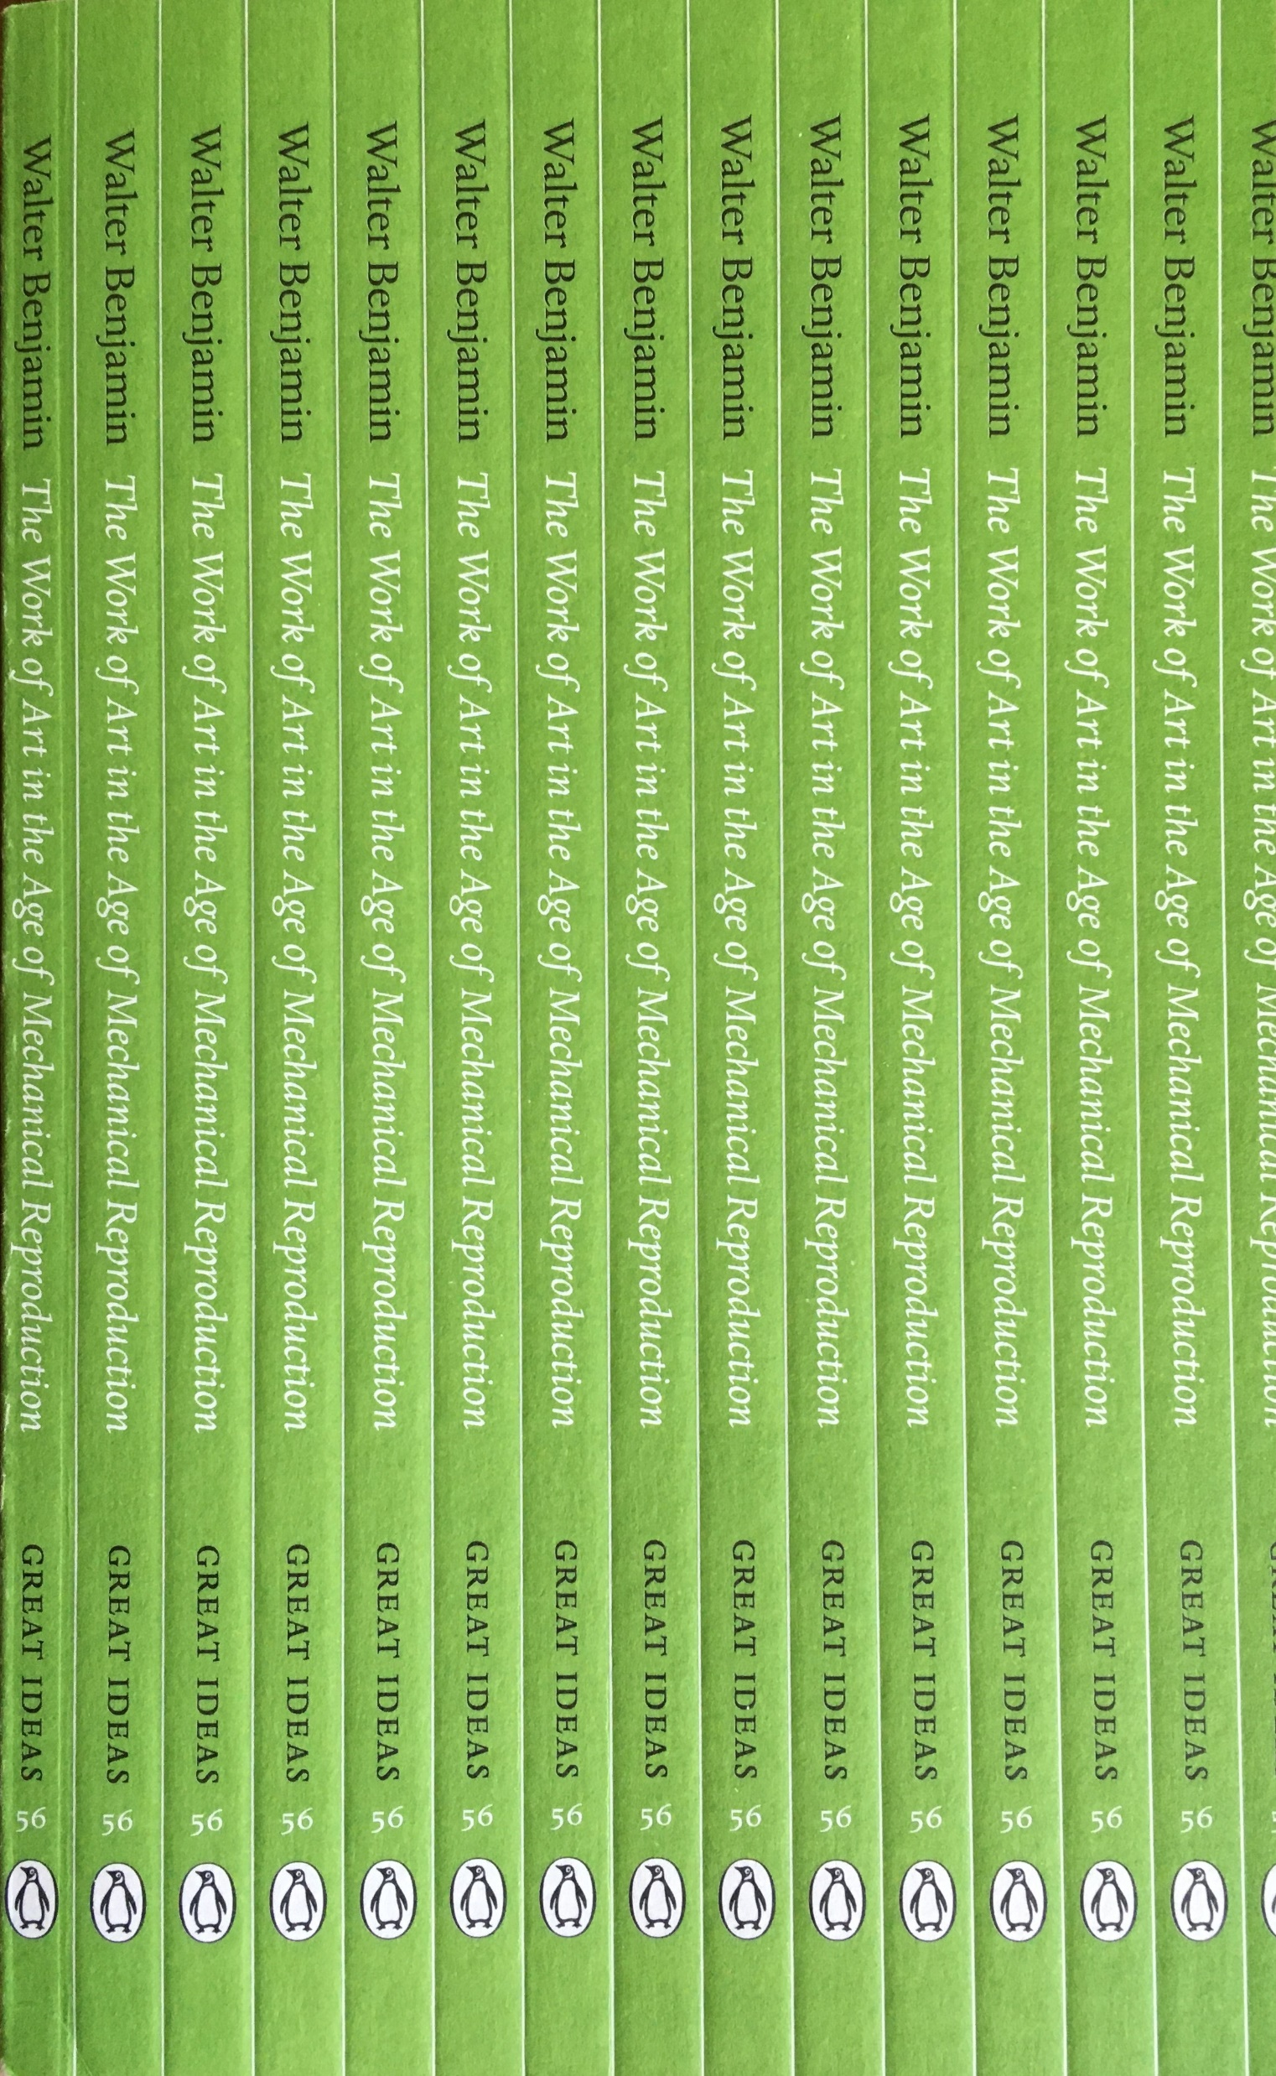
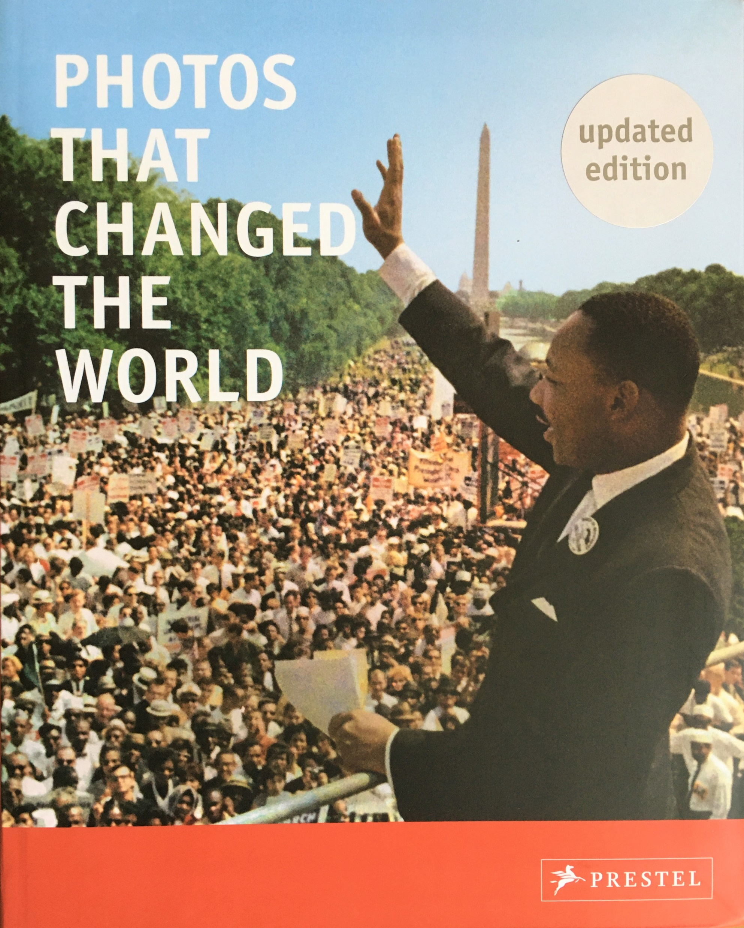
Towards A Philosophy of Photography (2000) Vilem Flusser
The Work of Art in the Age of Mechanical Reproduction (1936) Walter Benjamin
Photos That Changed The World (2000) ed. Peter Stepan

Slide 6
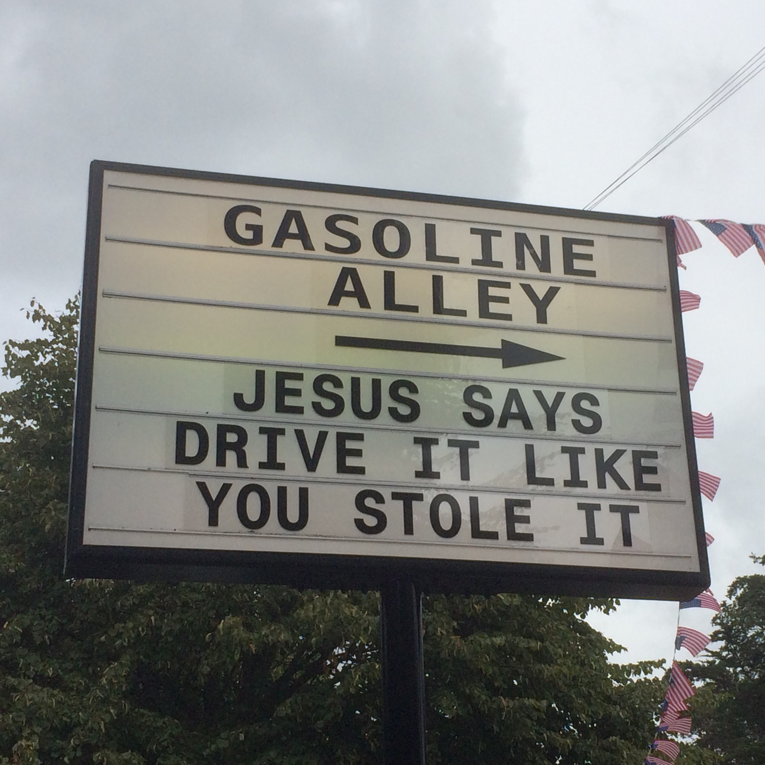
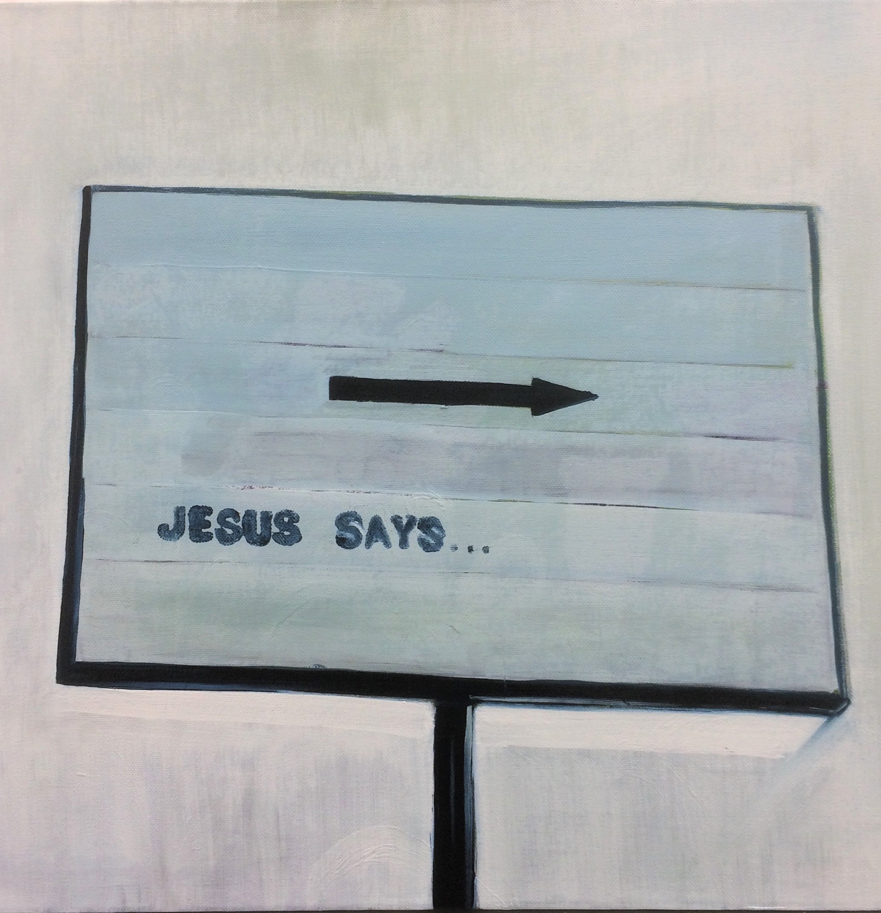

Slide 7
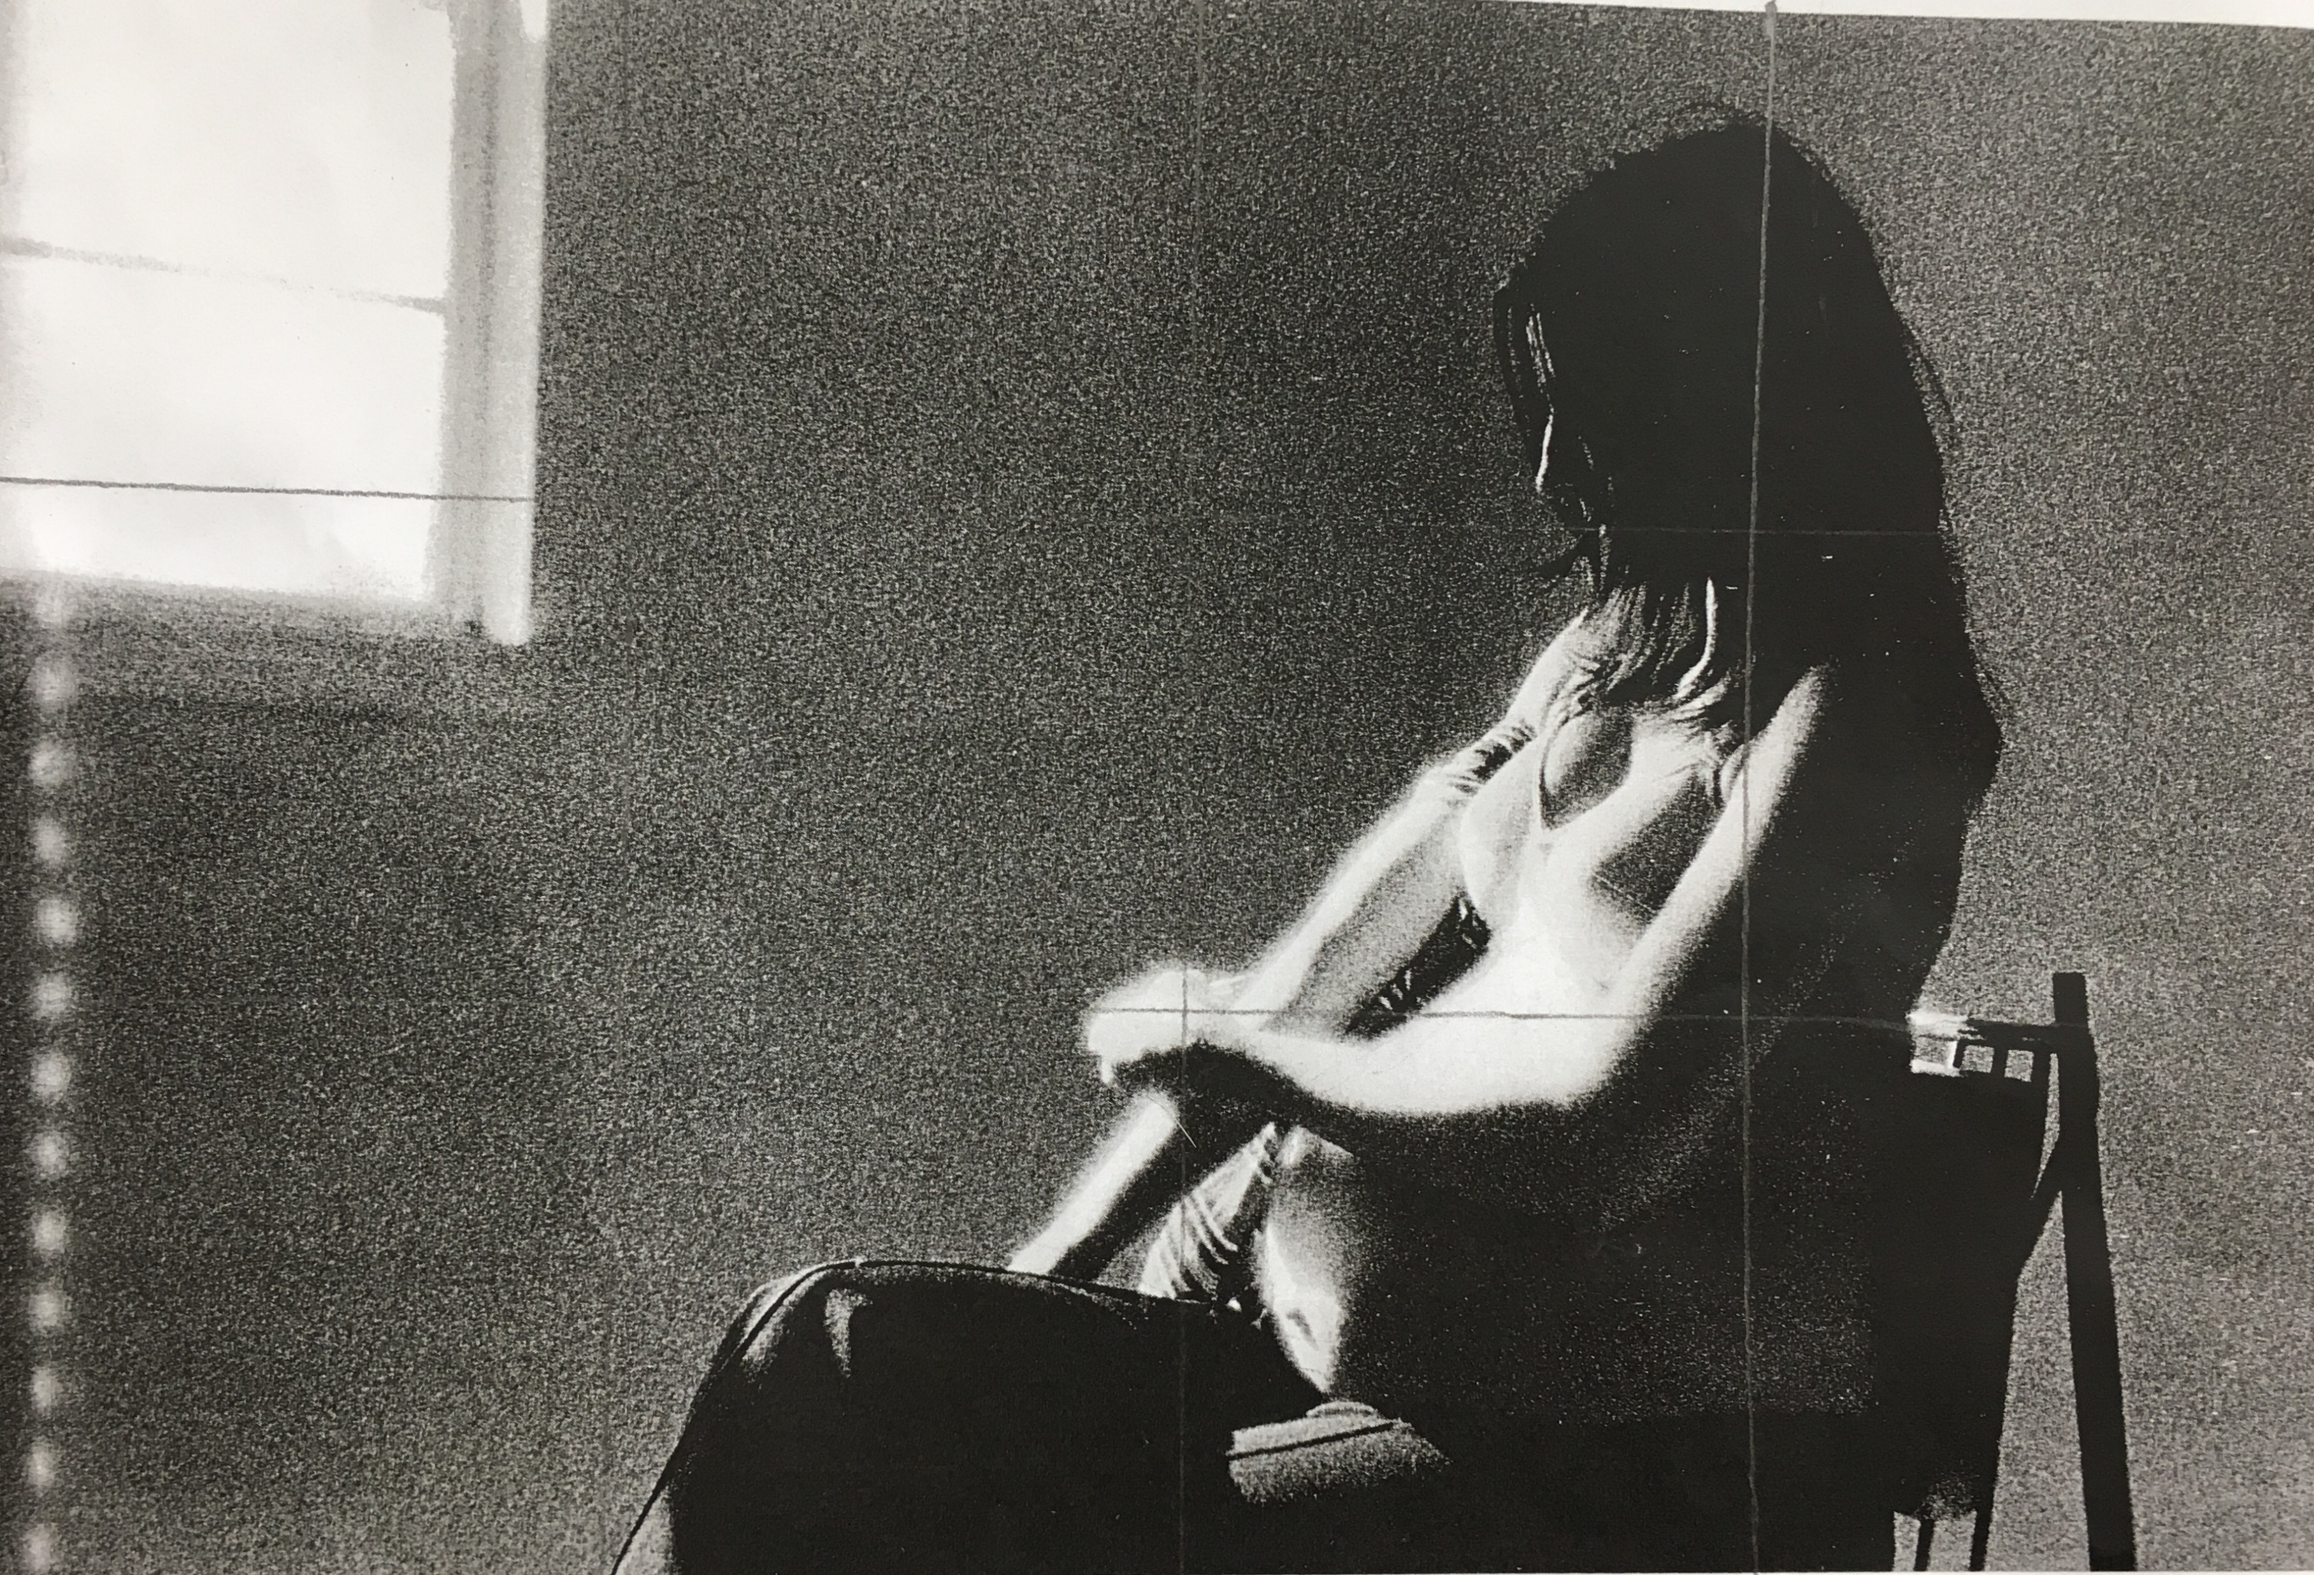
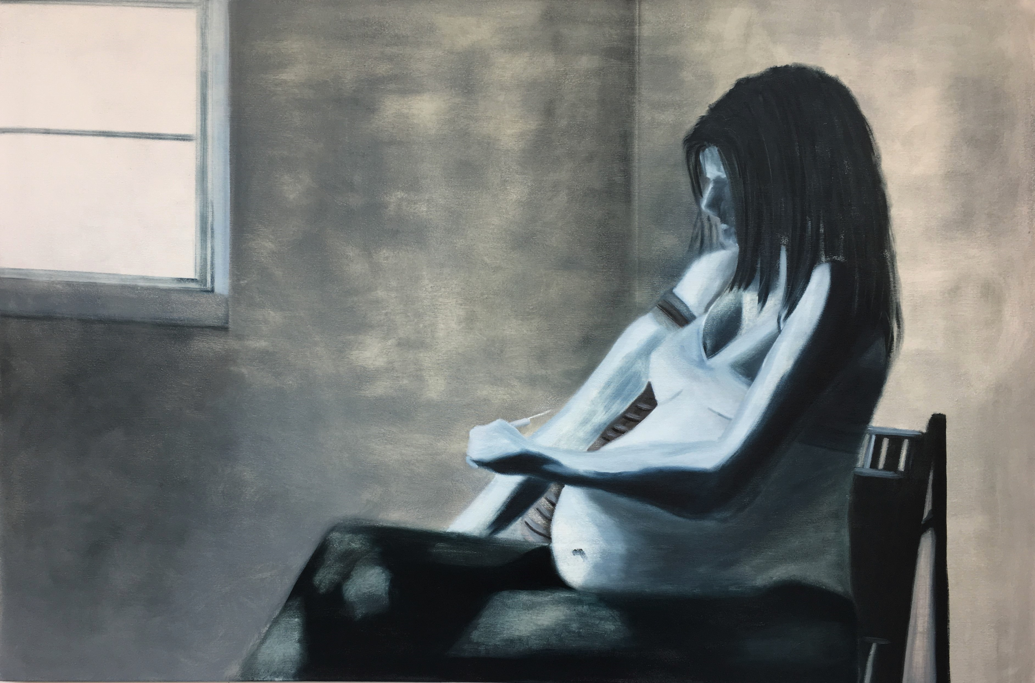
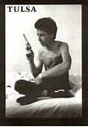
Tulsa (1971) Larry Clark
‘What Have I Become? (2019) 150x100cm Michael Palmer

Slide 8
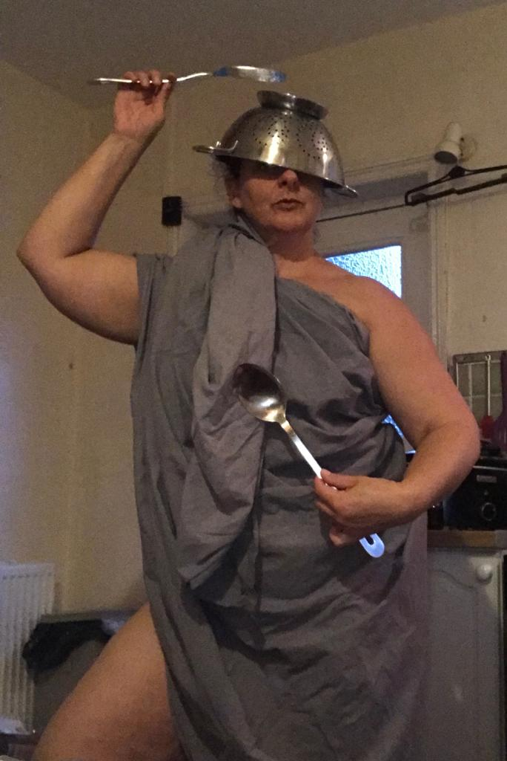
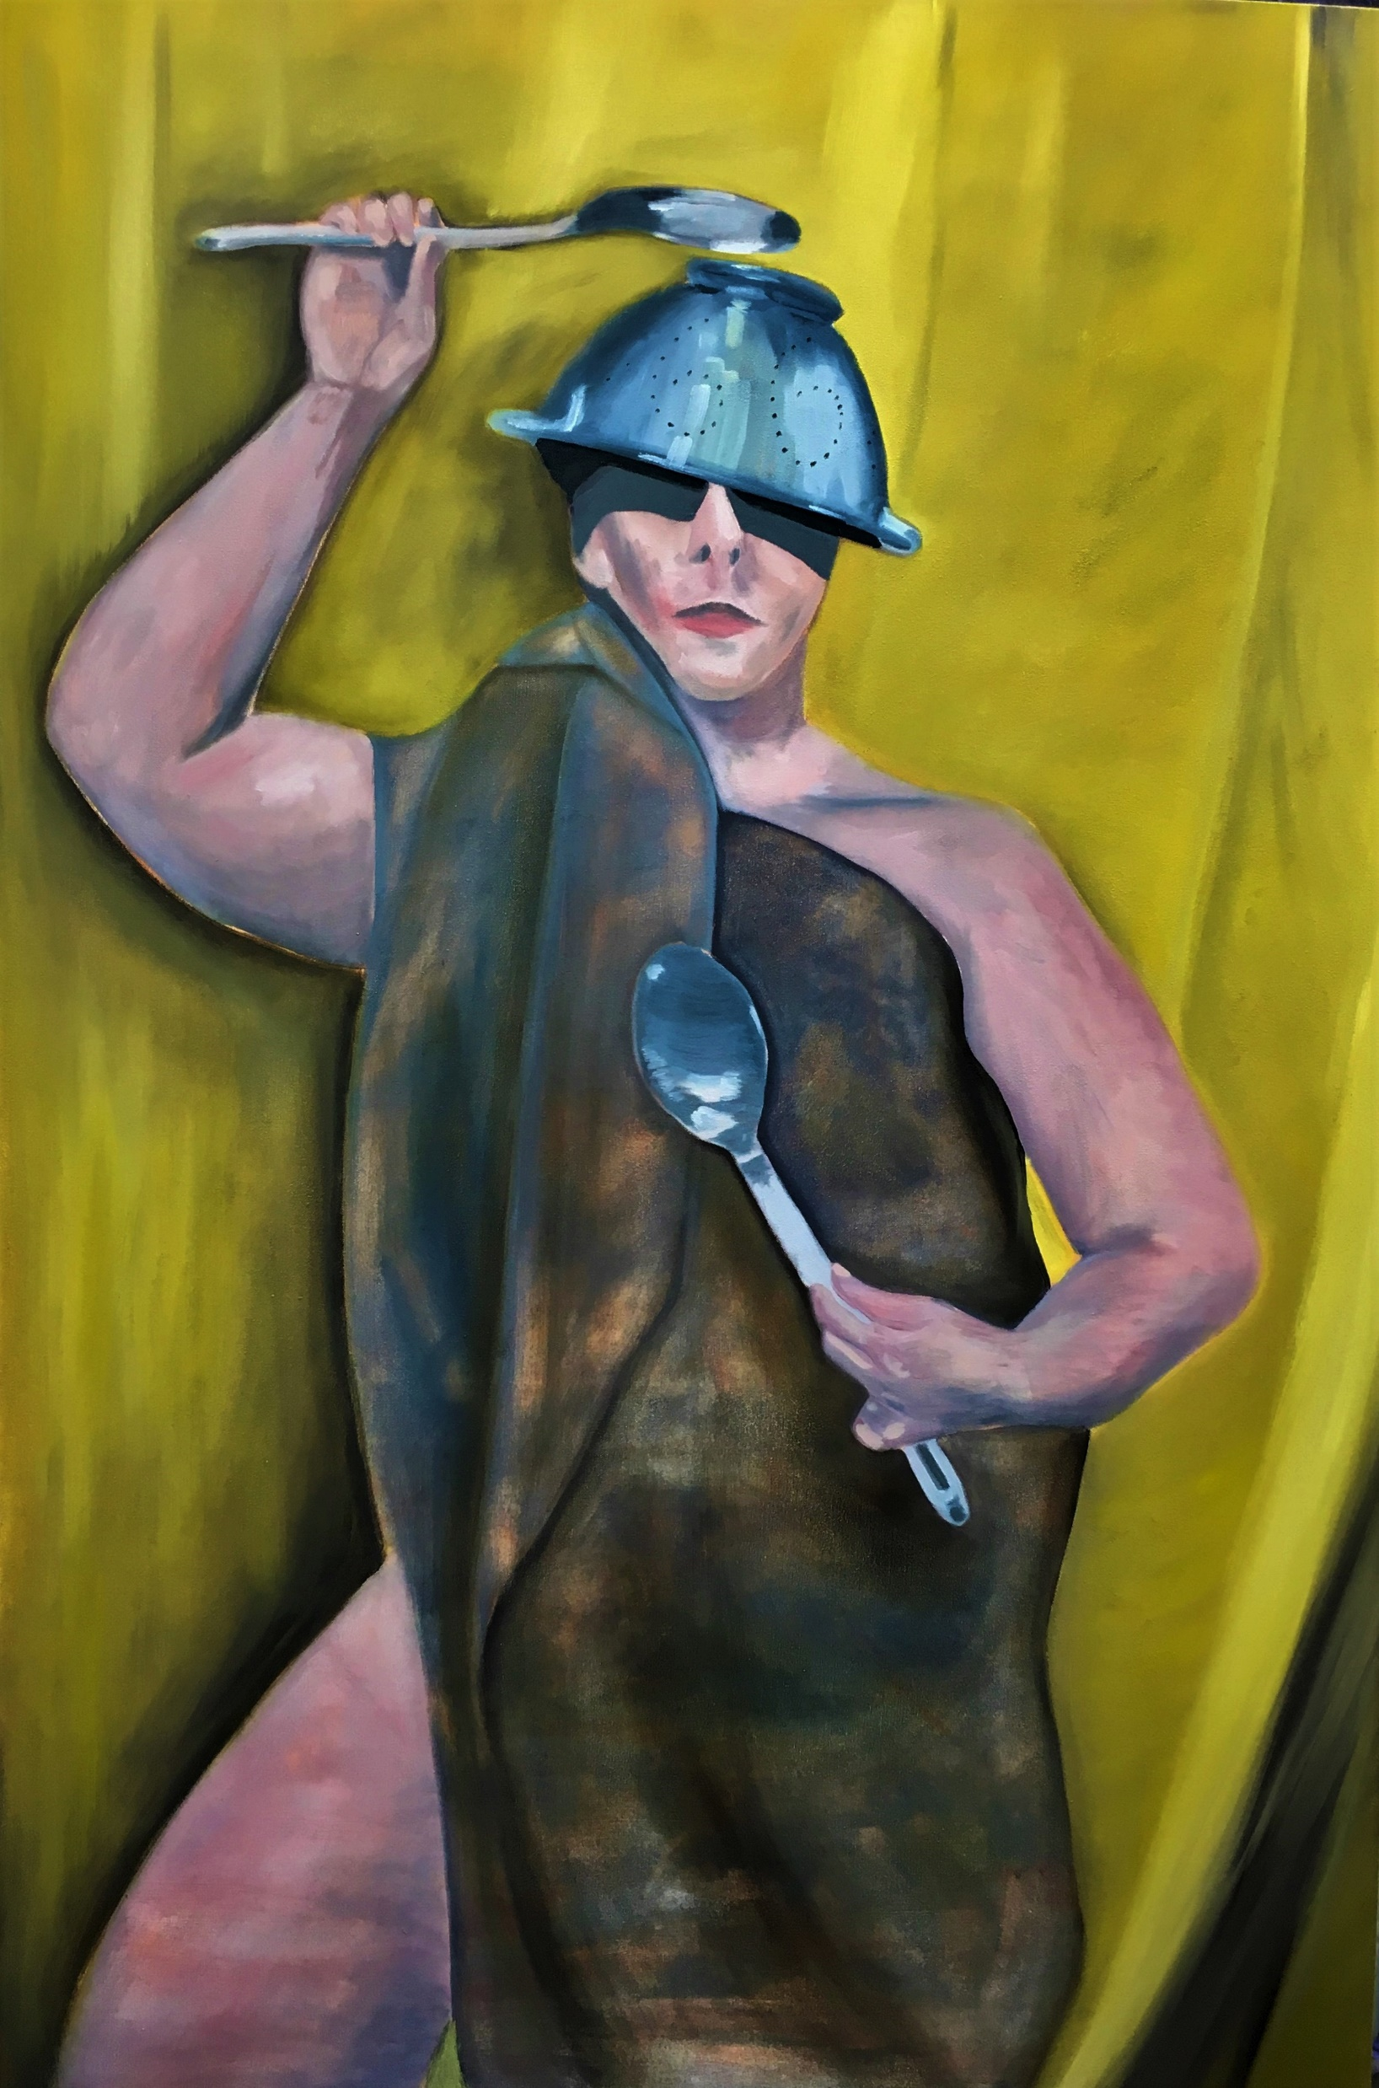
Helen (2019) Michael Palmer
‘Triumph’ (2019) 150x100cm Michael Palmer

Slide 9
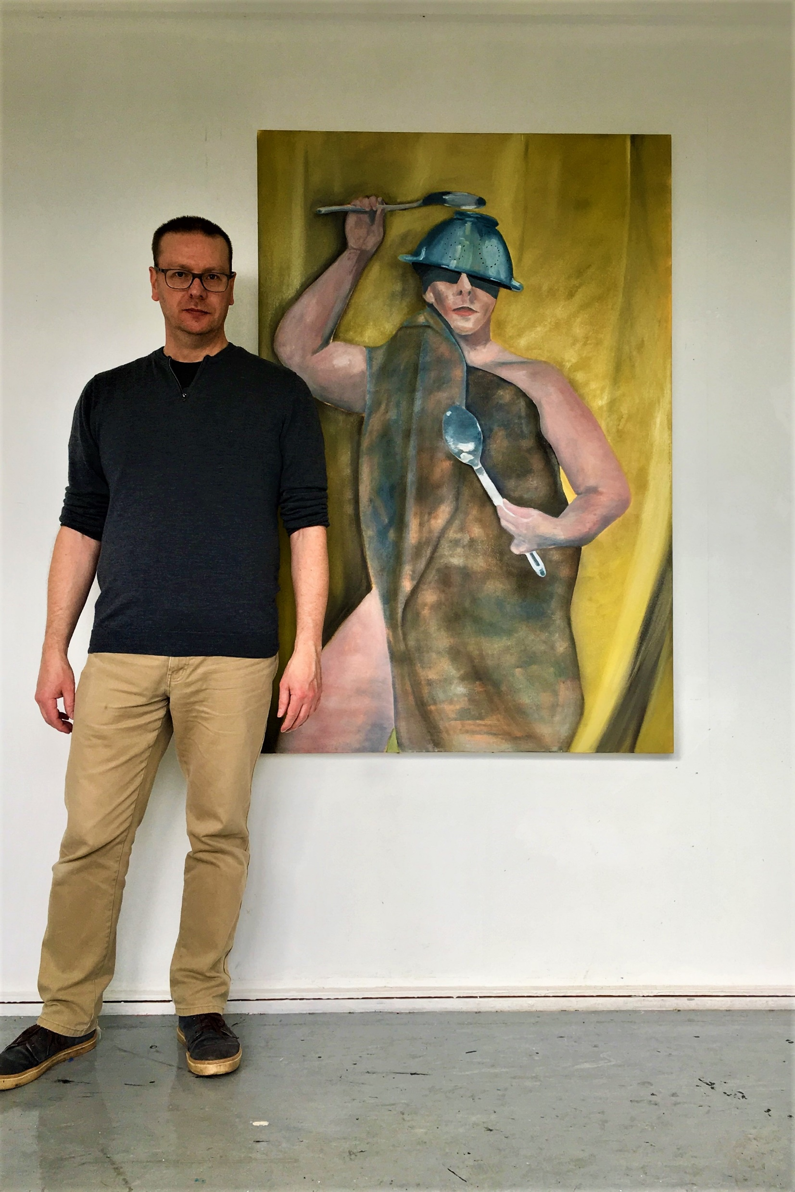

Slide 10
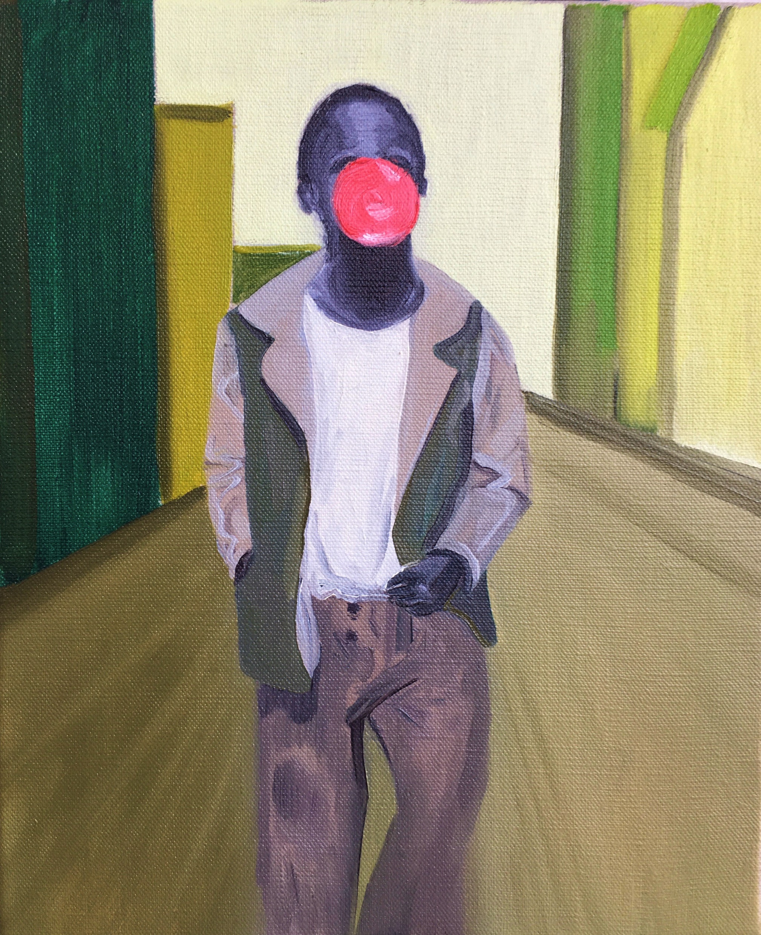
‘Bubble Gum Kid’ (2020)
30x20cm Michael Palmer
After Marvin E Newman ‘The Bubble Gum Kid’ (1950)

Slide 11
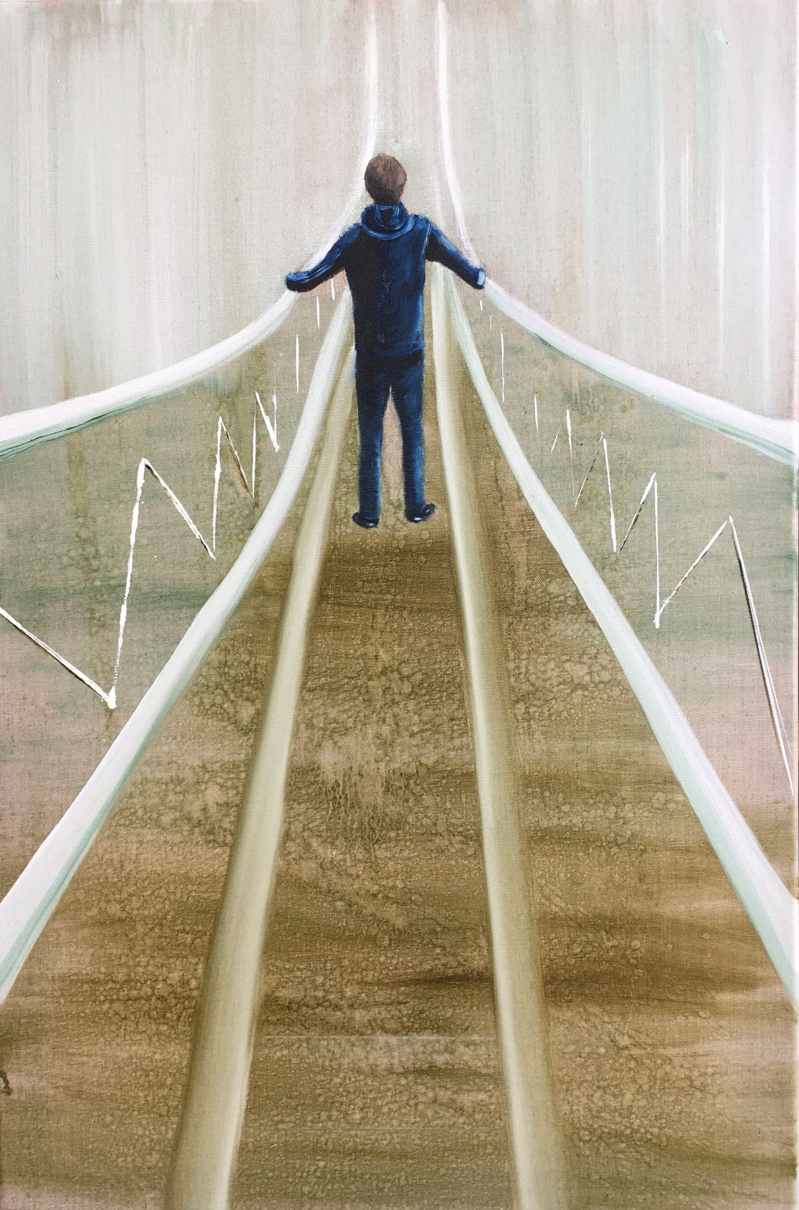
‘The White Bridge’ (2019)
76x50cm Michael Palmer

Slide 12
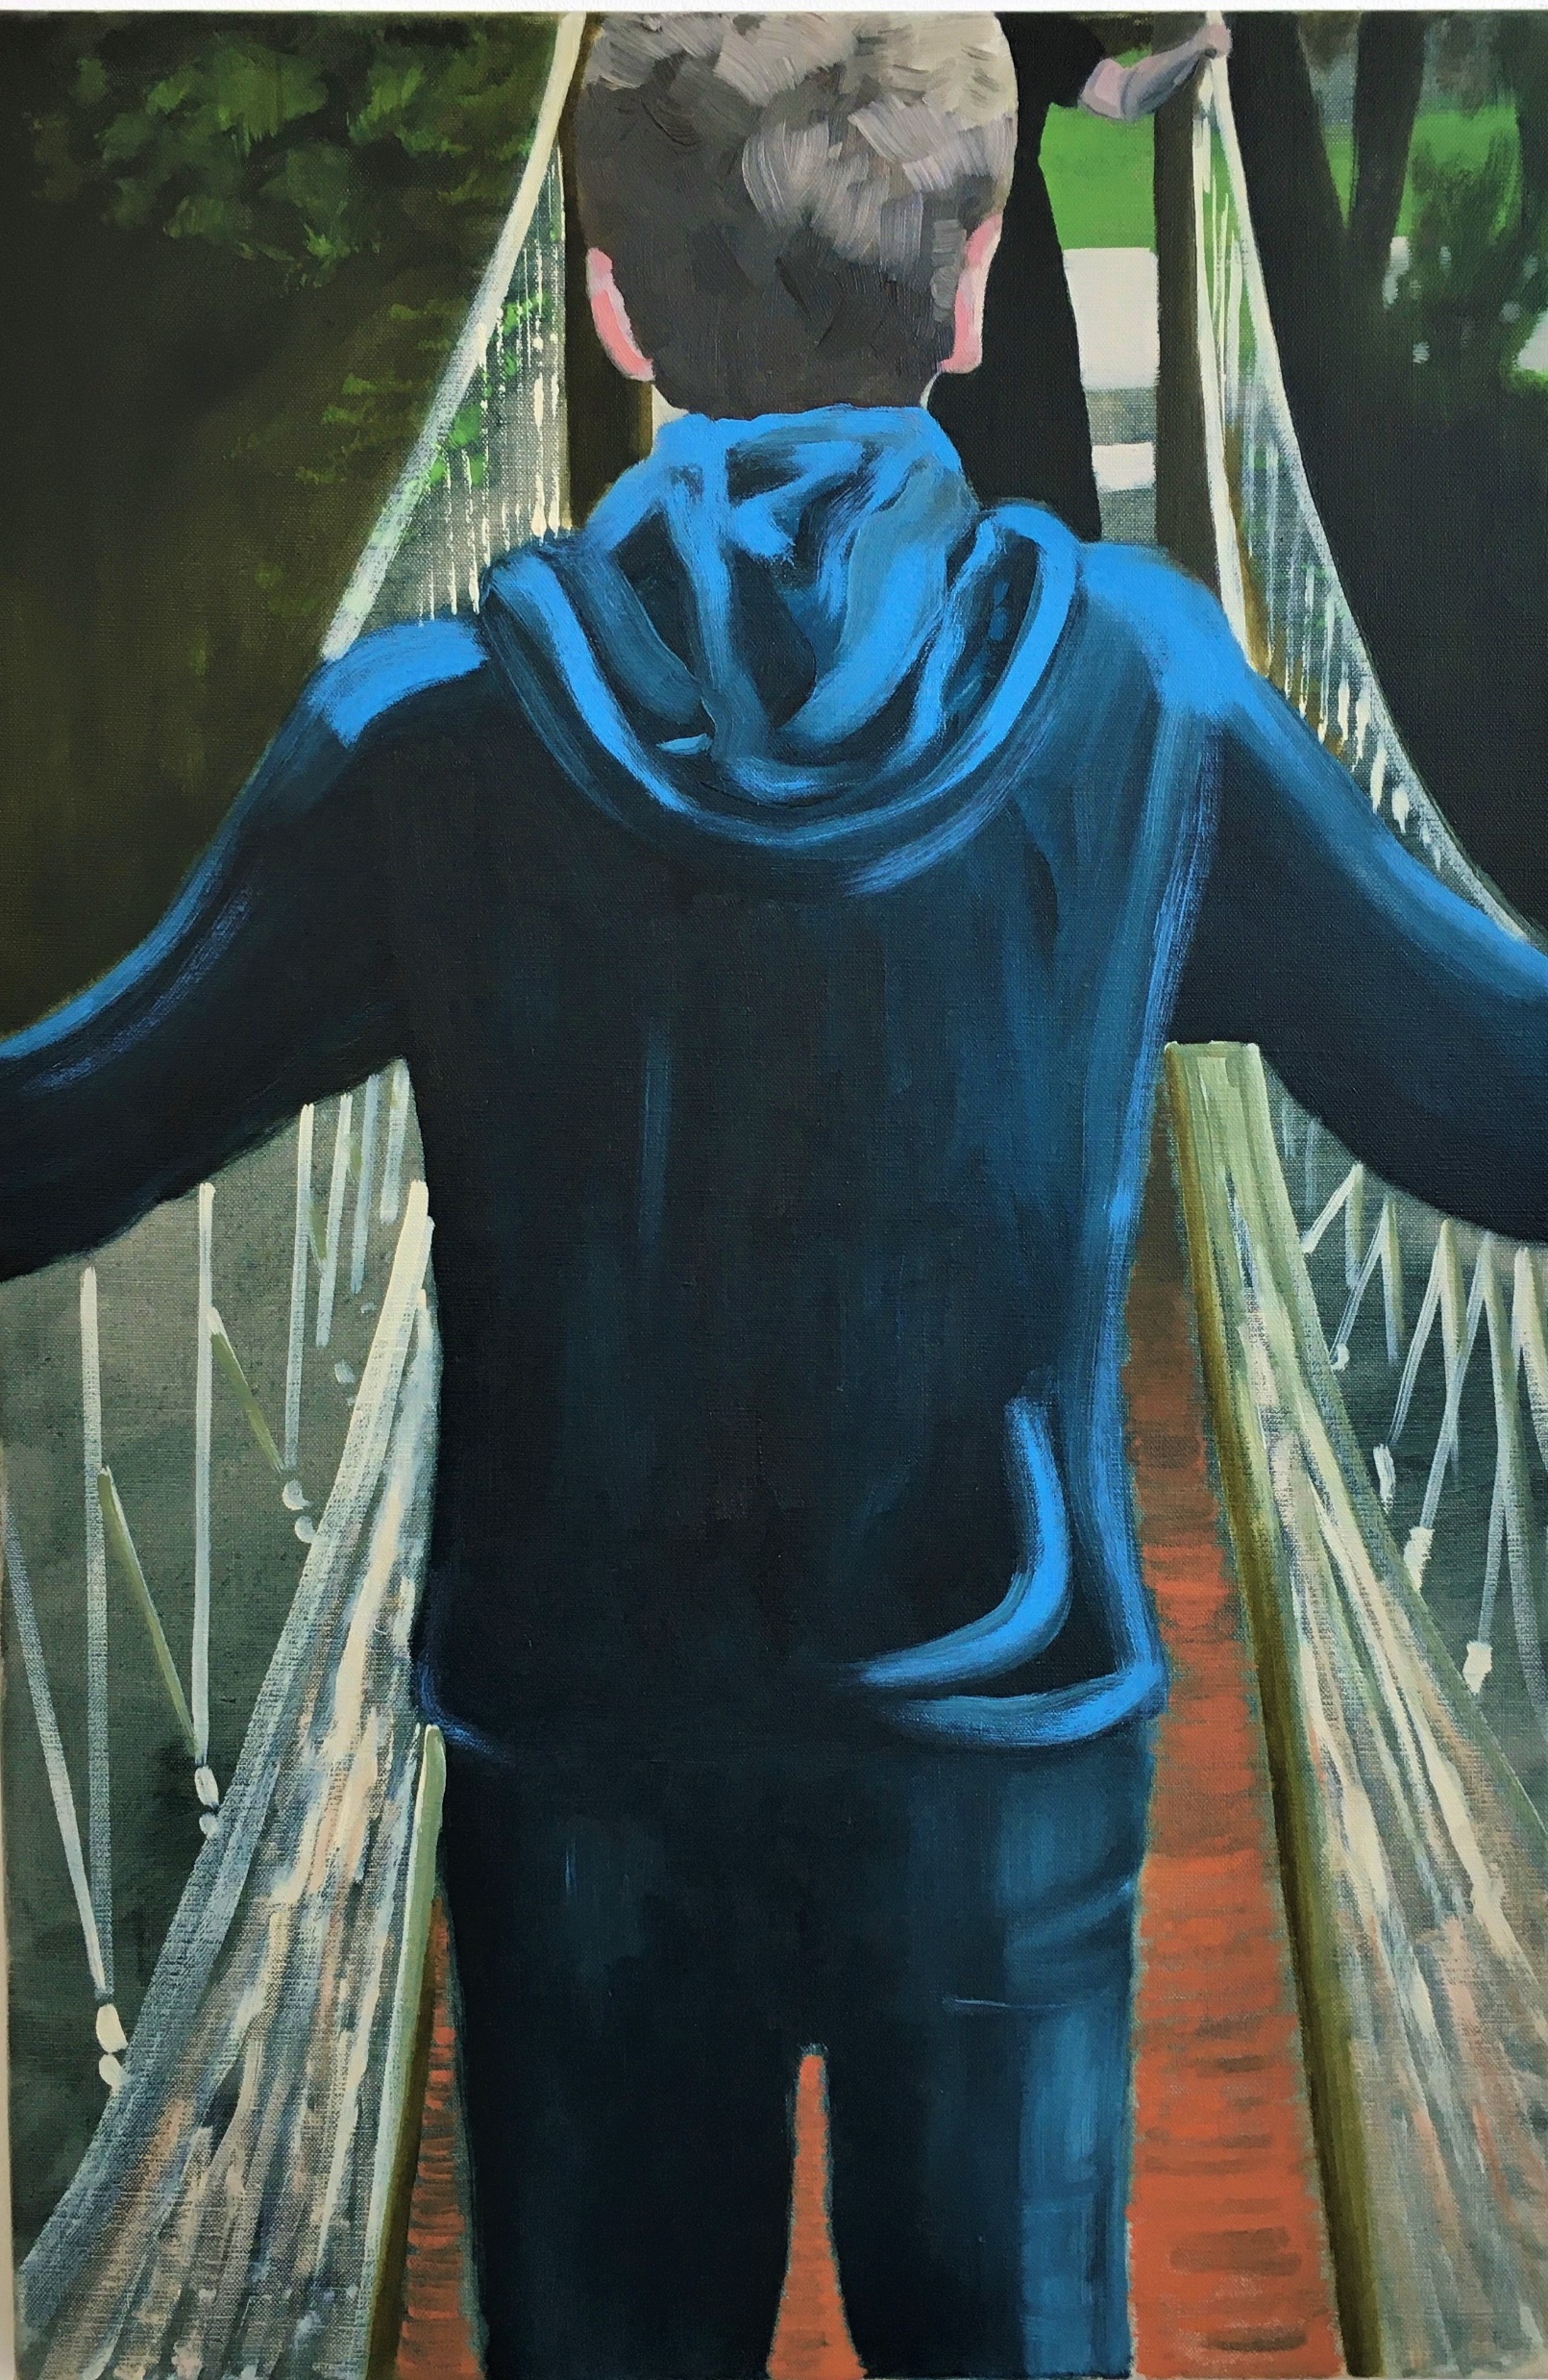
‘Wet Feet’ (2020) 76x50cm
Michael Palmer

Slide 13
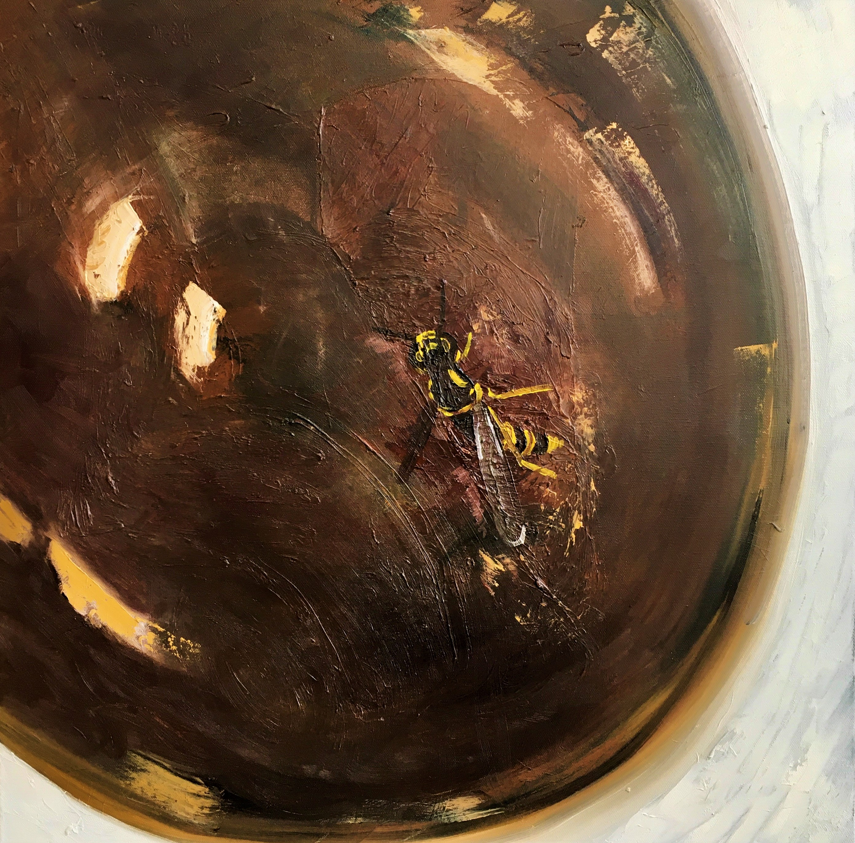
‘Wasp in My Coffee’
(2019) 60x60cm
Michael Palmer

Slide 14
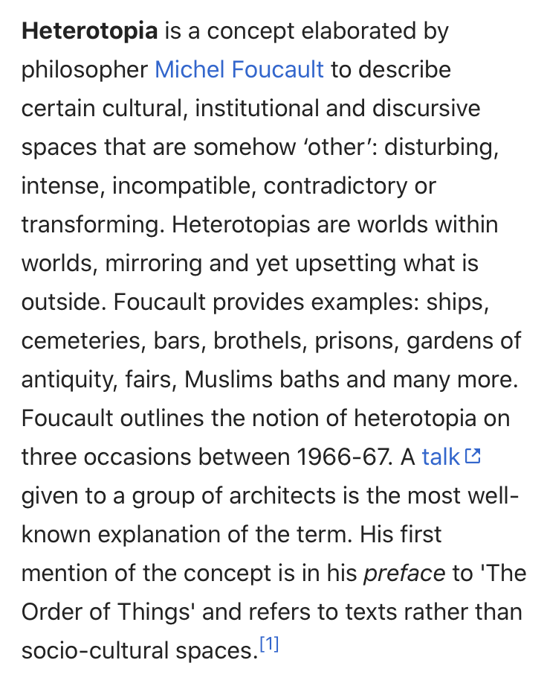
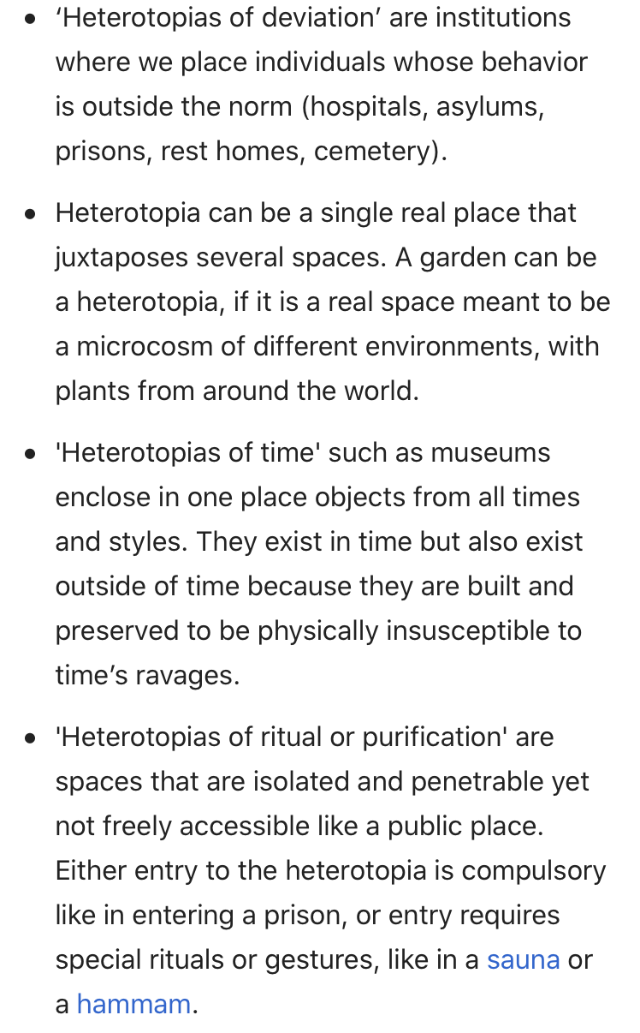
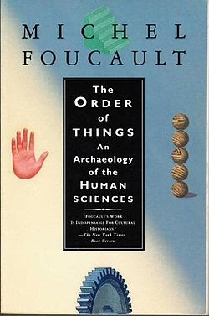

Slide 15
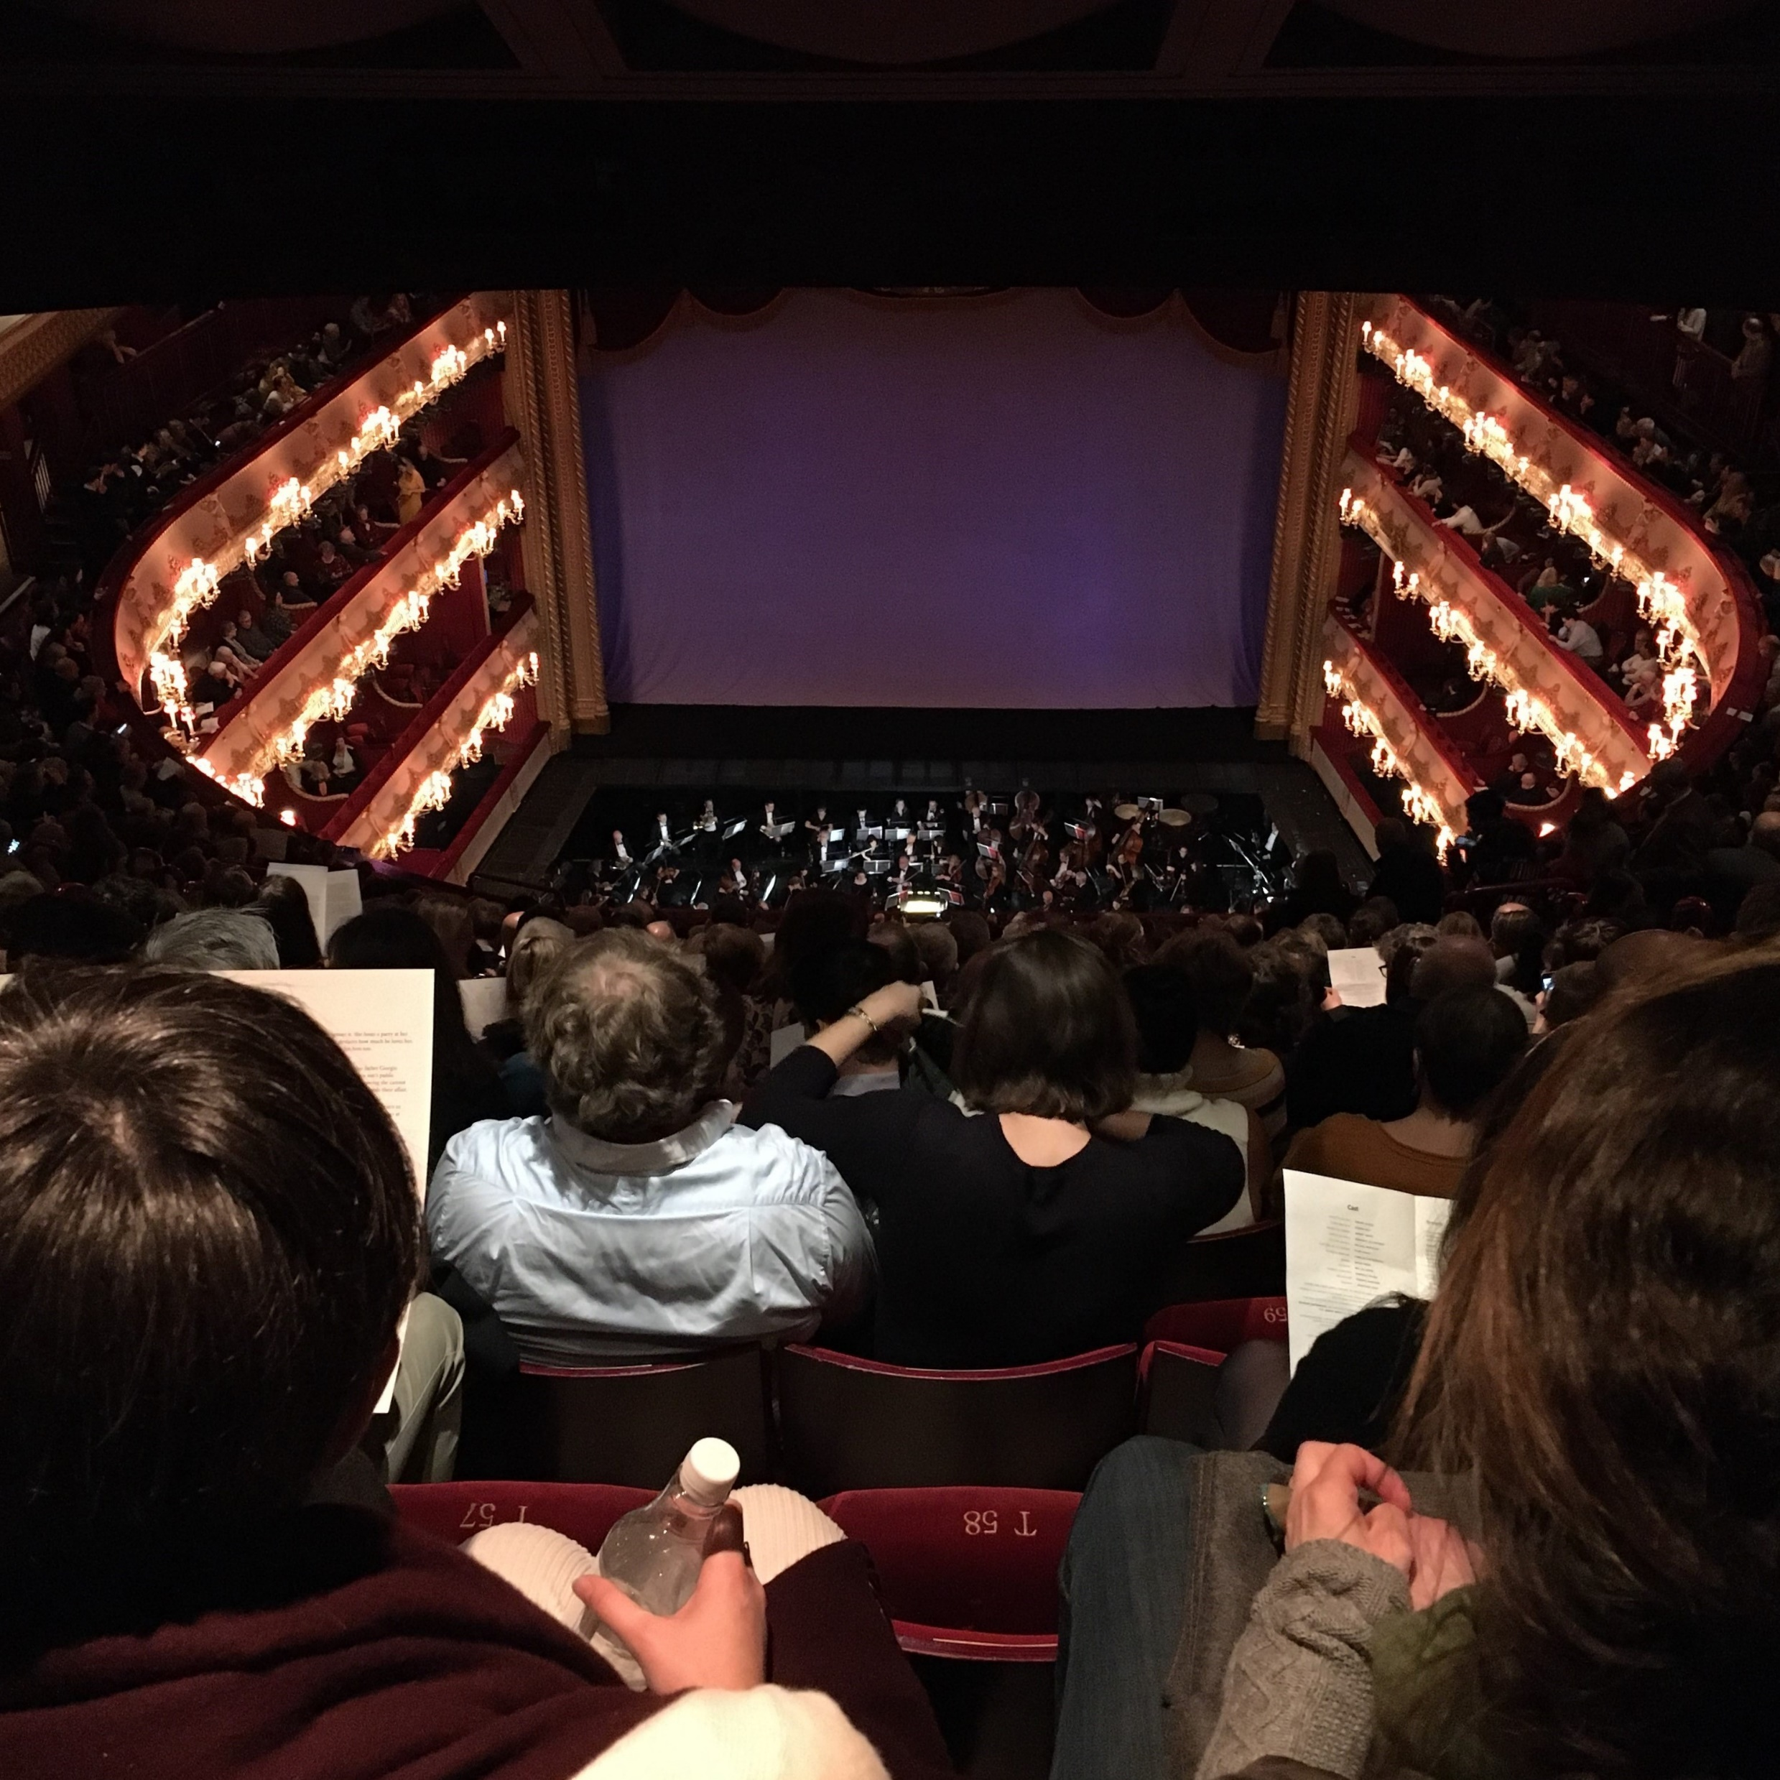
The Royal Opera House, London
(2020) Michael Palmer

Slide 16
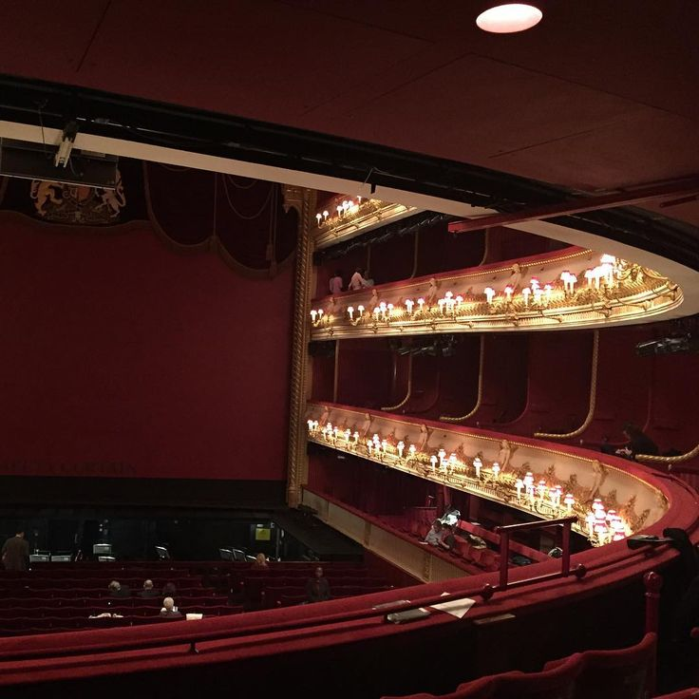
The Royal Opera House, London
(2020) Michael Palmer

Slide 17
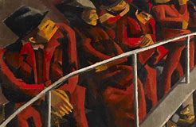
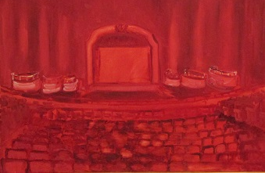
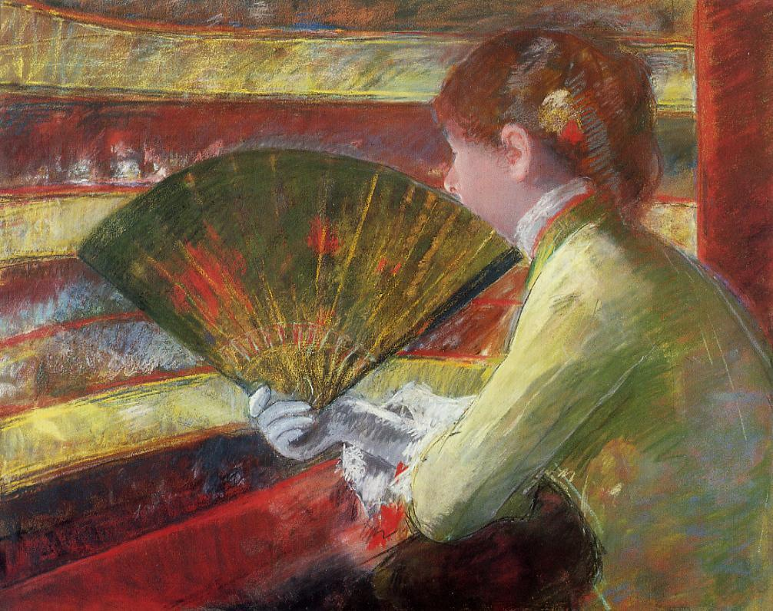
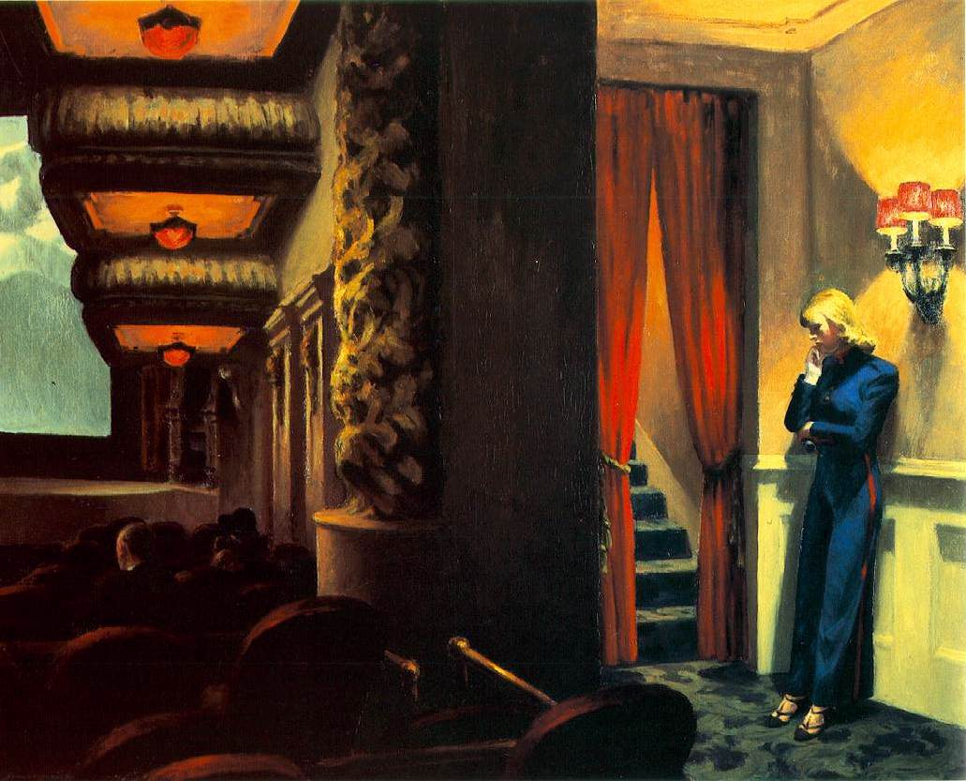
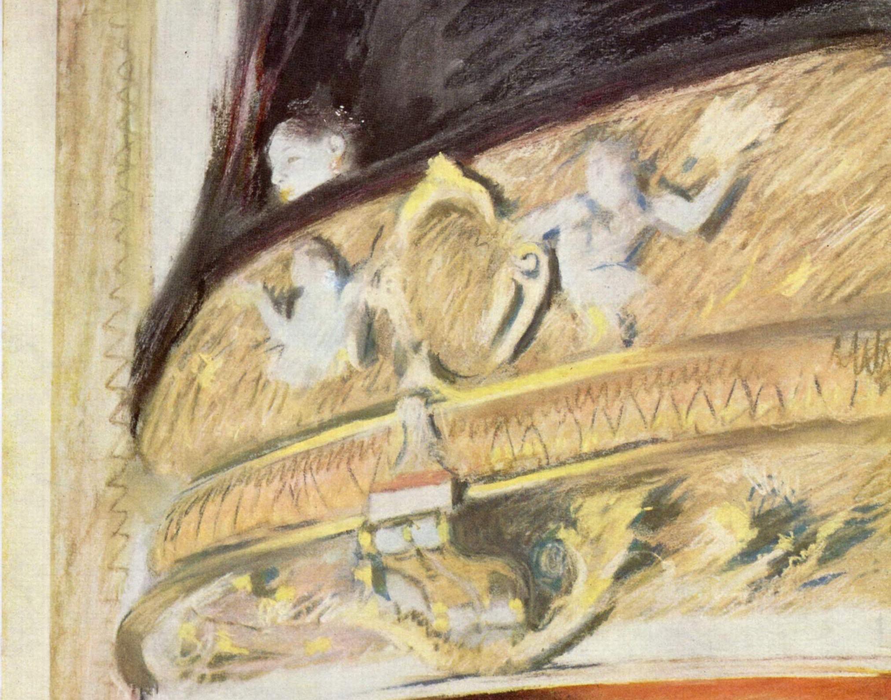

Slide 18
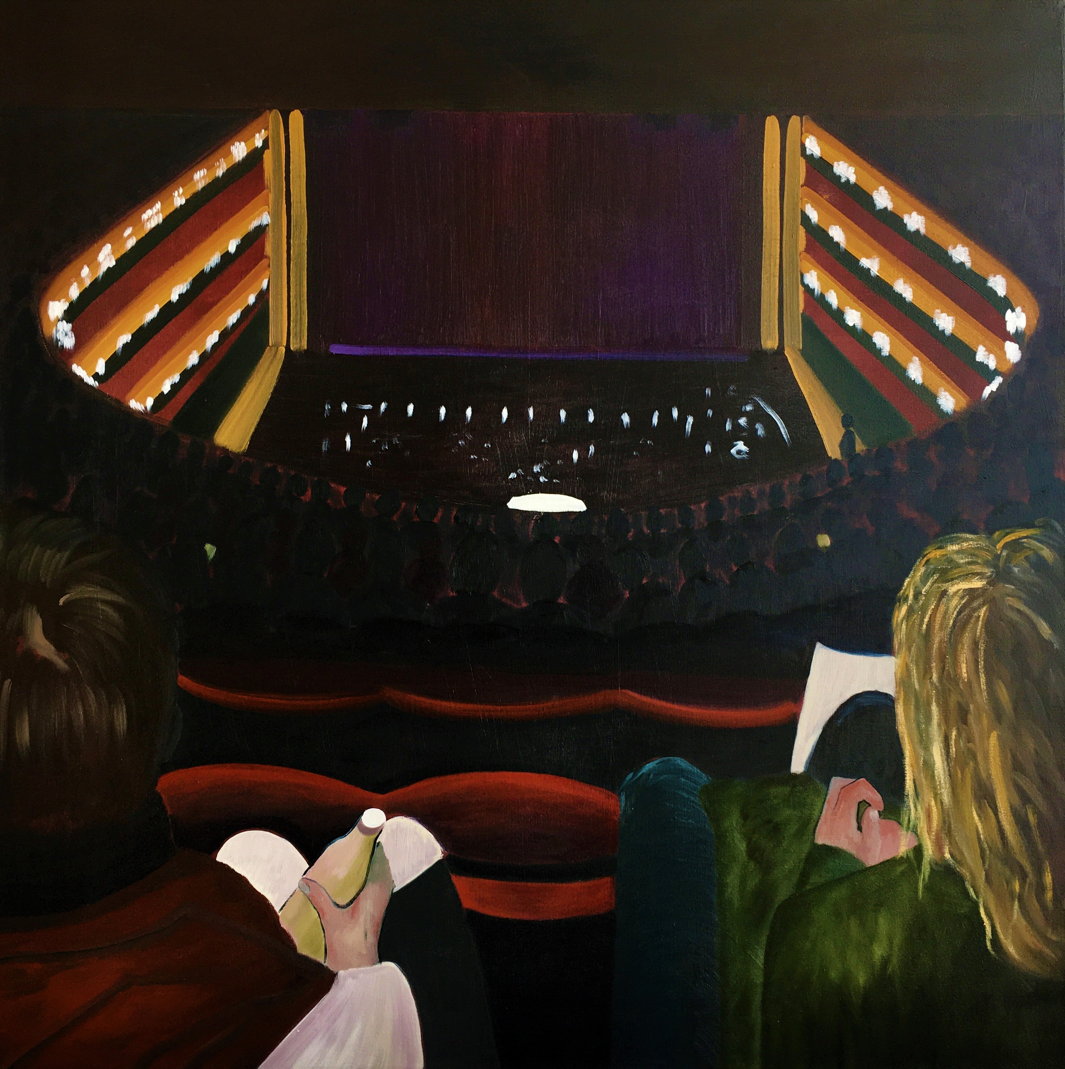
‘Violetta’ (2020) 100x100cm
Michael Palmer

Slide 19

Thank you
www.michaelpalmerstudio.com
michaelpalmerstudio

