Slide 1
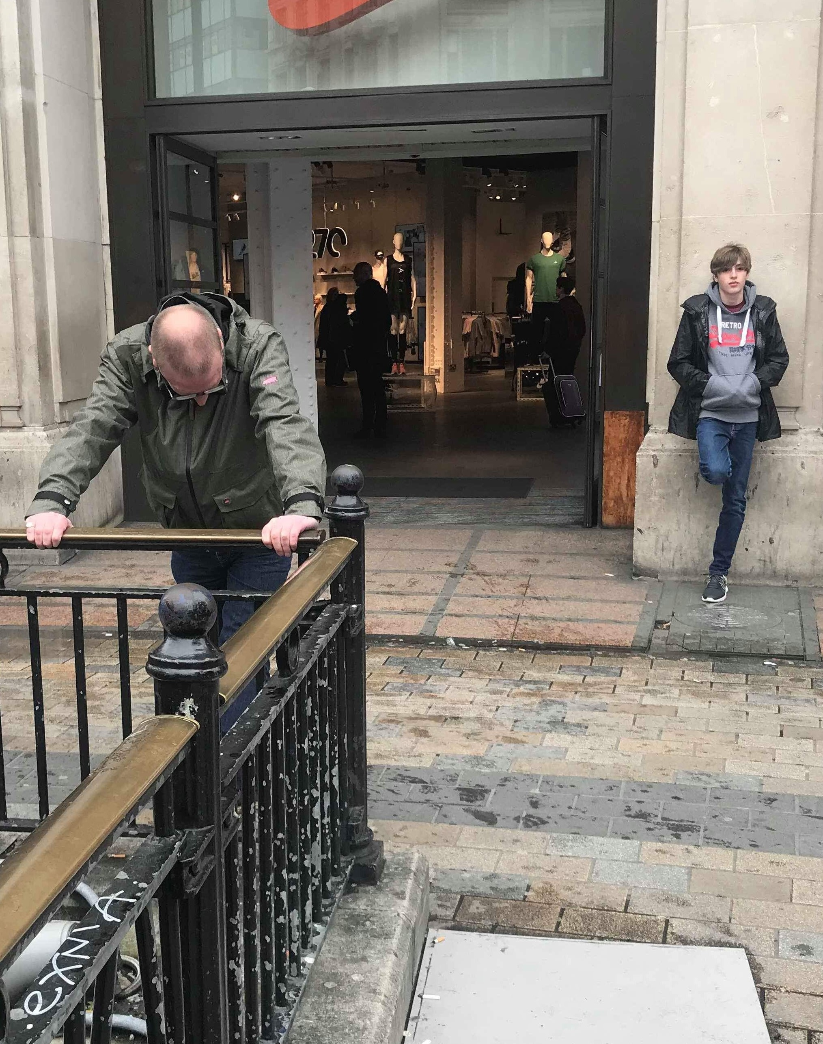
MA Fine Art Pechakucha Presentation 2020
By Michael Palmer

Slide 2
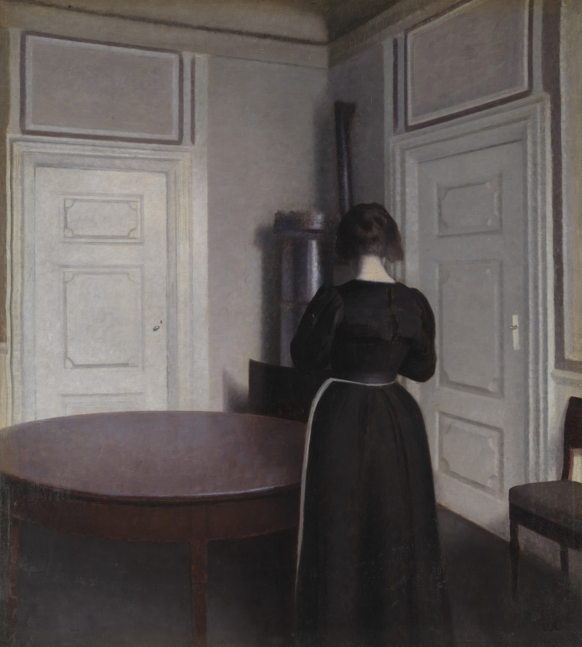
‘Interior’ (1899)
Vilhelm Hammershoi

Slide 3
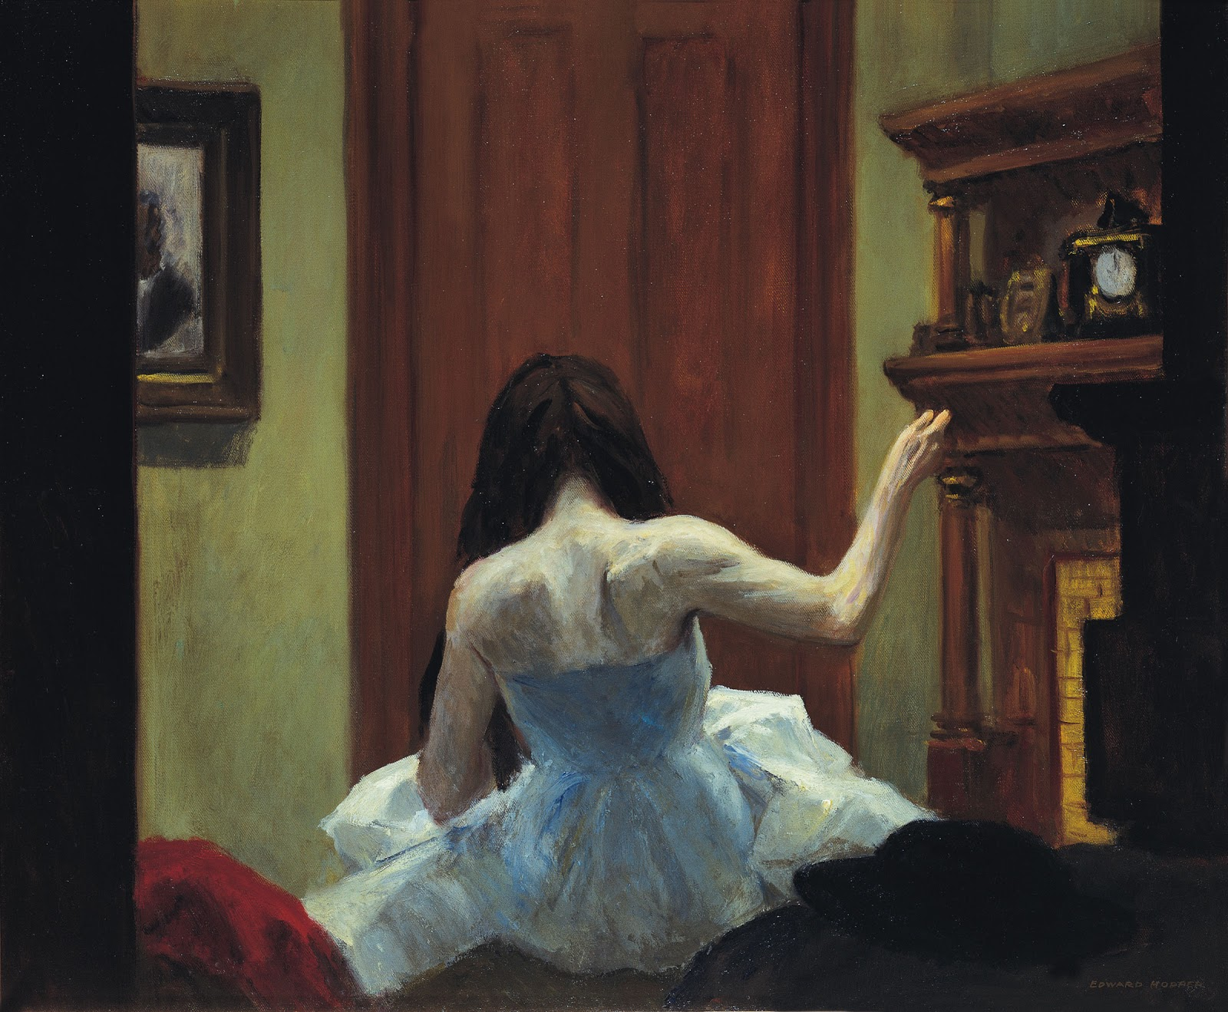
‘New York Interior’ (1921) Edward Hopper

Slide 4

‘#11692-492’ (2008) Todd Hido

Slide 5
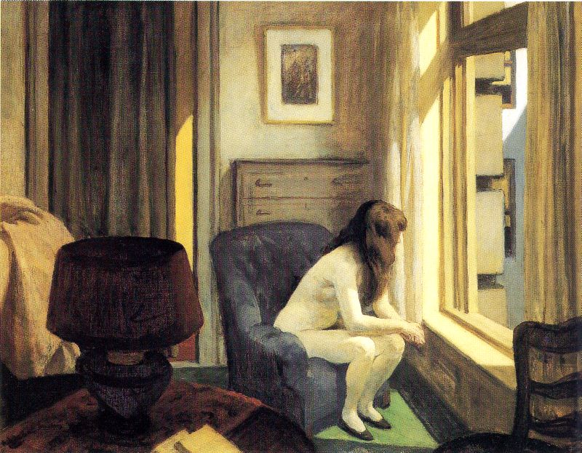
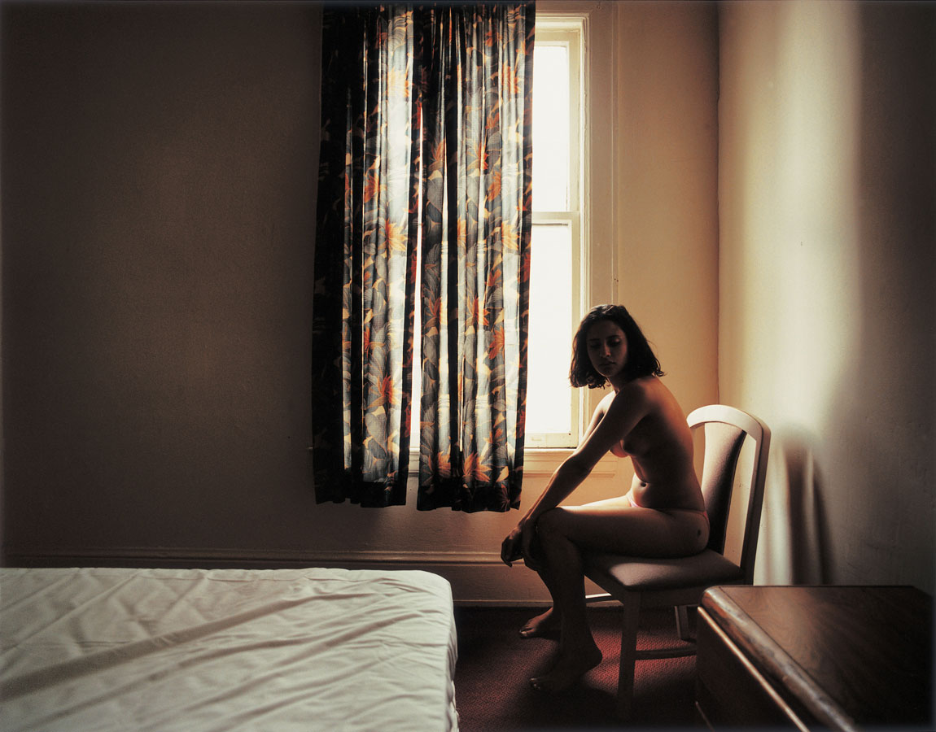
‘Eleven am’ (1926) Edward Hopper #4313 (2006) Todd Hido

Slide 6
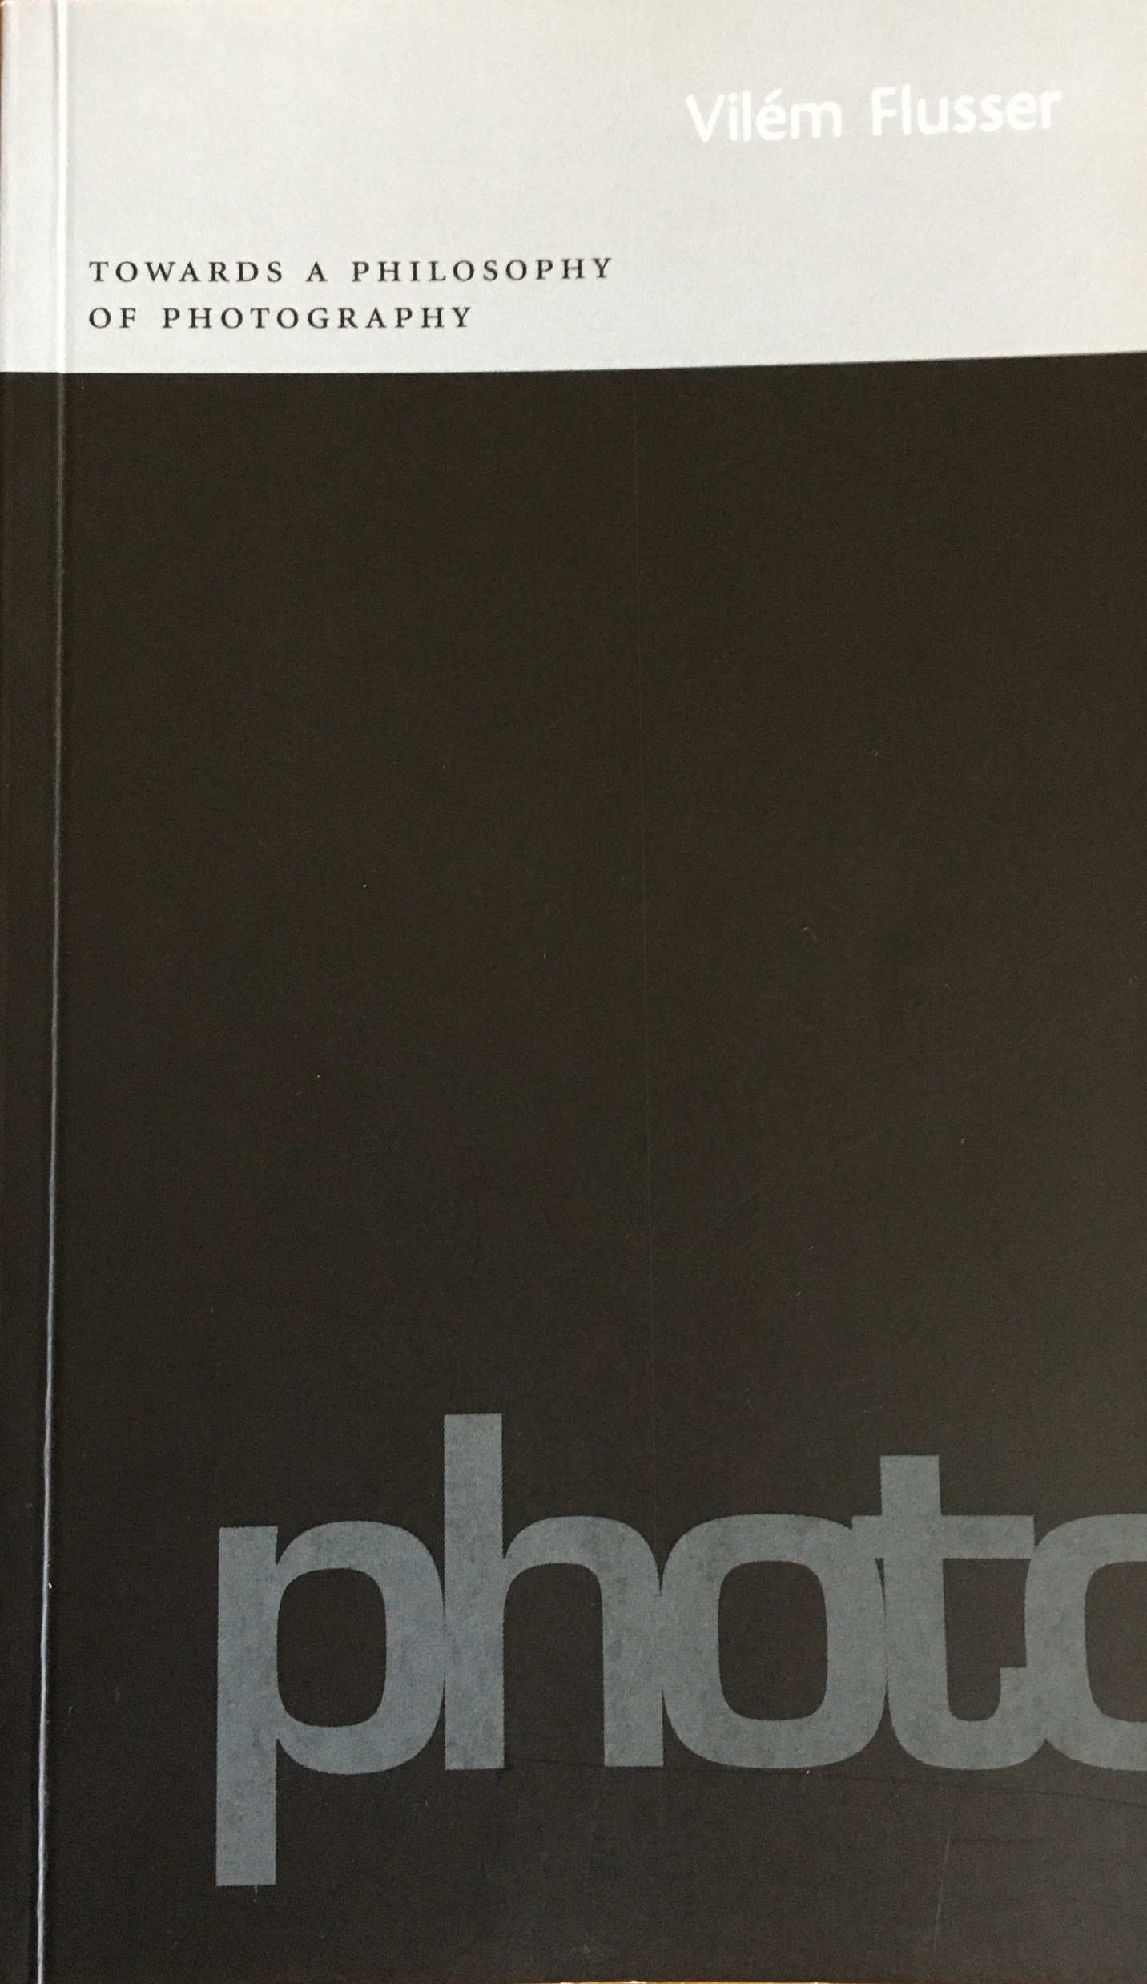
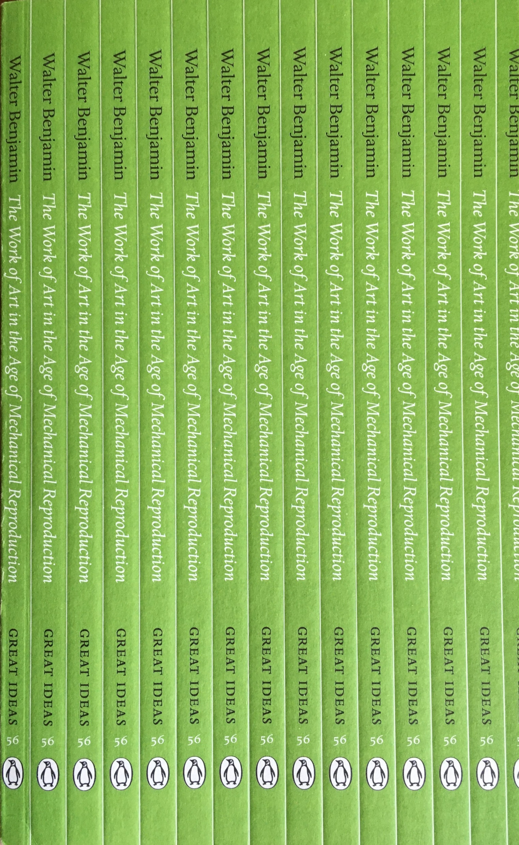
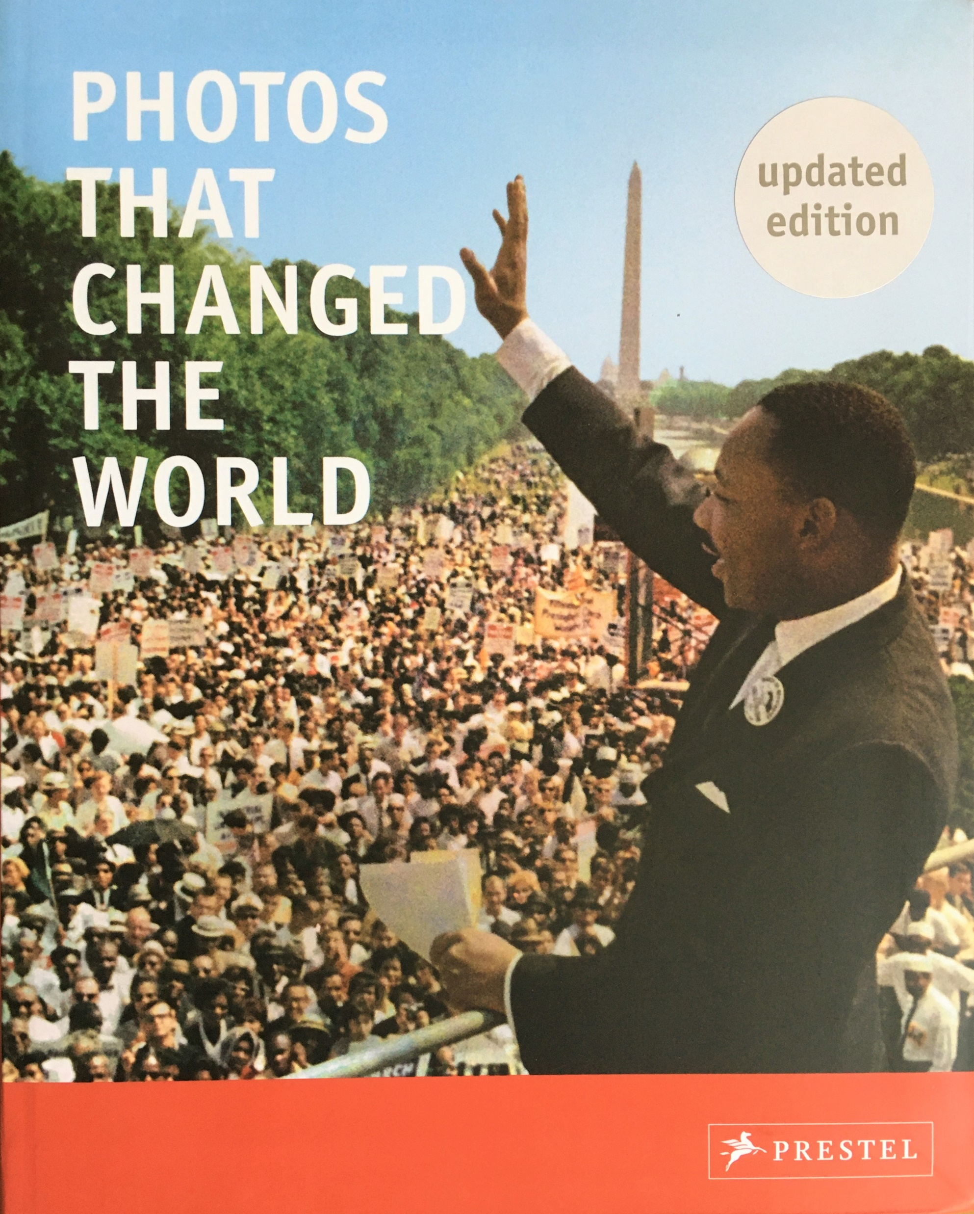
Towards A Philosophy of Photography (2000) Vilem Flusser
The Work of Art in the Age of Mechanical Reproduction (1936) Walter Benjamin
Photos That Changed The World (2000) ed. Peter Stepan

Slide 7
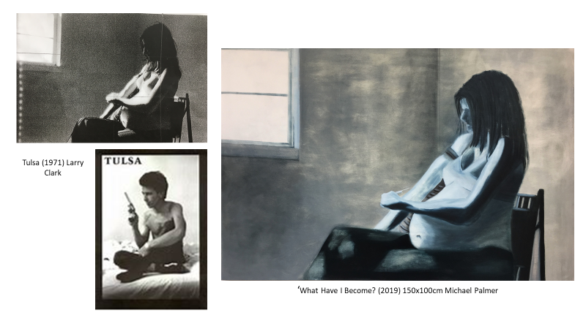

Slide 8
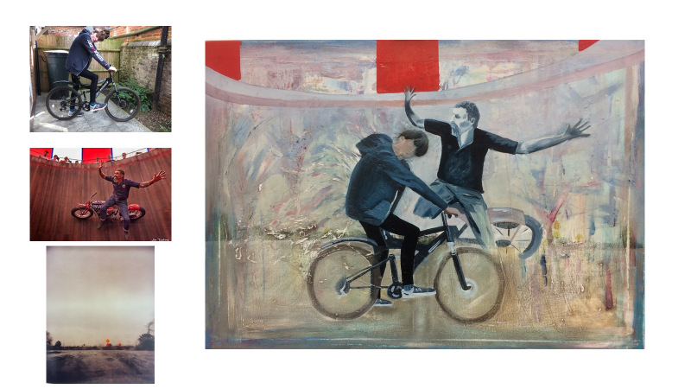
‘Freedom’ (2018) 36x24cm Michael Palmer

Slide 9
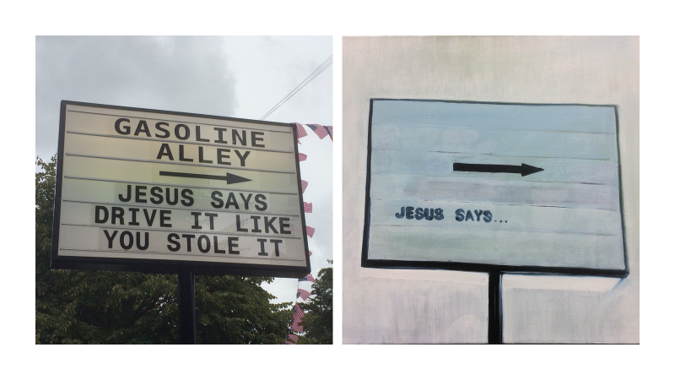
‘Gasoline Alley’ (2018) Michael Palmer
‘Jesus Says…’ (2018) 50x46cm Michael Palmer

Slide 10
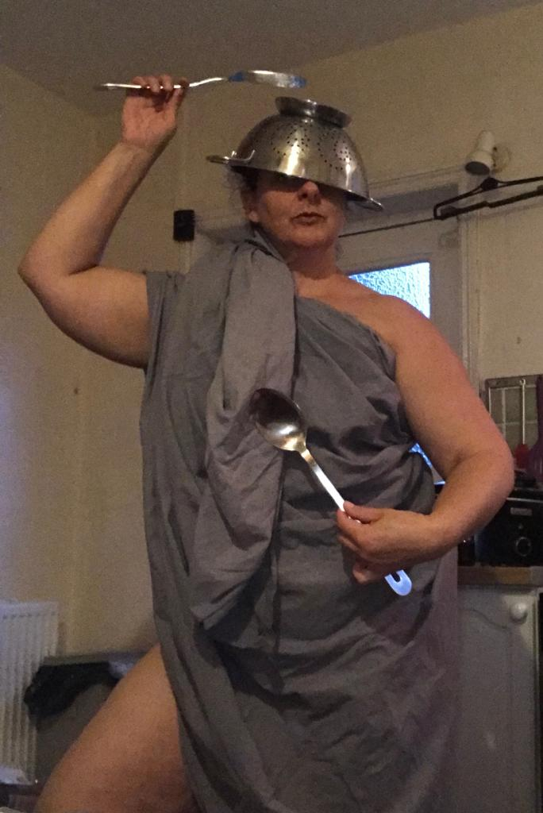
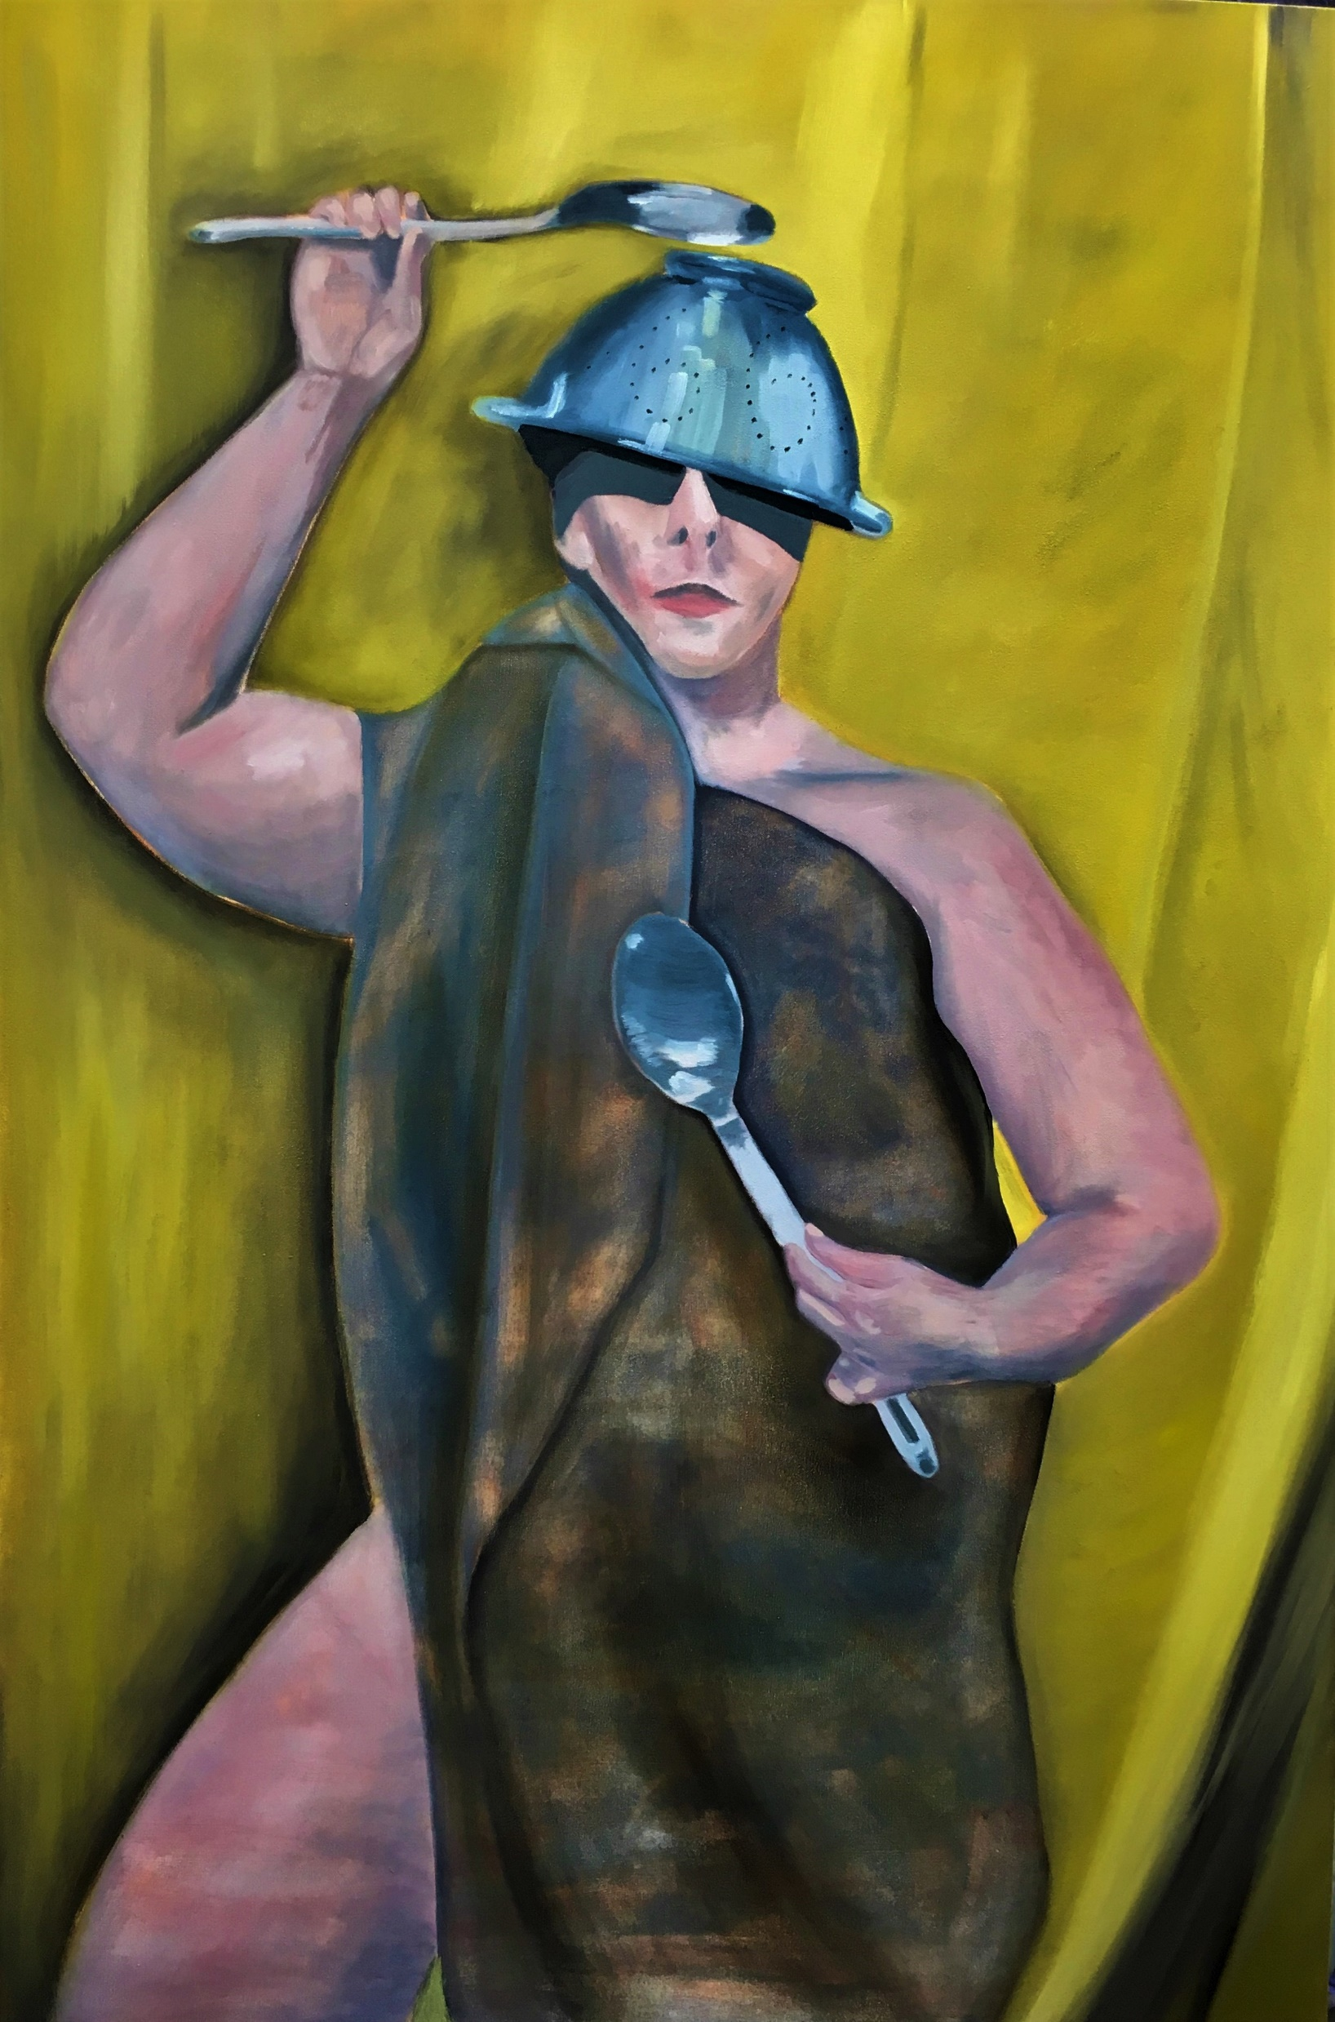
Helen (2019) Michael Palmer
‘Triumph’ (2019) 150x100cm Michael Palmer

Slide 11
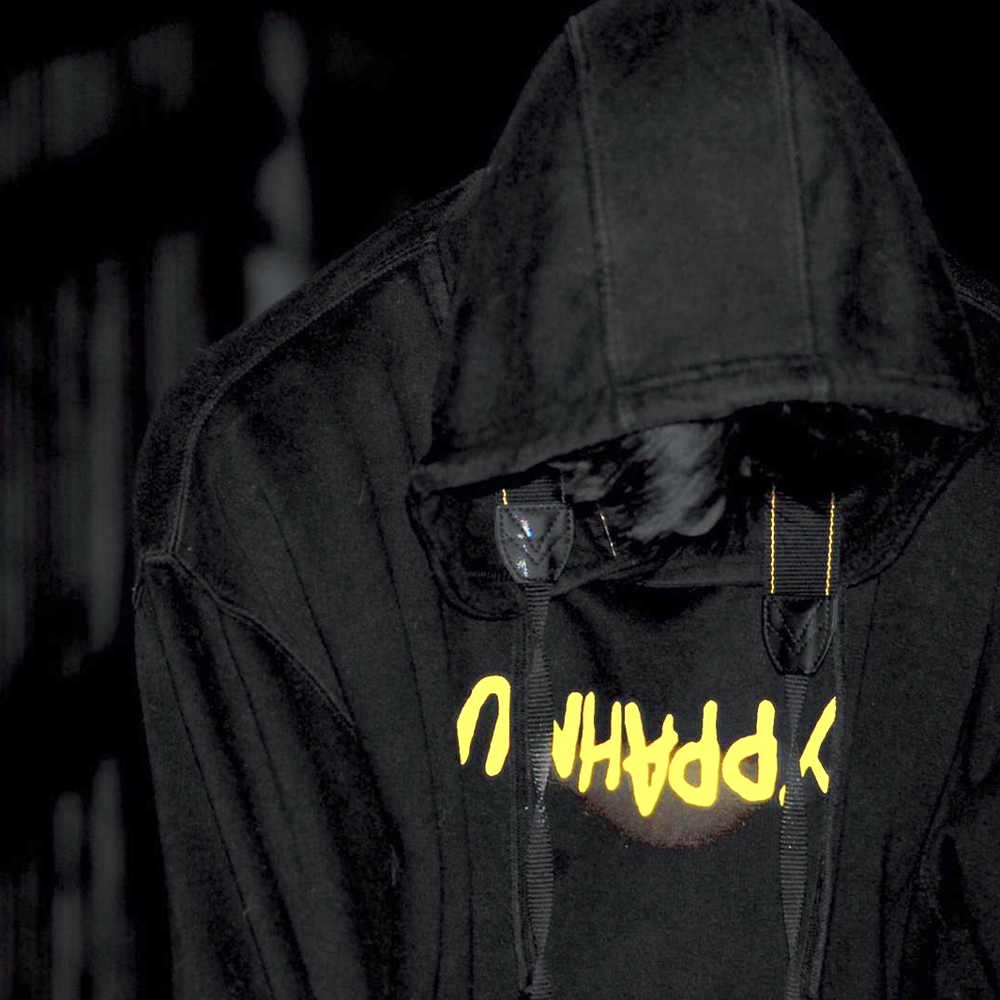
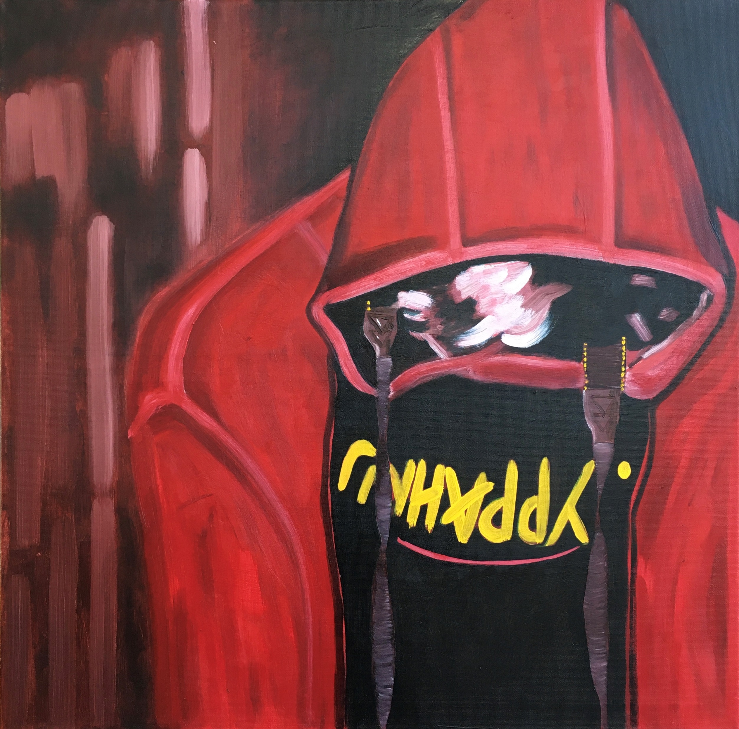
Sebastian Palmer (2019)
‘Unhappy’ (2019) 60x60cm Michael Palmer

Slide 12
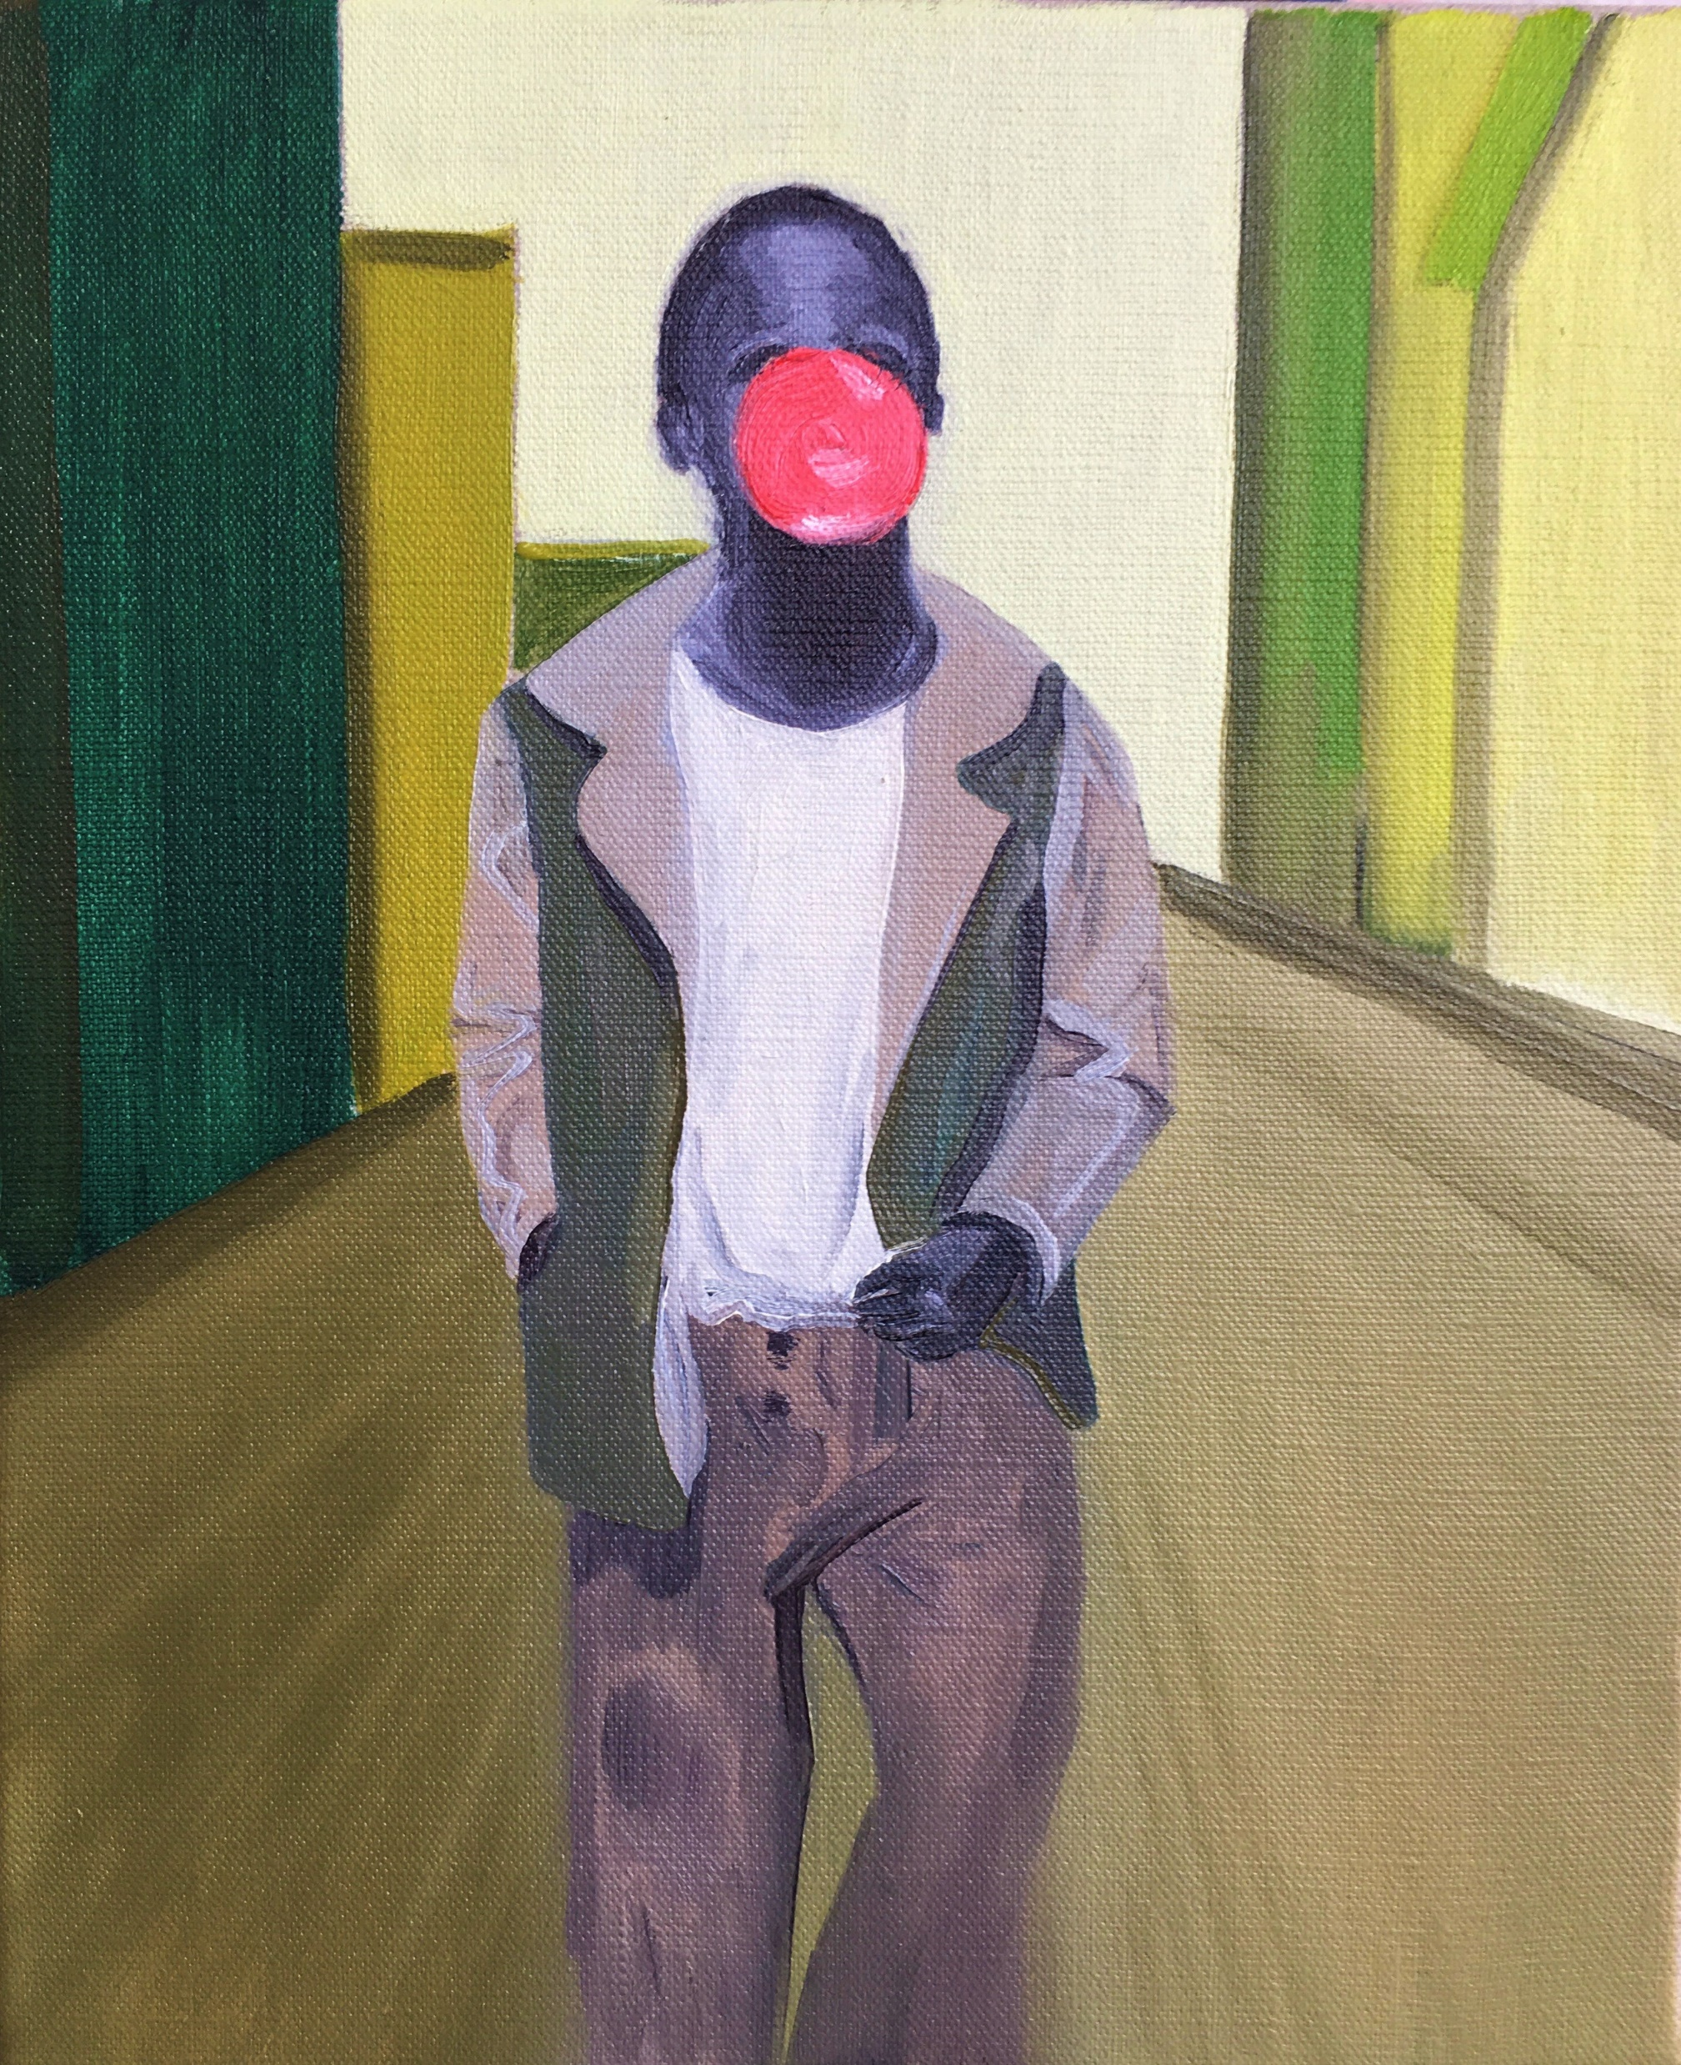
‘Bubble Gum Kid’ (2020)
30x20cm Michael Palmer
After Marvin E Newman ‘The Bubble Gum Kid’ (1950)

Slide 13
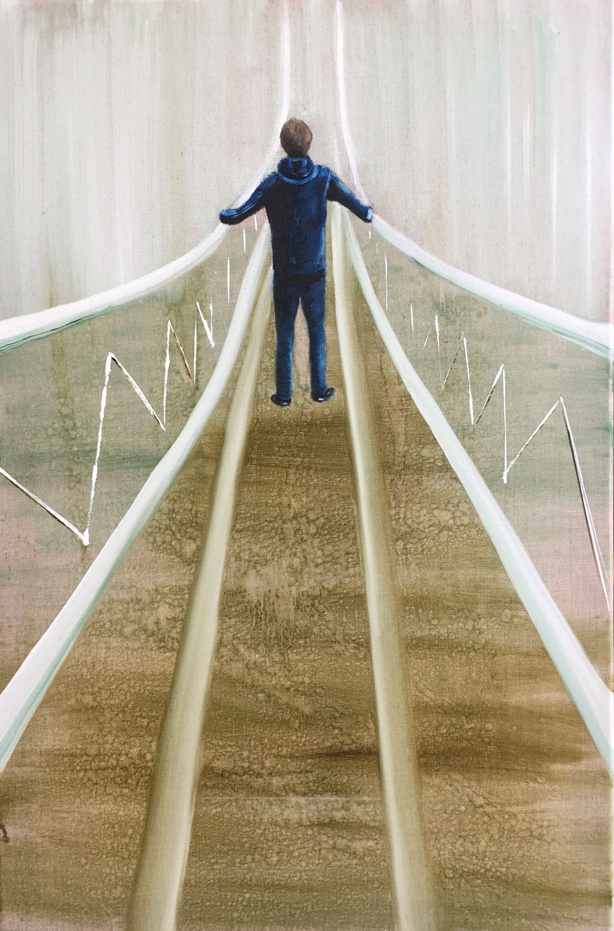
‘The White Bridge’ (2019)
76x50cm Michael Palmer

Slide 14
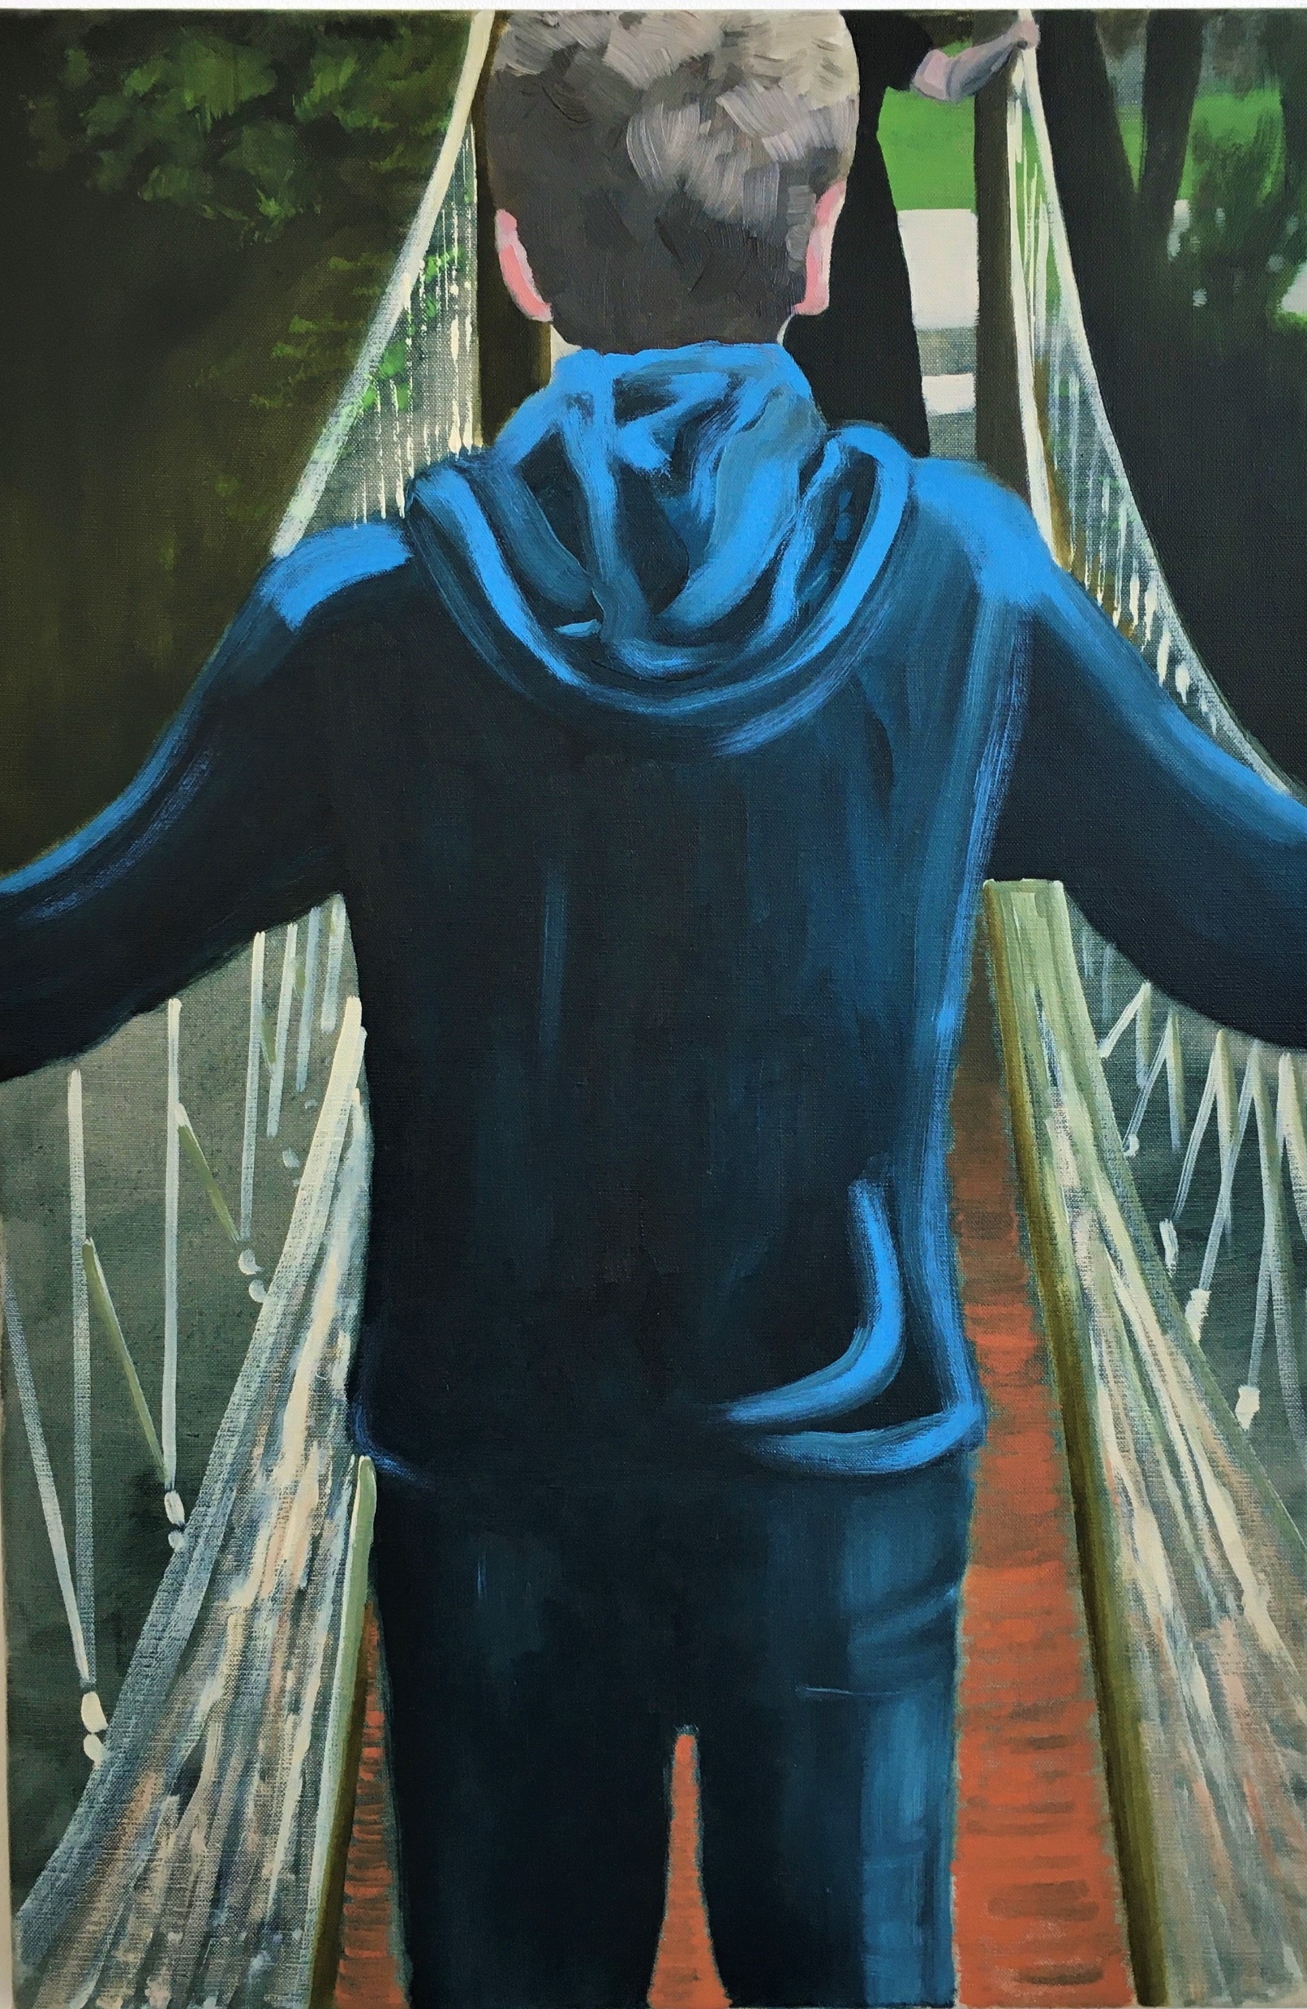
‘Wet Feet’ (2020) 76x50cm
Michael Palmer

Slide 15
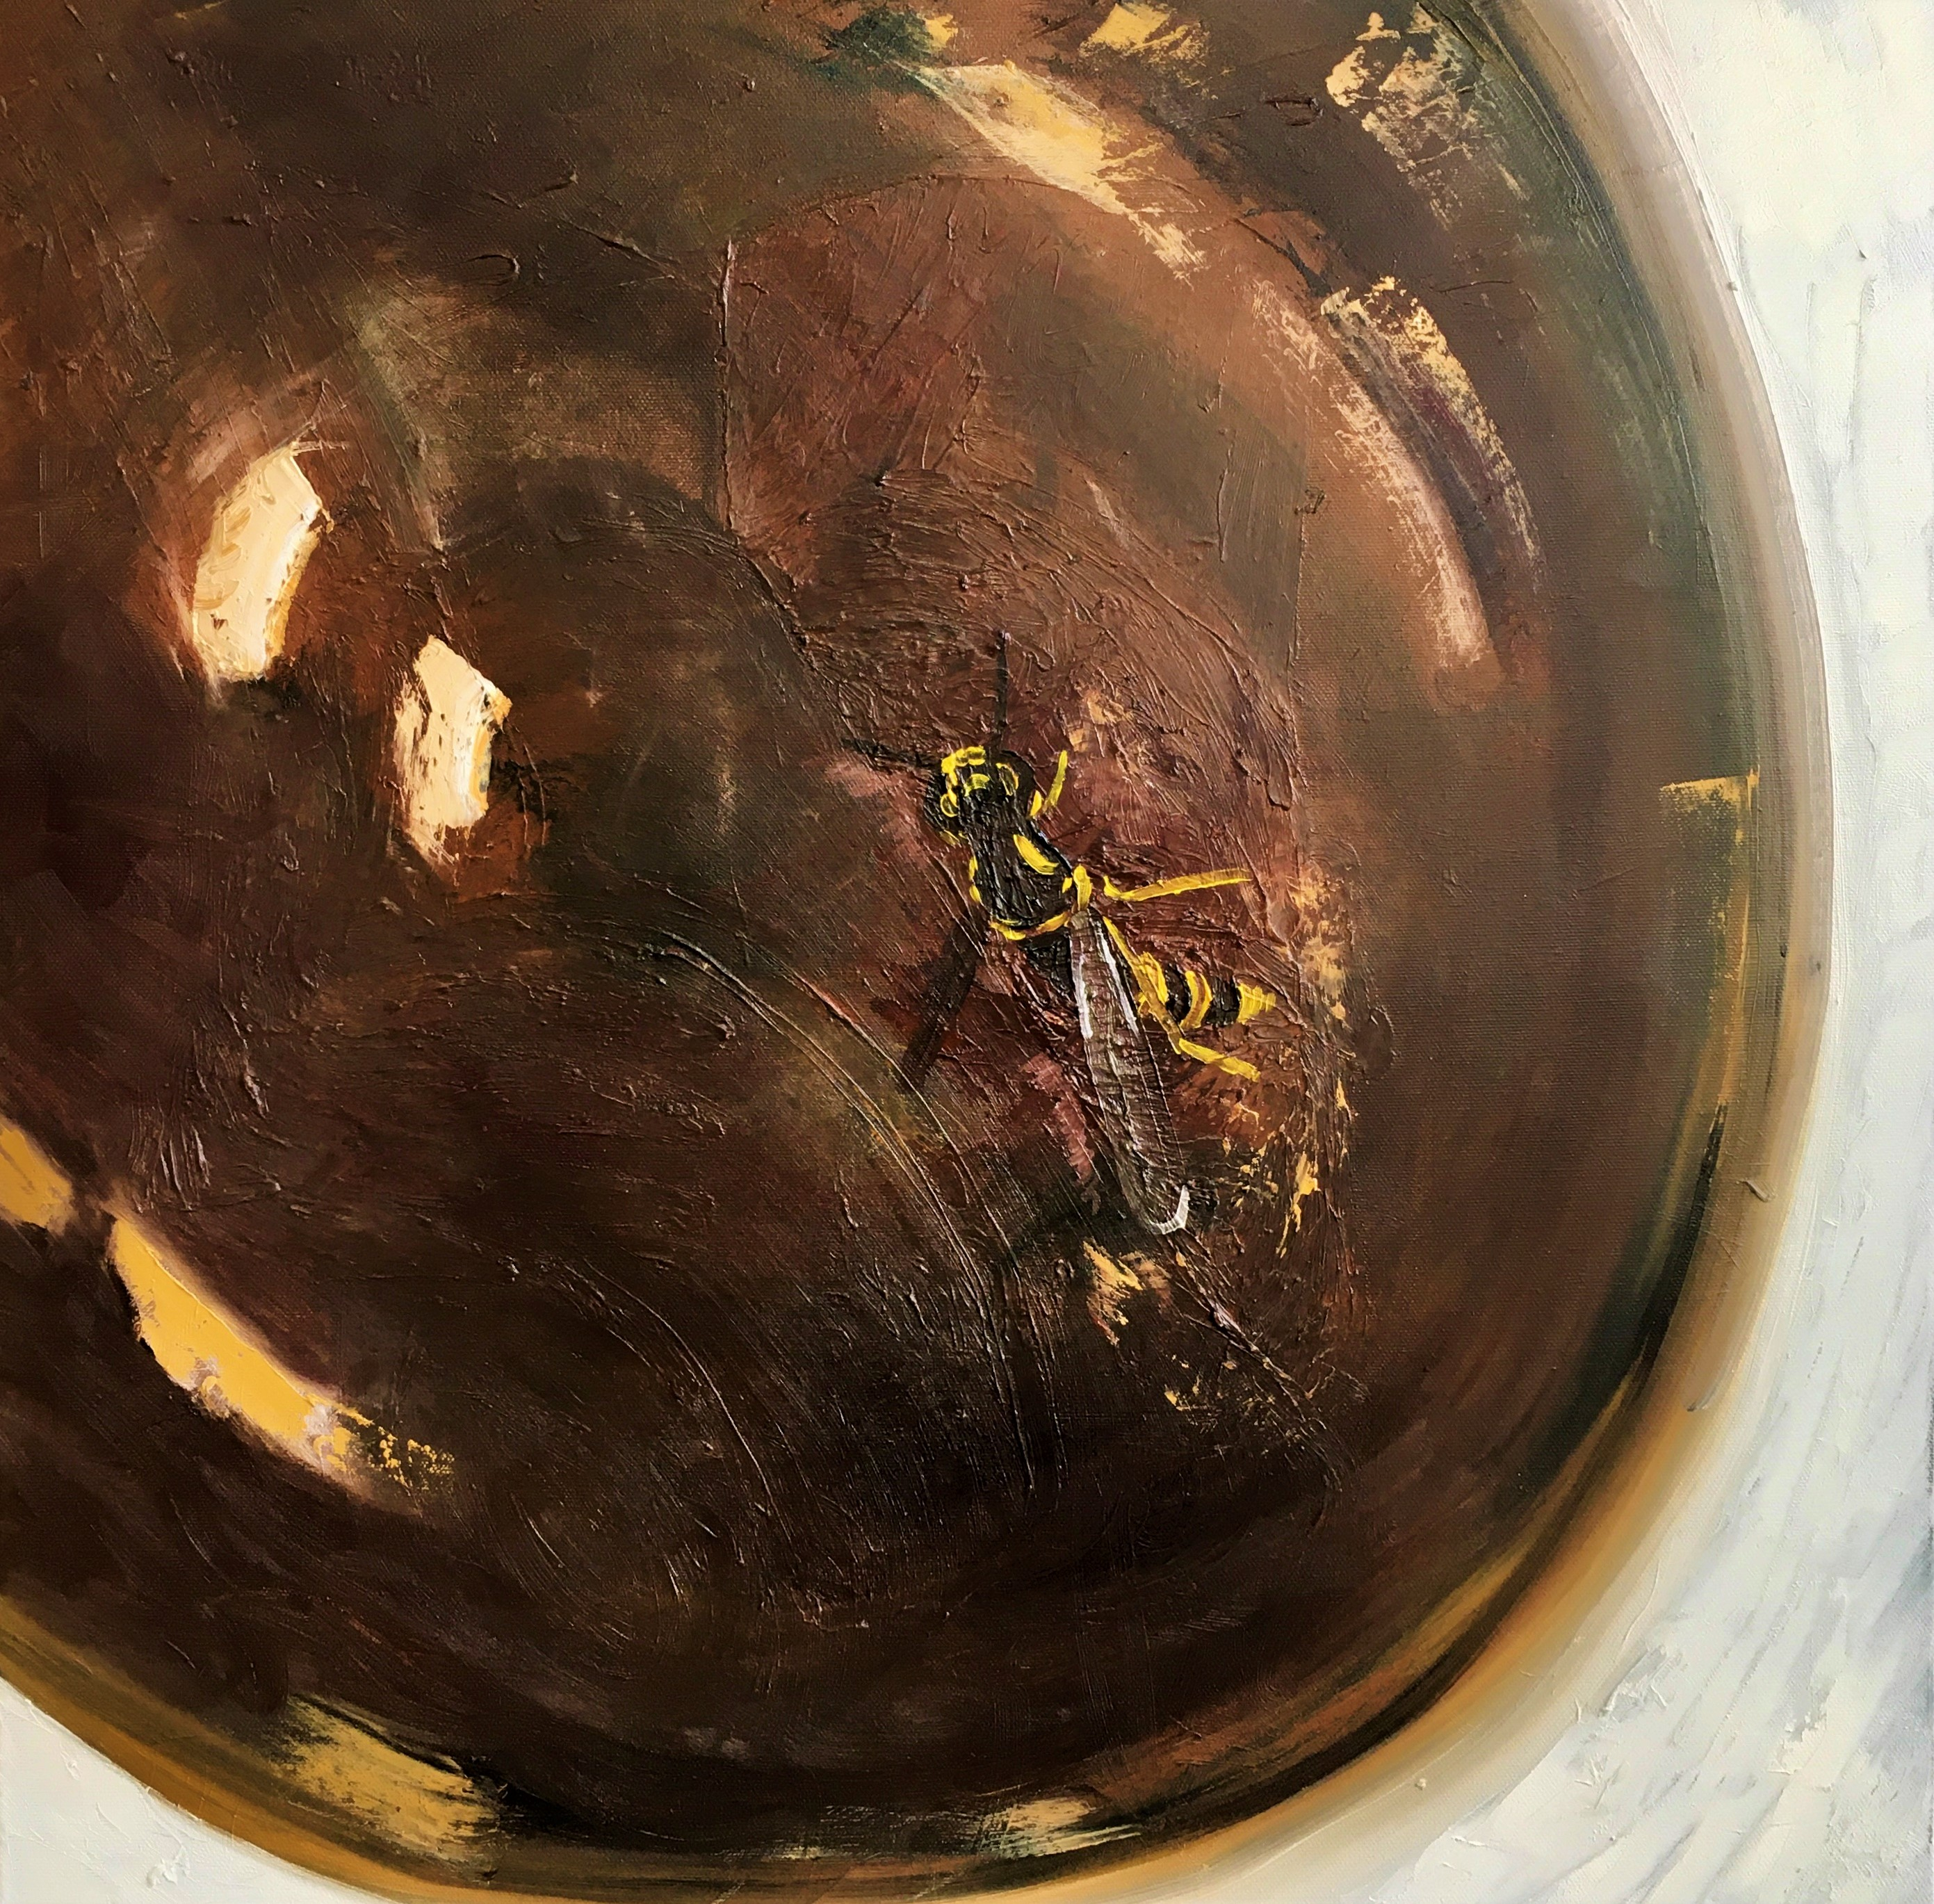
‘Wasp in My Coffee’
(2019) 60x60cm
Michael Palmer

Slide 16
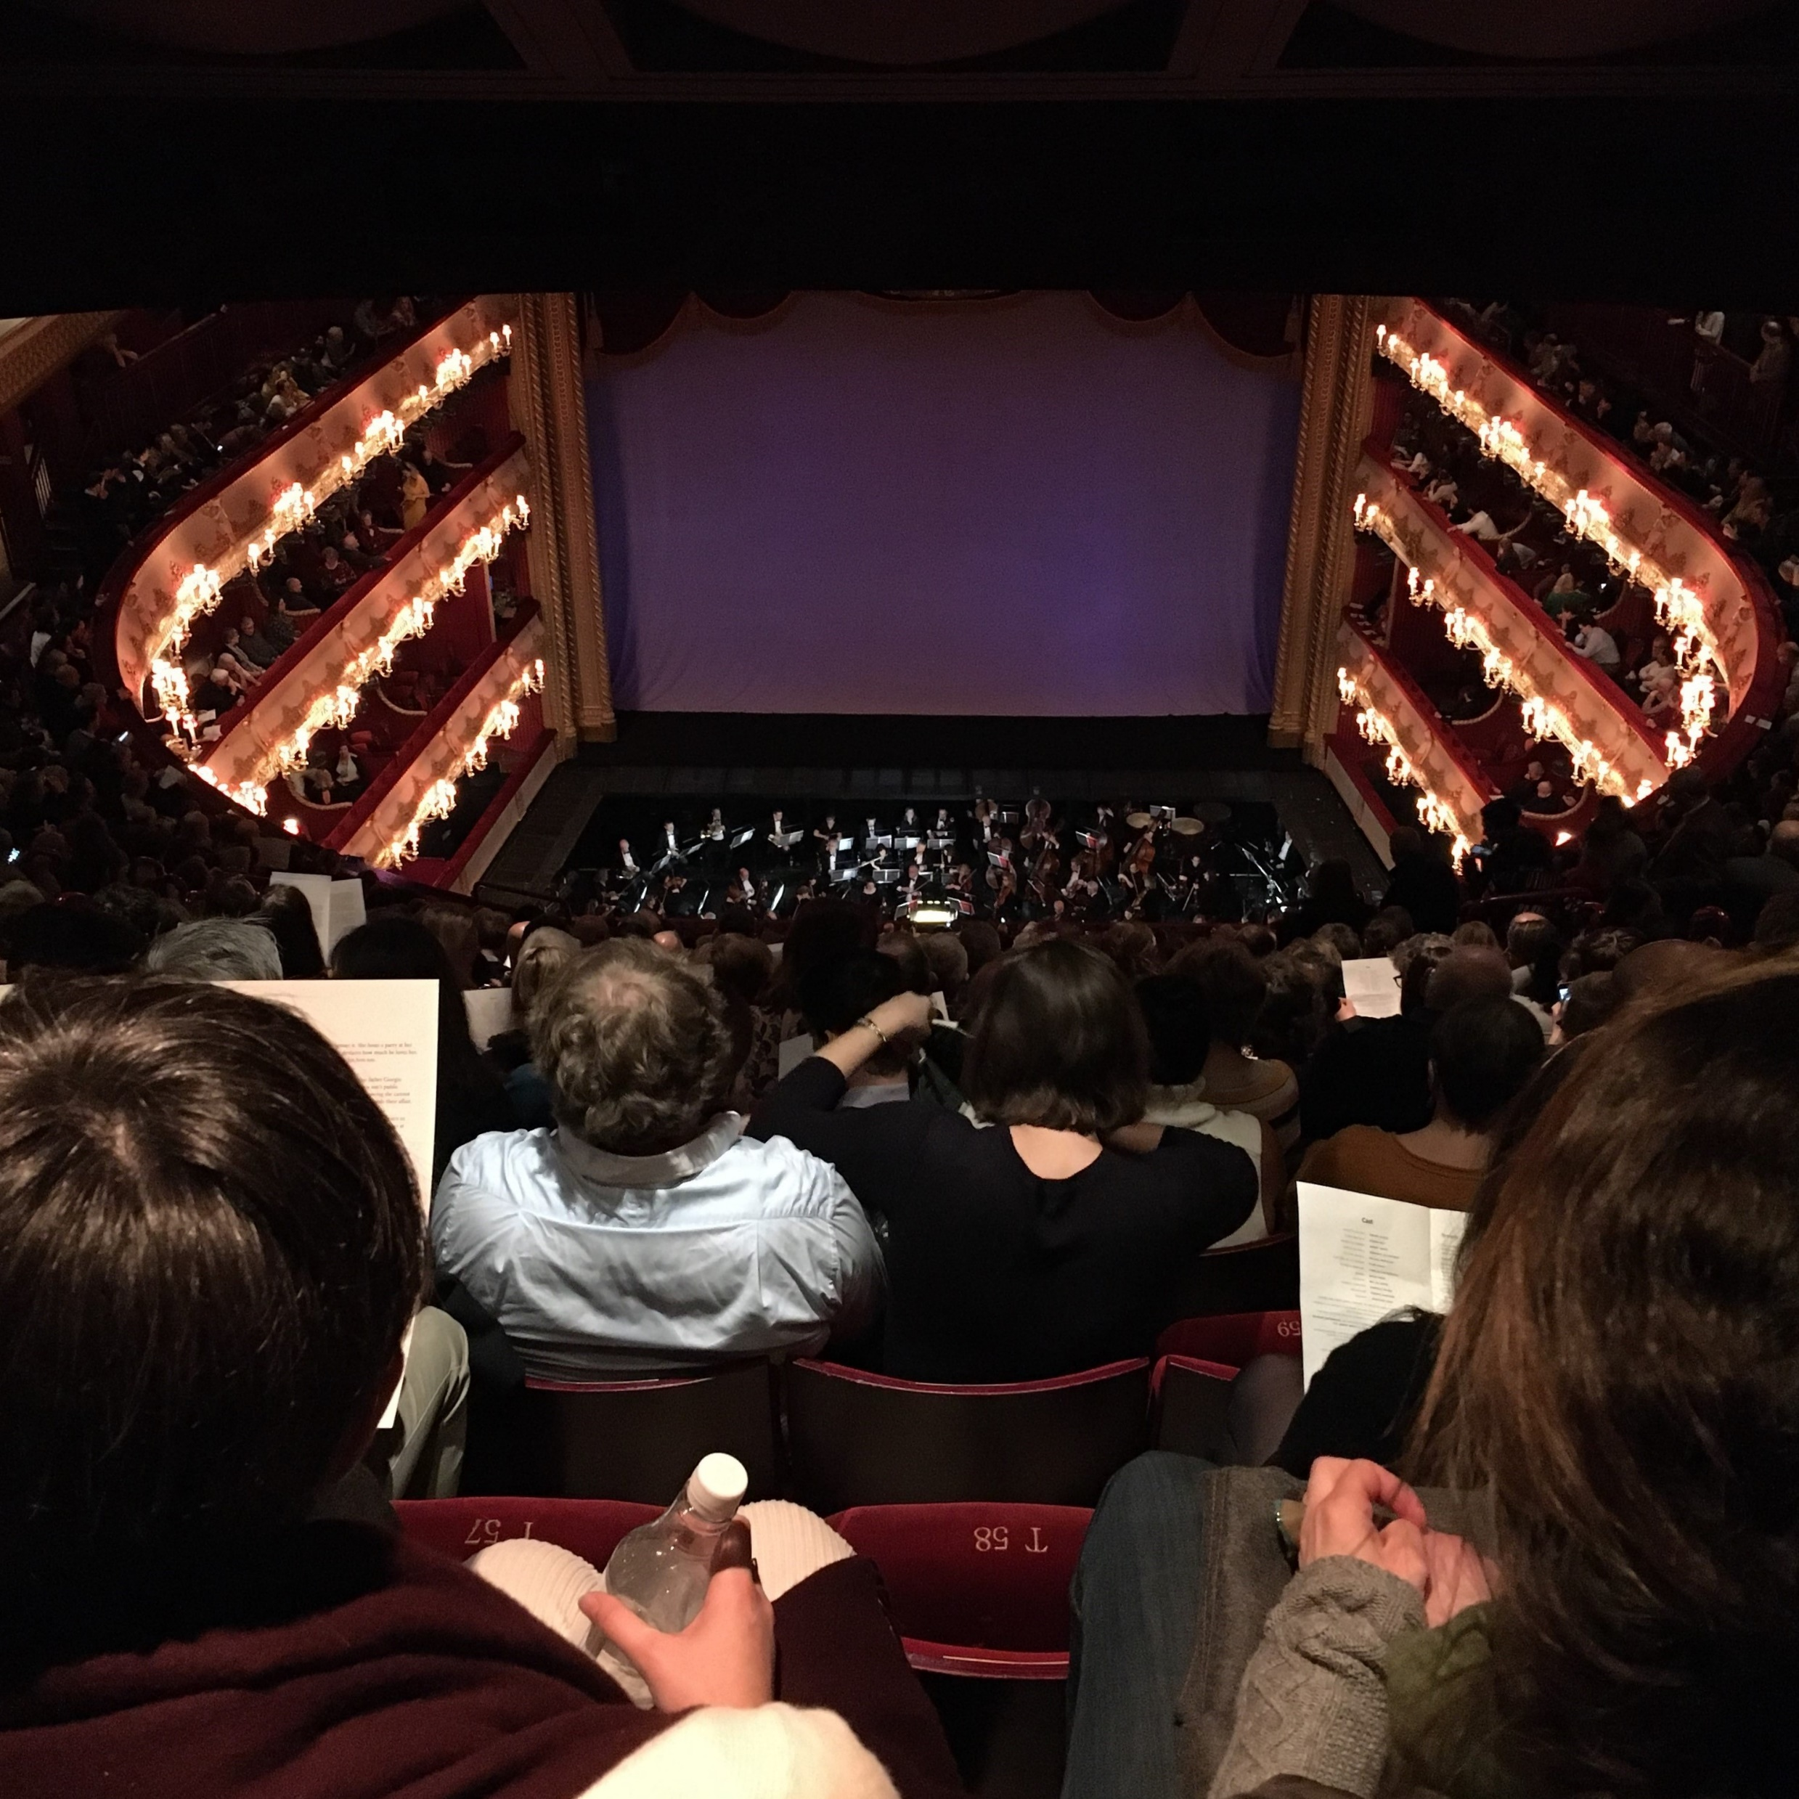
The Royal Opera House, London
(2020) Michael Palmer

Slide 17
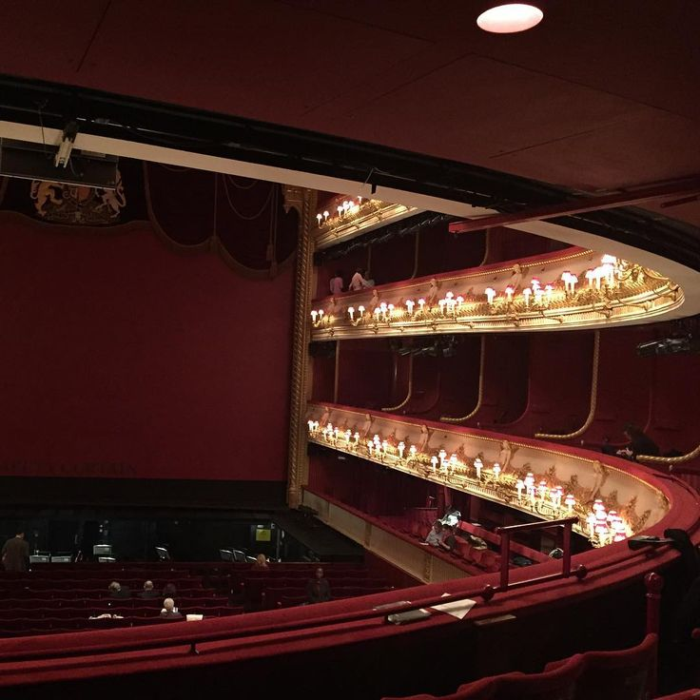
The Royal Opera House, London
(2020) Michael Palmer

Slide 18
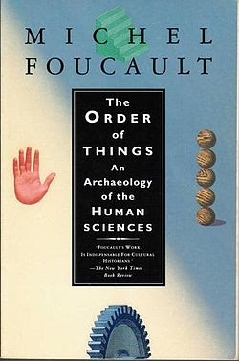
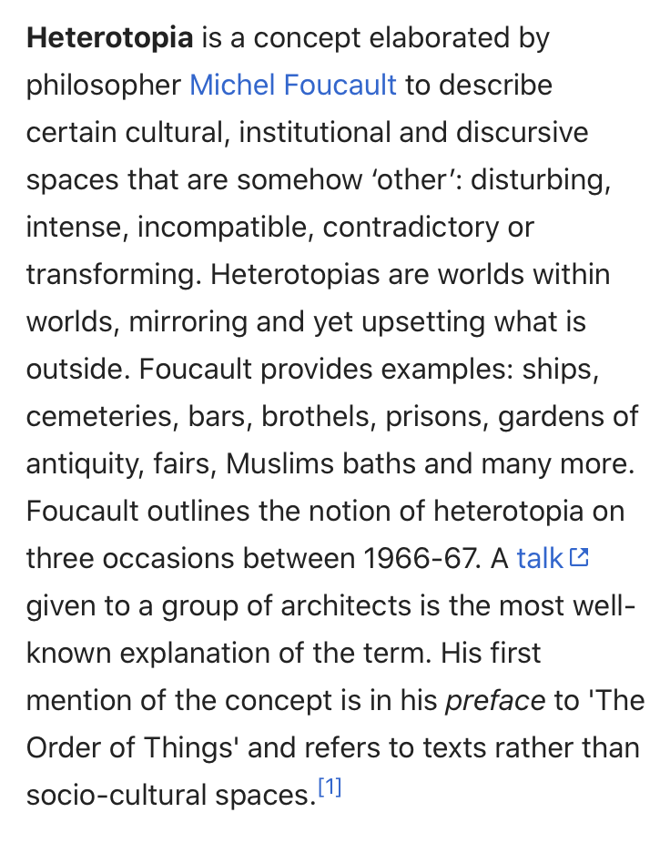
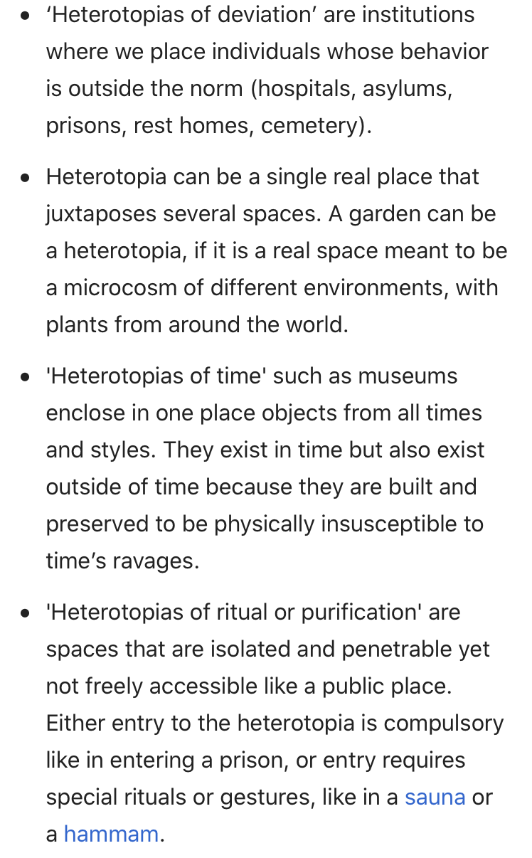

Slide 19
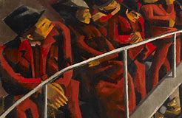
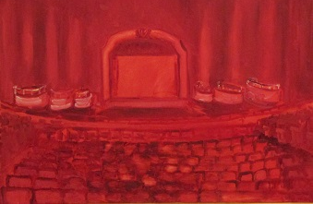
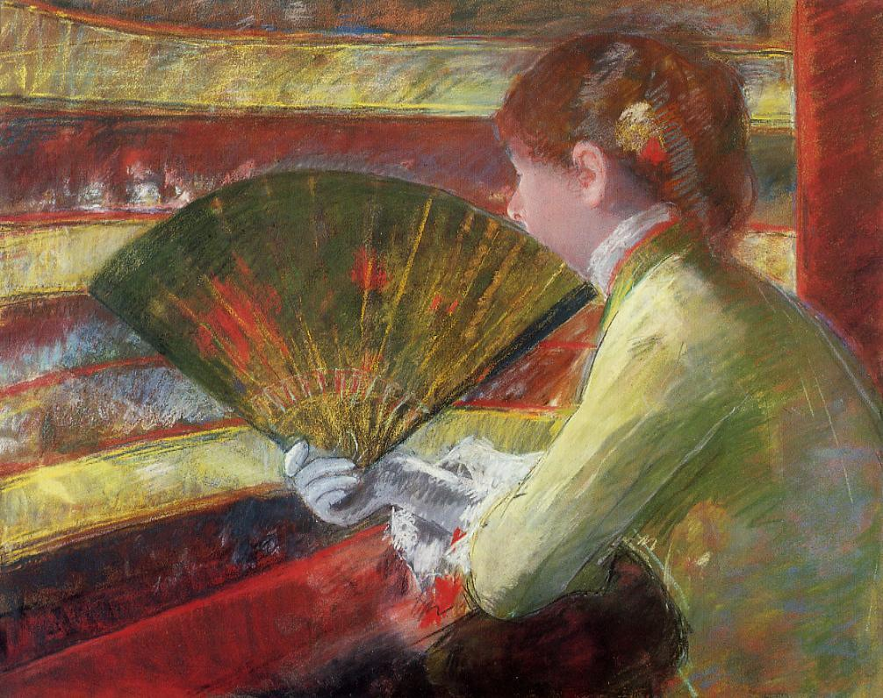
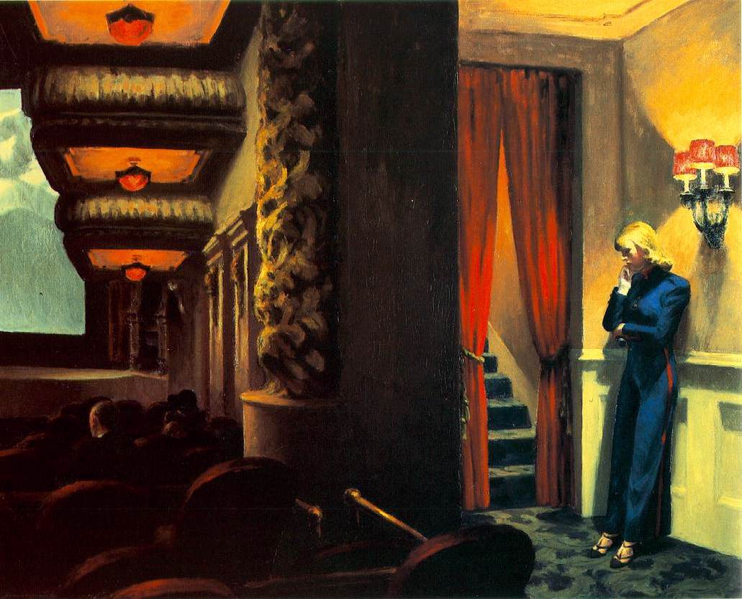
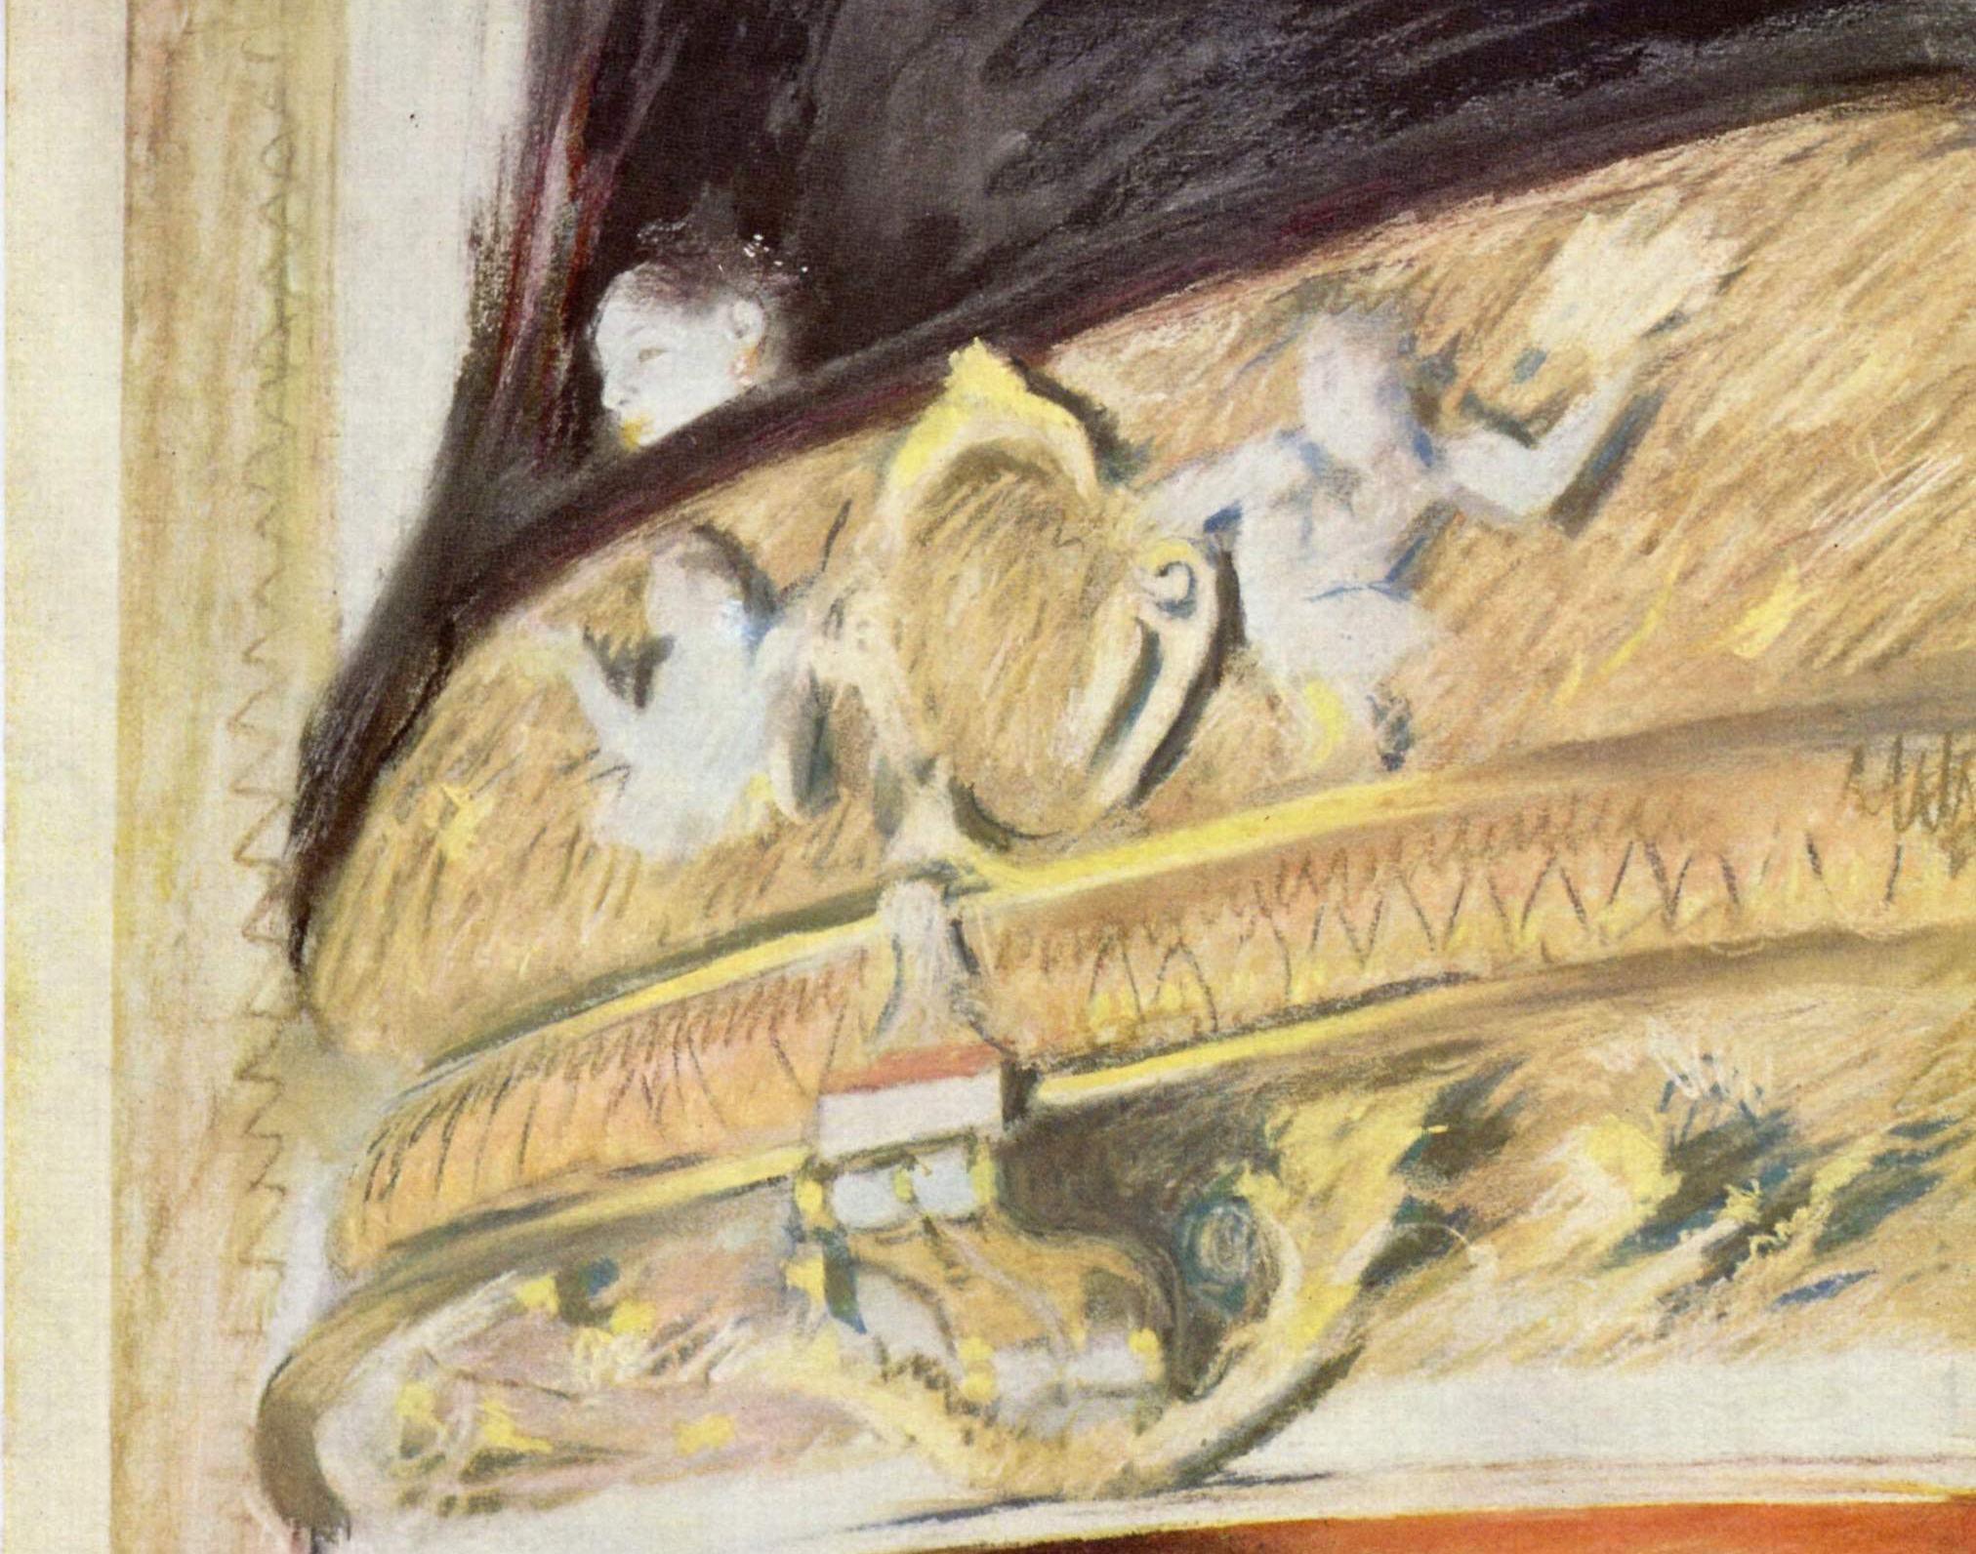

Slide 20
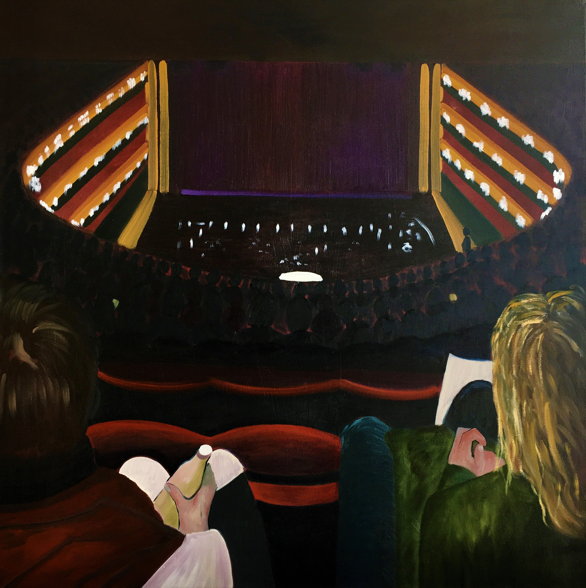
‘Violetta’ (2020) 100x100cm
Michael Palmer

